Slide 1
Distributed System Platform (DSP) Stakeholder Webinar
December 2023

Slide 2
Welcome and Logistics
Welcome and thank you for joining!​
Webinars are open to the public and recordings will be posted following the webinar on the Joint Utilities website: www.jointutilitiesofny.org ​
Please contact info@jointutilitiesofny.org if you have any additional questions following the webinar
Notes:
Speakers are tentative

Slide 3
Agenda
Welcome and thank you for joining!
Agenda Item | Presenters
Information Sharing | Walter Rojowsky and Leon Bukhman
ISO-DSP | Bonnie Graziano
Interconnection | Gabriele Viscariello
Integrated Planning | Alex Young
EVs | Yilong Xu
Webinars are open to the public and recordings will be posted following the webinar on the Joint Utilities website: www.jointutilitiesofny.org ​
Please contact info@jointutilitiesofny.org if you have any additional questions following the webinar

Slide 4
Information Sharing Presented by: Walter Rojowsky, Central Hudson & Leon Bukhman, Con Ed

Slide 5
Information Sharing – Supporting Access to Useful Data
The Joint Utilities are supporting customer access to information in several ways, including through the Integrated Energy Data Resource (“IEDR”) Program.
The IEDR is a centralized state-wide platform that provides access to energy data and information from New York's electric, gas, and steam utilities, and other sources.
Integrated Energy Data Resource (IEDR) Platform has launched
On March 31, 2023, NYSERDA formally launched the Initial Public Version (IPV) version of the IEDR platform, which includes an interactive map to explore detailed information and downloadable data of New York State's distributed energy resources (DERs), including installed DERs, queued DERs, and utility hosting capacity, and other information. The IPV can be reached here: https://iedr.nyserda.ny.gov/assess-electrical-infrastructure.
IEDR is expected to expand to include a broader set of features and functionality over time.
Moving forward, the Joint Utilities will continue to support the data delivery requirements for the IEDR.
For more information, visit https://iedr.nyserda.ny.gov/

Slide 6
JU is Supporting IEDR Initial Use Cases
Information Sharing
Large Installed Distributed Energy Resources (DERS)
Large Planned Distributed energy Resources (Interconnection Queue)
IEDR Next Steps
Data to support DER developers, DER owners and/or utilities to view all hosting capacity maps for the entire state with consistent data
Data to support Energy Service Entities (ESE) and/or government staff members who want to view all installed DERs that utilities have data on
Consolidated Hosting Capacity Maps
Access to information on large planned DERs including attributes, location, and status in a consistent format across utility service territories
DER Siting
Hosting Capacity and DER Map Enhancements
Access to Customer Billing Data
Access to Basic Rate Data and Tariffs
For more information, please go to IEDR Stakeholder Use Case Development - NYSERDA

Slide 7
Q&A Session for Information Sharing Working Group Moderated by: Matt Robison, ICF

Slide 8
ISO-DSP Presented by: Bonnie Graziano, Con Ed

Slide 9
Joint Utilities Prepare for NYISO DER and Aggregation Market
The Joint Utilities continue to work in support of a future energy marketplace where competitive market signals play a greater role and provide opportunity for distribution connected DER. Recent utility efforts include supporting the New York Independent System Operator (NYISO)’s implementation of its new 2019 DER Participation Model for DER and Aggregations.
Preparing for Go-Live
The NYISO expects to open enrollment for its 2019 DER Participation Model in December. The JU have been working with the NYISO to understand our respective processes and how they will need to interact as well as create requisite new processes and ascertain what new utility systems will be needed to effectively support enrollment, safety & reliability reviews, and operational coordination of DER aggregations participating in this new NYISO market.
The JU have demonstrated to NYISO how aggregators can obtain NYISO pricing node information from utility hosting capacity maps.
The JU have also presented at a NYISO ICAPWG meeting to describe their requirement for an interval meter at any DER that is part of a wholesale market participating aggregation.
Walkthrough of Enrollment and Billing Scenarios
The JU have had detailed conversations to discuss enrollment, billing, and settlement processes for DER aggregations. These conversations will continue in 2024 post Go – Live of the NYISO 2019 DER Participation Model.
Next: Continue to Coordinate with NYISO’s Development of a Fully Compliant FERC Order 2222 Market
Utilities will continue to coordinate with the NYISO as it develops its fully compliant FERC Order 2222 market for DER and Aggregations, launch expected by Q4 2026.

Slide 10
Interconnection Presented by: Gabriele Viscariello

Slide 11
Joint Utilities Continue Efforts to Facilitate Storage Interconnections and Explore UL CRD for Multimode
Potential Amendments to SIR Appendix K and Sharing of Charge and Discharge Windows
The JU is reviewing proposed edits to SIR Appendix K for battery energy storage (BESS) interconnections.
Proposed edits would help clarify BESS operating characteristics and ensure that developers are submitting all relevant data.
For example, the JU are proposing that developers submit a detailed list of auxiliary equipment to be used and the associated load.
Each utility has also prepared and shared their preferred territory - wide charge and discharge windows with developers.
These schedules are intended to help developers fulfill multiple use cases (NYISO market participation, VDER).
Discussions on UL CRD for Multimode
Of late, the JU have had some developers express interest in installing DERs with microgrid interconnect devices (MIDs) and backup interfaces (BUI) so that these systems can intentionally island.
The JU are exploring the requirement for appropriate UL certifications for the MIDs/ BUIs. The initial hypothesis is that the UL CRD for Multimode certification tests for backfeed prevention during intentional island conditions.
The JU is discussing this topic with UL. Pending the conclusion of these discussions, the JU will align on next steps (for e.g., amendments to the SIR, a communication to DER developers etc.).

Slide 12
Integrated Planning Presented by: Alex Young, National Grid

Slide 13
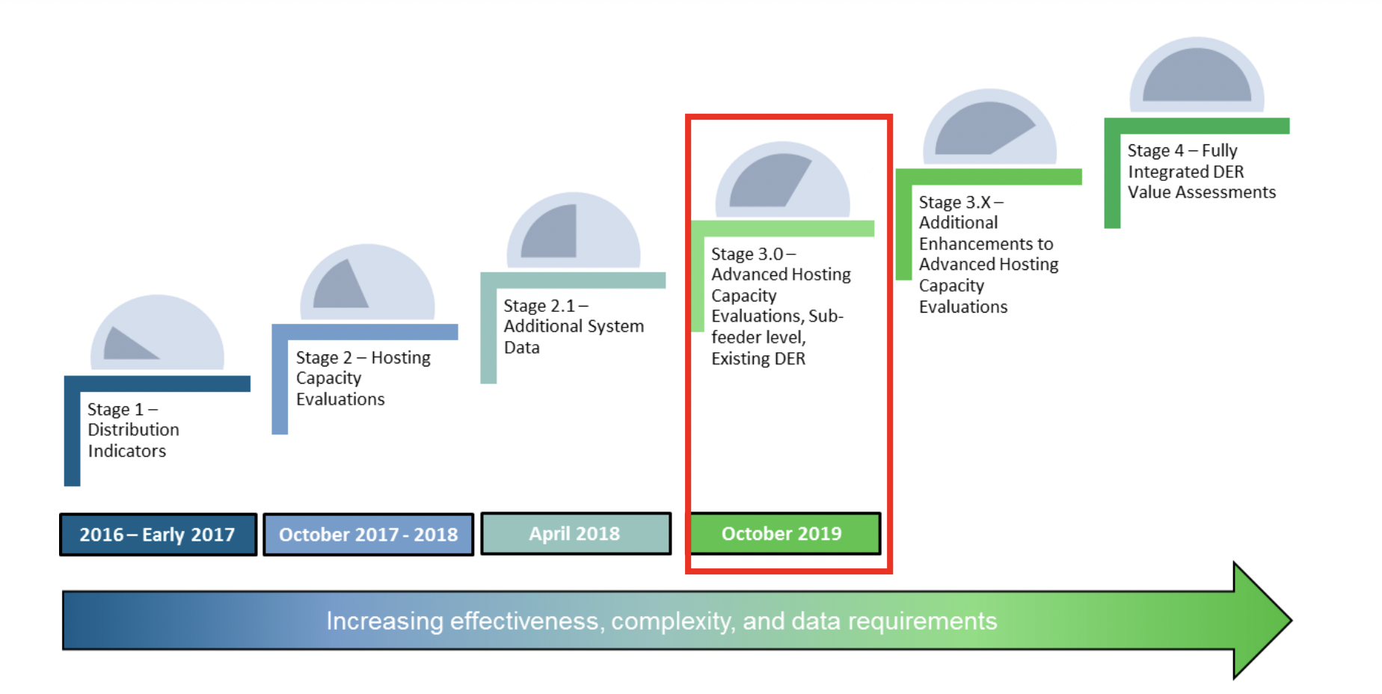
Evolution of the Roadmap
The Joint Utilities, with guidance from stakeholders, developed a four staged Hosting Capacity implementation roadmap. This was incorporated into New York Utility filings.
Stage 4 –Advanced Scenarios and Increased Granularity
Stage 4.1 – advanced functionality
Stage 3.5 – EV and Energy Storage Maps
2019 - 2020
2021 - 2022
2023

Slide 14
Overview: Stage 3.5
In 2022, the JU published Storage (ESS) HC maps showing… | In August, the JU presented
1 | Feeder-Level Hosting Capacity (min/max)
2 | Additional System Data
3 | Downloadable Feeder-Level Summary Data
4 | Reflect Existing DER in Circuit Load Curves and Allocations
Due to stakeholder feedback, all map views also showed…
post sub-transmission circuits that are available to host distributed generation on their individual portals to help developers best evaluate options for storage connections.

Slide 15
Overview of Stage 4.1 & More Recent Updates
Based upon your feedback, in 2023, the JU published HC updates showing… | In August, the JU presented
1 | Sub Feeder Level for Storage HC Map
2 | DG Connected Since Last HCA Refresh
3 | Nodal Constraints (Criteria Violations on PV and Storage Maps)
4 | Cost Share 2.0 Items on PV and Storage Maps
The JU is also providing the following information…
Six-month update for circuits that increase in DG > 500kW on the PV maps Links and/or instructions to access 8760 data Storage HC data made available via the API
Notes:
can guidance document include the cesir thresholds in the same table as the HCA thresholds for comparison?

Slide 16
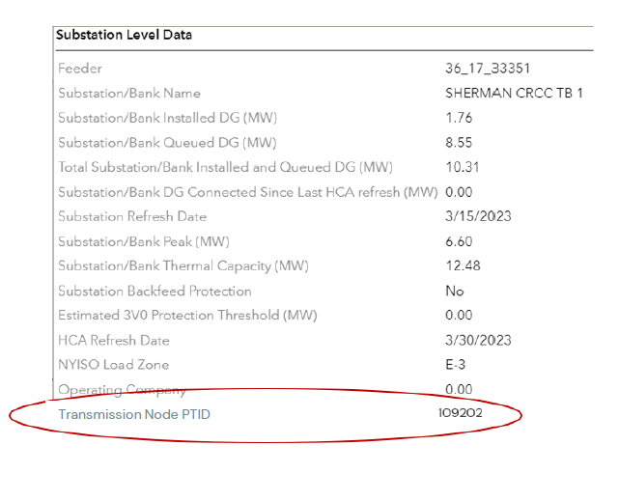
Transmission Node PTIDs
The utilities will publish Transmission Node PTIDs by year-end (2023) with some utilities earlier.
NYISO expects to go live with their aggregation market in the near term.
An aggregation needs to fall within the same transmission node PTID in this market.
The nodes are being published in alignment with NYISO’s progress. This is another means by which aggregators can access this information.

Slide 17
ITWG Collaboration
To maximize the value of the HC portal, the data shared on the portal should have some linkage to the CESIR & SIR.
Investment in the HC maps should provide that the maps are sharing information developers can use.
The Integrated Planning WG updates HC maps but does not have purview over interconnection.
The Interconnection Technical Working Group (ITWG) is discussing use-cases with developers
The HC maps to be updated upon ITWG alignment
The JU has presented their preliminary energy storage schedules to industry through the ITWG.
The JU recently received feedback from industry and are currently reviewing the feedback.

Slide 18
Electrification Maps
Two orders directed the evolution of the EV Load Capacity Map to an Electrification View.
Electric Vehicle Infrastructure Make-Ready Program and Other Programs (2020)
Energy Efficiency and Building Electrification
Issued and Effective: July 20, 2023
Utilities “shall, within 180 days of this Order, consult with Department of Public Service Staff, and expand the Electric Vehicle Load Serving Capacity Maps into “Electrification Load Serving Capacity Maps,” as discussed in the body of this Order.”
Utilities are collaborating with DPS Staff to develop the Electrification Maps for release in January 2024.
Per the request, the Joint Utilities will publish circuit level electrification maps, with a winter and summer view that stakeholders can toggle between.
The color scheme will be the same for winter and summer; the level of capacity is the only difference that will be presented.
The electrification maps will keep all the functionality of the EV maps, such as the environmental locations.
Notes:
We have not met with Staff to bring this approach, but should not announce in stakeholder session. Can talk about order more generally but not have proposal.
Fawad (NYSEG RGE) – Did we decide on showing env justice locations as well?
- Show, but question of summer/winter view. (as coming from EV map order). NYSEG RGE showing on EV Maps.

Slide 19
Lookahead: 2023 -2024
Continued work with ITWG
Once the ITWG aligns on use cases, the Integrated Planning WG will take this information to discuss next steps for advancing ESS HC maps
Electrification Maps
January 2024

Slide 20
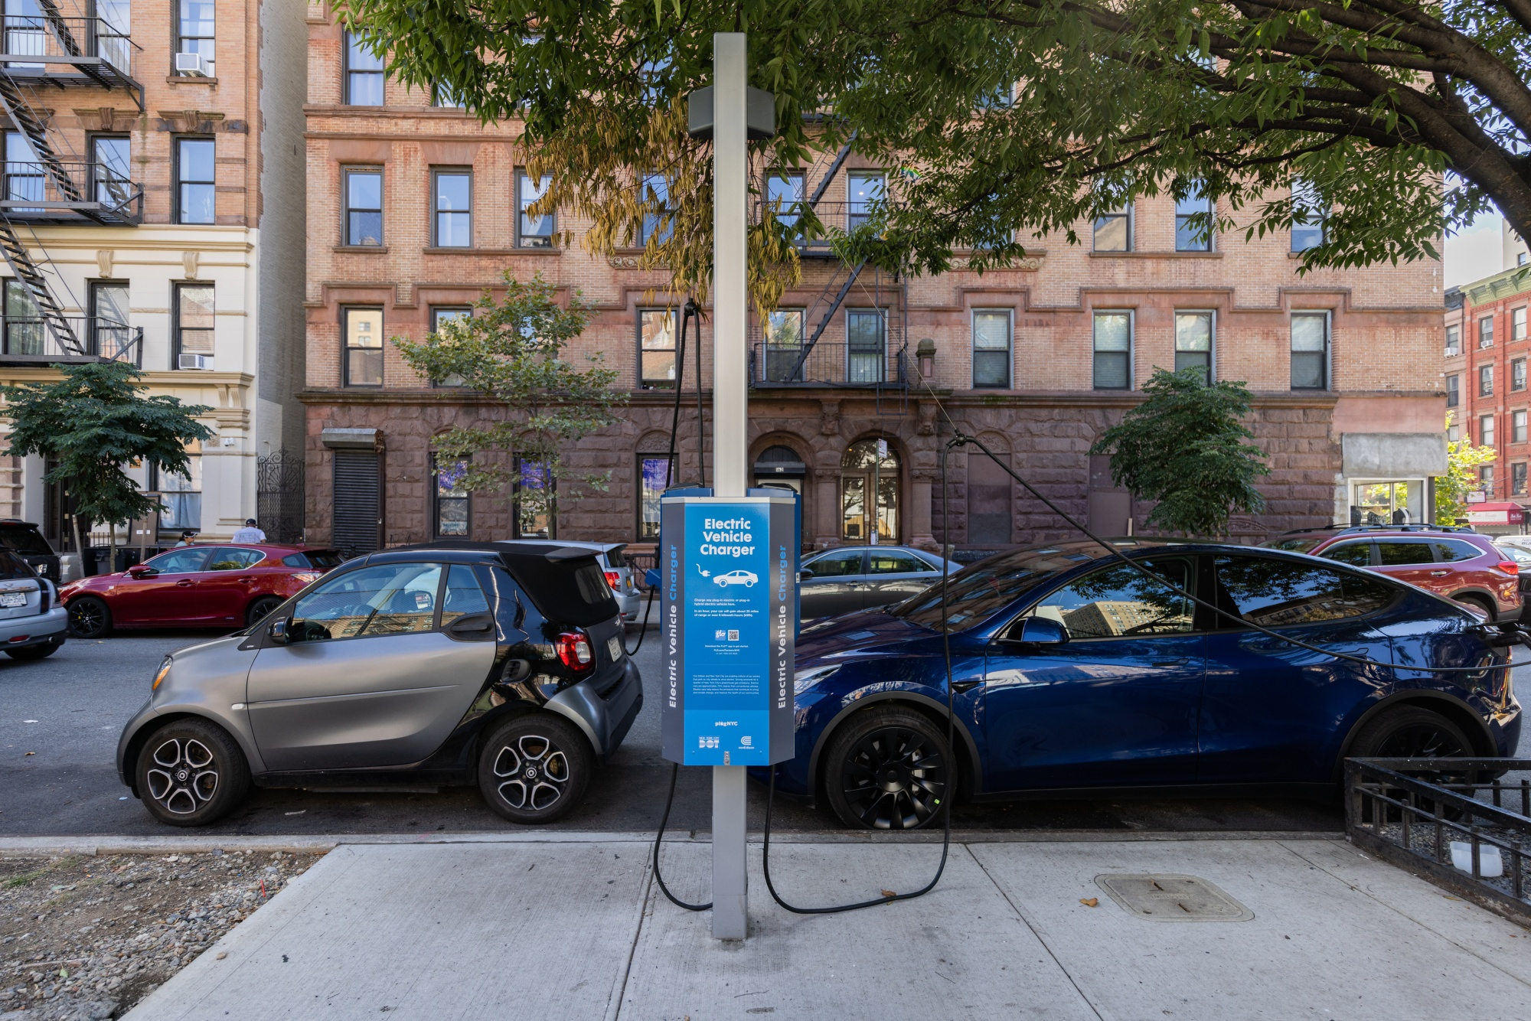
Electric Vehicles Presented by: Yilong Xu, Con Edison

Slide 21
JU EV Programs and Proceedings
GRID MANAGEMENT & OPERATING COST RELIEF
INFRASTRUCTURE & SERVICES
Order Modifying Make-Ready Program¹ authorized Nov. 16
CECONY/O&R Authorized Nov. 20
Authorized Nov. 20
Active Programs
Fleet Assessment Service¹
LDV Make-Ready Program¹
Downstate Commercial Managed Charging³
Residential Managed Charging¹
Demand Charge Rebate³
Micromobility Program¹
MHDV Pilot¹
Proceedings / Pending Authorizations
MHDV Proactive Planning²
Upstate Commercial Managed Charging³
Load Management Technology Incentive Program³
MHDV Make-Ready Program²
Phase-in Rate³
Case 18-E-0138
Case 23-E-0070
Case 22-E-0236
Notes:
Starting with overview of active programs and forthcoming ones

Slide 22
Make-Ready Program Changes
Program Highlights
Opportunities and Resources for Stakeholders
Budgets | Total budget of $1.243B; increase of $542M from 2020 Order Increased budget for MHDV Pilot
Baselines | Updated baseline costs for L2 and DCFC to better reflect market costs
Targets | L2 plug target statewide decreased to 38,356 (-29%) DCFC plug target statewide increased to 6,302 (320%)
Eligibility | Enhanced eligibility for DAC-level incentives Expanded eligibility for energy storage, advanced technologies and MHDV Pilot
New Program | Micromobility make-ready incentive program CECONY and O&R to implement downstate program, and NYSERDA to implement upstate program
DPS stakeholder webinar on Dec. 21 to provide an overview of the Midpoint Review Order
Utility online tracker of progress towards plug goals
EV Infrastructure Interconnection Working Group will be convened by Mar 15 to assess queue management
Interconnection Technical Working Group will take up Vehicle-to-Grid Integration
New electrification maps will be published in Jan. and updated on an annual basis
Continued opportunities to engage fleets including with transit authorities, school districts, etc. with program incentives and technical assistance
Notes:
Budgets
Total statewide budget of $1.243B, an incremental increase of $542M from 2020 Order
This includes all programs - LD MRP, micromobility, MHD pilot, admin, etc.
Increase in budget for DCFC Make-Ready by ~$447M
Decrease in budget for L2 Make-Ready by ~$42M
MHD pilot – budget increased from $43M to $67M
Baselines
Baseline cost per L2 plug were updated:
Upstate: $7,067 per plug
Downstate: $14,801 per plug
Baseline costs per kW were updated for DCFC for each utility:
Central Hudson: $717.64
Con Edison: $1,110.56
National Grid: $473.61
NYSEG: $450.76
O&R: $611.13
RG&E: $747.57
Targets
Con Edison's L2 target increased 15%, while all other utilities L2 targets decreased
L2 budget and targets really shifted down to NYC, where there is a greater need for L2 charging given there are fewer single-family homes and lots of garages/MUDs/curbside parking
All utilities saw DCFC targets increase.
Eligibility
Some changes to up-to-100% tier incentives:
L2 sites in MUDs must now meet premise-specific criteria
Curbside chargers are now eligible
No changes for DCFC
energy storage and advanced tech like automated load management systems are now eligible for make-ready incentives
Expanded eligibility for MHD pilot – CSC now eligible for up to 50% if in DAC or public
New program
Micromobility - $20M for CECONY and O&R, $5M for NYSERDA to implement upstate program
Opportunities and resources for stakeholders:
DPS webinar on order
Utility online tracker - in addition, Con Ed holds monthly webinars for our trade-allies
EVIIWG on queue mgmt. – CECONY will develop initial straw proposal for consideration
VGI will be discussed in ITWG
Load serving capacity maps will be updated annually – new layer for heating electrification will be added
Continued opportunities to engage fleets including with transit authorities, school districts, etc. with program incentives and technical assistance

Slide 23
EV Rate Design Alternative Proceeding Updates
Authorized Programs
Pending Authorizations
Downstate Commercial Managed Charging Program (CECONY and O&R)
Offers incentives for peak avoidance and overnight off-peak charging, and use-case-specific adders
Tariffs and incentives will be effective 1/19/2024
Demand Charge Rebate
50% rebate available to commercial charging customers upstate and publicly accessible DCFC charging stations downstate until the EV Phase-In Rate is available
Tariffs and incentives will be effective 1/19/2024
Proposed incentives for peak avoidance and overnight off-peak charging
Upstate Commercial Managed Charging
Proposed reallocation of DCFC Per-Plug Incentive budgets to support load management technologies
Load Management Technology Incentive Program
Proposed long-term EV rate solution to eventually replace Demand Charge Rebate
Phase-in Rate
Notes:
Downstate CMCP:
o Peak Avoidance Incentive: $/kW incentive for avoided kW during peak periods, with differing incentives for winter and summer
o Overnight Off-Peak Charging Incentive: $/kWh incentive for all charging between midnight-8 am
• All commercial charging customers will be eligible for the program, including participants in demand response and SmartCharge New York
• Use-case specific incentive adders for public L2 and transit will provide additional operating cost relief (until the EV PIR becomes available)

Slide 24
2024 Programs and Proceedings Major Milestones
Technical Standards Working Group presents EPRI initial testing results
DPS initiates EV Infrastructure Interconnec-tion Working Group 3/15
Expected timing for authorization of remaining EV Rate Design Alternative programs
MHDV Proceeding continues
Order Modifying Make-Ready Program released*
Order Implementing Immediate Solutions Programs released**
EPRI delivers accuracy testing results
DPS files accuracy testing Phase 3 report
Q4 2023
Q1 2024
Q2 2024
Q3 2024
JU filed updated immediate solution implementation plans**
JU contracted EPRI to conduct EV/EVSE accuracy testing for residential managed charging
JU files updated Make-Ready Program Implementation Plans on 1/12 and Annual Report on 3/1*
Immediate Operating Cost Solutions becomes effective on 1/19**
Continued focus on program implementation and improvement
JU files first semi-annual Make-Ready Report 8/23*
*Midpoint Review Order and JU filings can be found via NYSDPS Case 18-E-0138
**Order Implementing Immediate Solutions and JU filings can be found via NYSDPS Case 22-E-0236
Notes:
Timeline of where we are and what’s on the horizon – highlighting major milestones, esp ones relevant for stakeholders
Above timeline – stakeholder/DPS/PSC actions
Below timeline – JU actions

Slide 25
Q&A Session Moderated by: Matt Robison, ICF

Slide 26
Q&A Session
Please submit questions via the ‘question function’ on the webinar interface
Additional questions may be emailed to info@jointutilitiesofny.org following the webinar
Visit www.jointutilitiesofny.org for more information
Quarterly Newsletter
Check out our quarterly newsletter with meaningful, substantive updates related to the DSIPs

Slide 27
Thank you!
Website: www.jointutilitiesofny.org
E-mail: info@jointutilitiesofny.org

