Slide 1
Distributed System Platform (DSP) Stakeholder Webinar
December 16

Slide 2
Welcome and Logistics
Welcome and thank you for joining!​
Webinars are open to the public and recordings will be posted following the webinar on the Joint Utilities website: www.jointutilitiesofny.org ​
Please contact info@jointutilitiesofny.org if you have any additional questions following the webinar
Notes:
Speakers are tentative

Slide 3
Agenda
Welcome and thank you for joining!
Agenda Item | Presenters
ISO-DSP | John Romano, Con Edison
Interconnection | Gabe Viscariello, National Grid
Hosting Capacity Maps and Analysis | Alex Young, National Grid
Information Sharing | Damian Sciano, Con Edison
Electric Vehicle Make-Ready Program | Christina Ficicchia, Avangrid
Monitoring & Control | John Baudanza, National Grid
Webinars are open to the public and recordings will be posted following the webinar on the Joint Utilities website: www.jointutilitiesofny.org ​
Please contact info@jointutilitiesofny.org if you have any additional questions following the webinar
Notes:
Speakers are tentative

Slide 4
ISO-DSP Presented by: John Romano

Slide 5
DER Participation in Markets and FERC 2222
Progressing Toward Implementation
Utility Preparations for Launch of the NYISO DER Market Participation Model
Processes and systems updates are being put in place to prepare for market launch targeting Q2 of 2023.
Per NYISO’s November 14th filing with FERC, full FERC 2222 participation is being pushed to December 31, 2026
Continued Collaboration with the NYISO
The JU continues to work with the NYISO to prepare for market launch. Recent highlights include:
Refining processes and the exchange of information related to registration, enrollment, operational coordination, data exchanges, etc.
Providing Utility input on draft NYISO manual revisions
Resolving emergent process concerns related to Q2 2023 market launch
Stakeholder Sessions
On August 30th, 2022 the JU held a stakeholder session with DER community members focused on necessary telemetry requirements for safe and reliable operation of the distributed grid.
A copy of the recording and presentation are provided on the JU website.

Slide 6
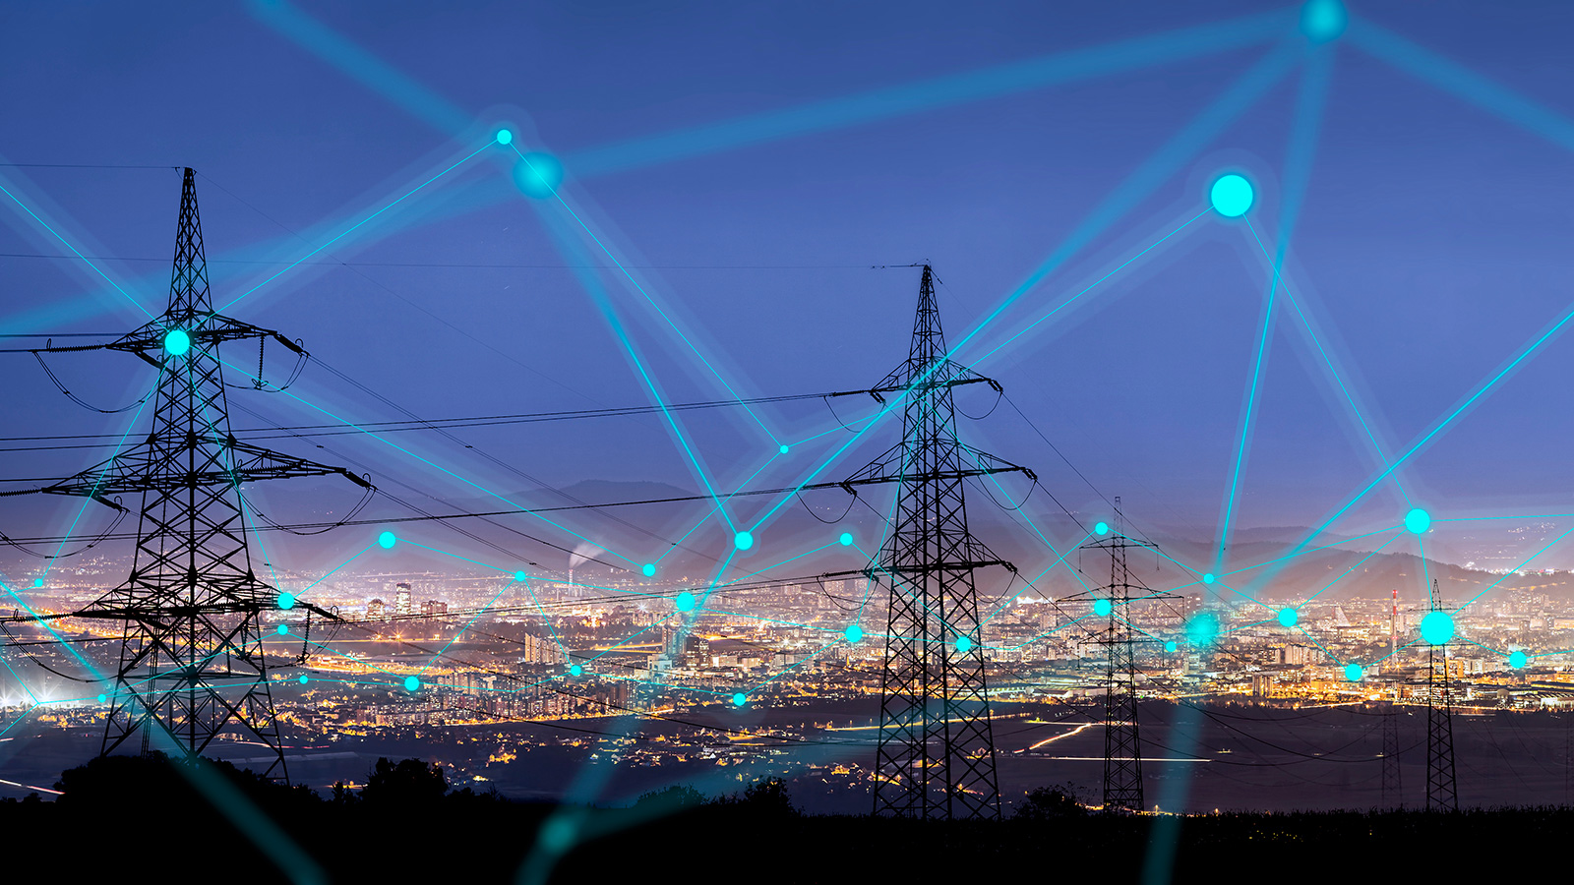
Interconnection Presented by: Gabe Viscariello

Slide 7
Preparing for UL 1741-SB, IEEE 1547-2018 Compliant Inverters
JU Take Steps to Accommodate New Types of Inverters
JU collaborate with stakeholders and DPS to edit SIR
Updates to the SIR were made and finalized in October 2022 and are anticipated to bring greater clarity for developers
JU have also aligned on addition of language to the SIR related to UL 1741 – SB and IEEE Std 1547 – 2018, ensuring that compliant inverters are installed in New York as UL 1741 – SB certified inverters are permitted in New York starting January 1, 2023
Providing information on required smart inverter settings
The JU are updating their respective technical interconnection documents to accommodate the new bulk power system support and voltage support setpoints introduced through the adoption of IEEE 1547-2018
The JU will also point developers to the specific locations in the documents where the new settings will be included. This is expected to further increase the efficiency of the interconnection process and result in time savings for developers
Clarifying details on IEEE 1547 – 2018 implementation
The JU have provided several details to developers on aspects including – standardization of inverter settings across the companies, settings verification for compliance, and cases where the settings may differ from the JU’s default values
The JU have also provided guidance to indicate that implementation of new voltage support settings will result in minimal curtailment, as only the Volt – VAr setting will be enabled by default
The JU are willing to have further conversations with developers regarding curtailment analyses and curtailment of project output due to implementation of the new inverter settings, with the understanding that these analyses will need to occur outside of the existing CESIR process

Slide 8
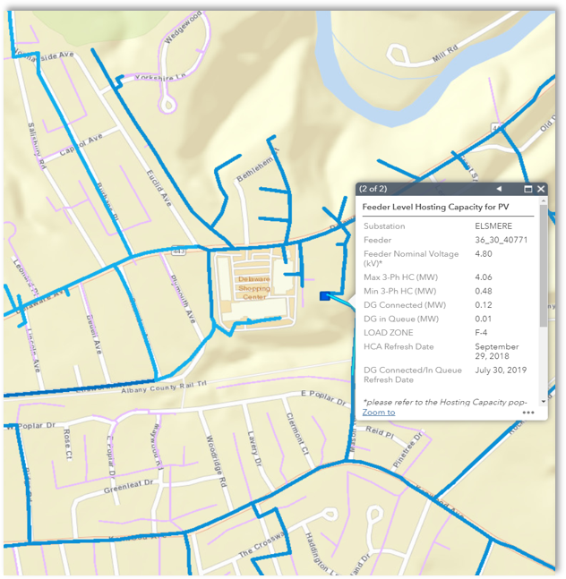
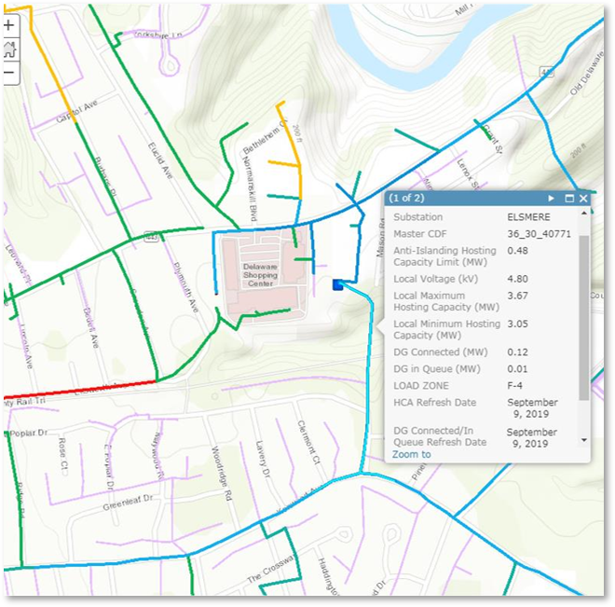
Hosting Capacity Maps and Analysis Presented by: Alex Young

Slide 9
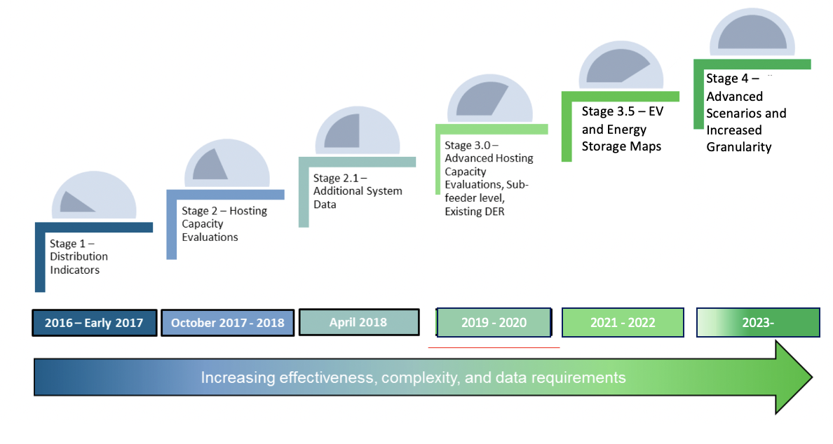
Hosting Capacity
Overview
The Joint Utilities, with guidance from stakeholders developed a four staged Hosting Capacity implementation roadmap.
This was incorporated into New York Utility filings.
The Utilities are on Stage 3.5.

Slide 10
Stage 3.5 of Roadmap: Stage 1 of Storage HC Maps
Current Battery Energy Storage Hosting Capacity Maps Capability
1 | Feeder-Level Hosting Capacity (min/max)
2 | Additional System Data
3 | Downloadable Feeder-Level Summary Data
4 | Existing DER in Circuit Load Curves and Allocations
5 | Sub-transmission circuits available to host distributed generation
6 | Daytime minimum load and peak load
7 | Separate Displays for Load and Generation HC
8 | Color-coded Breakpoints
9 | Pop-ups with additional information
10 | Some utilities provide Cost Share 2.0 information. (All will have it by April 2023).

Slide 11
Next Steps
Roadmap for Continuing Stage 3.5
Immediate | Interim Step | Next Steps
April 1, 2023 | Late 2023-2024 | TBD
Sub Feeder Level for Storage HC Map Nodal Constraints (Criteria Violations) on PV and Storage HC Maps Six-month Update for Circuits that Increase in DG > 500kW Cost Share 2.0 Items DG Connected Since Last HCA Refresh | Additional ’scenarios’ based on Interconnection WG Collaboration with Stakeholders | Continued granularity

Slide 12
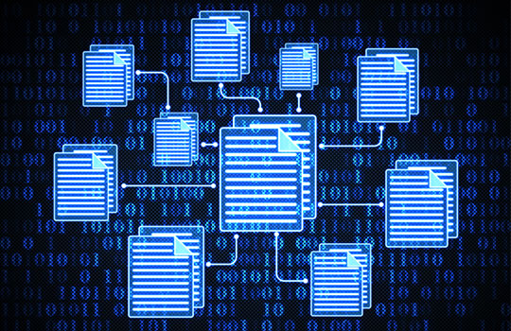
Information Sharing Presented by: Damian Sciano

Slide 13
Data Sharing Updates
Working Toward IEDR Implementation
Integrated Energy Data Resource (IEDR)
[October 2022] The IEDR Development Team was introduced: E-Source (primary), UtilityAPI, Flux Tailor, TRC Companies, HumanLogic
[November – December 2022] The utilities transferred complete initial public version (IPV) test datasets for Consolidated Hosting Capacity Maps, Installed DERs and Planned DERs
[Ongoing] The IEDR Program Team have targeted a working IPV platform in Q1 2023 with the following use cases:
Installed DERs
Planned DERs
Consolidated Hosting Capacity Maps
Machine Readable Rates and Tariffs
[Ongoing] The Joint Utilities shared legal agreements with NYSERDA and Development Team vendors, which are required to be in place in order to share data to develop the IEDR Platform
[Ongoing] Each utility has filed Individual IEDR quarterly reports for Q3-Q4 2021 and Q1-Q3 2022, which can be found under Case 20-M-0082

Slide 14
Data Sharing Updates
Working Toward IEDR Implementation
Data Access Framework (DAF)
The Joint Utilities have filed the following documents with the PSC and are looking forward to further collaboration with PSC Direction:
Case 20-M-0082: In the Matter of the Strategic Use of Energy Related Data
Green Button Connect User Agreement and Onboarding Process – filed 8/13/2021
Consent Process Assessment and Customer Consent Engagement Plan - filed 9/20/2021
Joint Utility Data Access Implementation Plan - filed 9/20/2021
Joint Utilities' Petition to Modify the Data Security Agreement Self-Attestation Requirements and Implement a Governance Review Process For Regular Self-Attestation Updates – filed 5/3/2022
IEDR Order Petition for Clarification – filed 12/1/2022

Slide 15
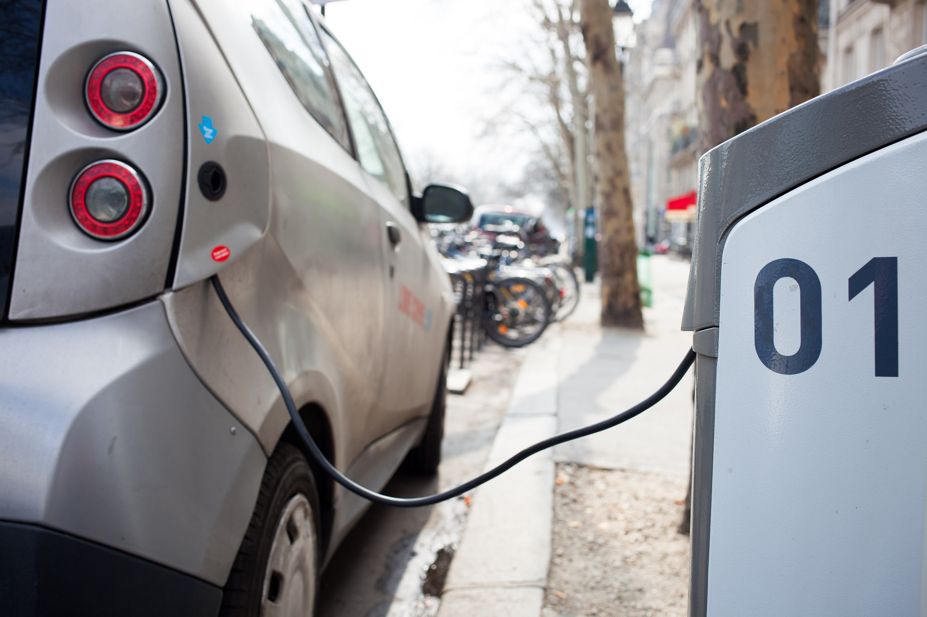
Electric Vehicle Make-Ready Program “MRP” Presented by: Christina Ficicchia

Slide 16
New York EV Program and Policy Landscape
Utilities have an important role to play in meeting the many policy and program goals
Light-Duty Vehicle (LDV) Make-Ready Funding / Eligibility (L2, DCFC)
Medium- and Heavy-Duty Vehicle (MHDV) Make-Ready Pilot
Federal NEVI Formula Funding
Fleet Assessment Services
2035 100% ZEV Sales Mandate
DCFC Per-Plug Incentive
Residential Managed Charging Program
Clean Transportation Prizes
DCFC EV Rate Design Legislation
2035 100% Electric School Bus Mandate
Programs
State Policy

Slide 17
Make-Ready Program Mid-Point Review Progress
Meaningful stakeholder engagement is critical for Make-Ready Program improvements
December 1
Tech Conference 3: Disadvantaged Communities and Medium- and Heavy-Duty Vehicles
September 20
Mid-Point Review Kickoff Stakeholder Session
November 18
Tech Conference 1:
NREL Study and Incentive Baselines
March
60-day public comments due
October 3
End of Public Comment Period
November 29
Tech Conference 2:
Reporting Data and Vehicle-Grid Integration
January 4
Staff Recommendations Whitepaper Filed
June/July 2023 Sessions
Make-Ready 2.0 Order expected
Notes:
The July 2020 Make-Ready Order requires a Mid-Point Review to assess the progress toward program goals and targets in the first half of the EV Make-Ready Program. The Mid-Point Review began at the end of September with a stakeholder meeting with the Joint Utilities and DPS Staff. Stakeholders submitted comments on the program in response to some questions from Staff, which formed the basis for a series of Technical Conferences hosted by Staff in November and December. These conferences focused on the topics outlined here: The NREL Study and Incentive Baselines; Reporting Data and Vehicle-Grid Integration; and Disadvantaged Communities and Medium- and Heavy-Duty Vehicles.
Staff will release a Whitepaper for public comment in the new year based on the Mid-point review

Slide 18
JU Mid-Point Review Priorities for Make-Ready Program
JU asking for the following program changes through the Mid-Point Review
Align incentive budget baselines to actual average costs
Consider extending program timeframe to hit existing targets and additional goals past 2025
Expand Medium- and Heavy-Duty Vehicle Make-Ready Pilot offering and eligibility to remove barriers to participation
Expand fleet advisory services to meet volume of demand and needs of fleets
Expand eligibility to technology that can reduce infrastructure costs (paired energy storage systems, rectifier cabinets, smart panels, etc.) to reduce capital and/or operational costs, and in some cases moderate their impact on the grid
The utilities are far from meeting the targets for the program. Incentives are stimulating the market, but not enough to hit targets for the program.
Note: Data as of August 2022

Slide 19
Utility Make-Ready Program Resources
Utility | Email | Website
Central Hudson | EVMakeready@cenhud.com | Electric Vehicle Make-Ready Infrastructure Program
Con Edison | EVMRP@coned.com | Electric Vehicle PowerReady Program
National Grid | EVNationalGridUNY@nationalgrid.com | Electric Vehicle Charging Station Programs
NYSEG | EVPrograms@nyseg.com | Electric Vehicle Charger Make-Ready Program
RG&E | EVPrograms@rge.com | Electric Vehicle Charger Make-Ready Program
Orange and Rockland | ev@oru.com | Electric Vehicle Power-Ready Program

Slide 20
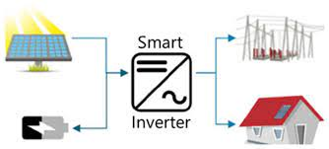
Monitoring & Control Presented by: John Baudanza

Slide 21
Joint Utilities Document Monitoring Parameters
Joint Utilities Advance Discussions on Monitoring DERs via Smart Inverters
Consistent monitoring requirements and parameters across the Joint Utilities will bring benefits to developers in the form of time savings and improved interconnection process efficiency.
The Joint Utilities are evaluating effective ways to utilize smart inverter technology for the monitoring of inverter – based DER
The companies have identified the appropriate data points distributed resources will be required to provide
These data points have been memorialized in a document that will be shared publicly with stakeholders in the coming months
As a next step, the companies will identify the appropriate control points and functionality for DERs, which will aid in maintaining grid resiliency and reliability and maintain continuity of service for customers
The monitoring and control parameters identified by the Joint Utilities are aligned with the interoperability requirements and communications protocols presented in IEEE Std 1547 – 2018

Slide 22
Q&A Session Moderated by: Matt Robison, ICF

Slide 23
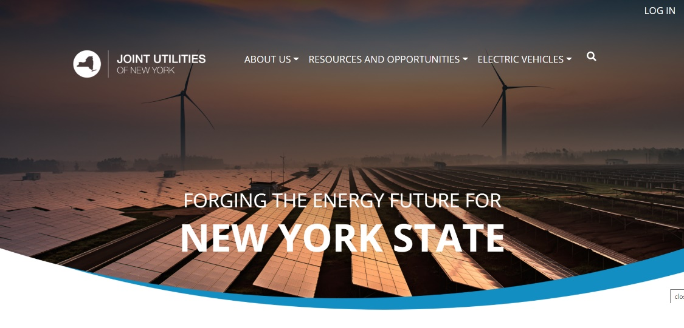
Q&A Session
Please submit questions via the ‘question function’ on the webinar interface
Additional questions may be emailed to info@jointutilitiesofny.org following the webinar
Visit www.jointutilitiesofny.org for more information
Quarterly Newsletter
Check out our quarterly newsletter with meaningful, substantive updates related to the DSIPs

Slide 24
Thank you!
Website: www.jointutilitiesofny.org
E-mail: info@jointutilitiesofny.org

