Slide 1
Hosting Capacity Stakeholder Webinar
(May 13, 2021)
Audio DIN: +1 929-232-3340;
Code: 861 291 937#

Slide 2
Engagement Group Ground Rules*
All stakeholder engagement (Advisory Group and Engagement Group) meetings, webinars and information exchange are designed solely to provide an open forum or means for the expression of various points of view in compliance with antitrust laws.
Under no circumstances shall stakeholder engagement activities be used as a means for competing companies to reach any understanding, expressed or implied, which tends to restrict competition, or in any way, to impair the ability of participating members to exercise independent business judgment regarding matters affecting competition or regulatory positions.
Proprietary information shall not be disclosed by any participant during any stakeholder engagement meeting or its subgroups. In addition, no information of a secret or proprietary nature shall be made available to stakeholder engagement members.
All proprietary information which may nonetheless be publicly disclosed by any participant during any stakeholder engagement meeting or its subgroups shall be deemed to have been disclosed on a non-confidential basis, without any restrictions on use by anyone, except that no valid copyright or patent right shall be deemed to have been waived by such disclosure.
AG & EG discussions will be open forums without attribution and no public documents by the AG or EG will be produced unless publication is agreed upon by the group.
*Ground Rules adapted from the JU Advisory Group

Slide 3
Agenda
Agenda Item | Time Slot
Introductions and Meeting Goals | 10:00 AM – 10:10 AM
Reminder of Available Reference Materials | 10:10 AM – 10:20 AM
Recap Recent Activities | 10:20 AM – 10:35 AM
Battery Storage Stakeholder Presentation (NY-BEST) | 10:35 AM – 10:50 AM
Discuss Initial JU Hosting Capacity Roadmap for Storage | 10:50 AM – 11:05 AM
State of DER Dashboard (ITWG Industry Liaison) | 11:05 AM – 11:30 AM
Open Discussion / Q&A IEDR Touchpoints New Items | 11:30 AM – 12:00 PM

Slide 4
Meeting Goals
Recap recent activities to advance stakeholder interests.
Provide energy storage stakeholders an opportunity to discuss their priorities for a hosting capacity map for energy storage.
Begin to discuss the initial JU roadmap for releasing hosting capacity maps for energy storage.
Solicit feedback on additional data items and functionality to consider as part of the JU roadmap.

Slide 5
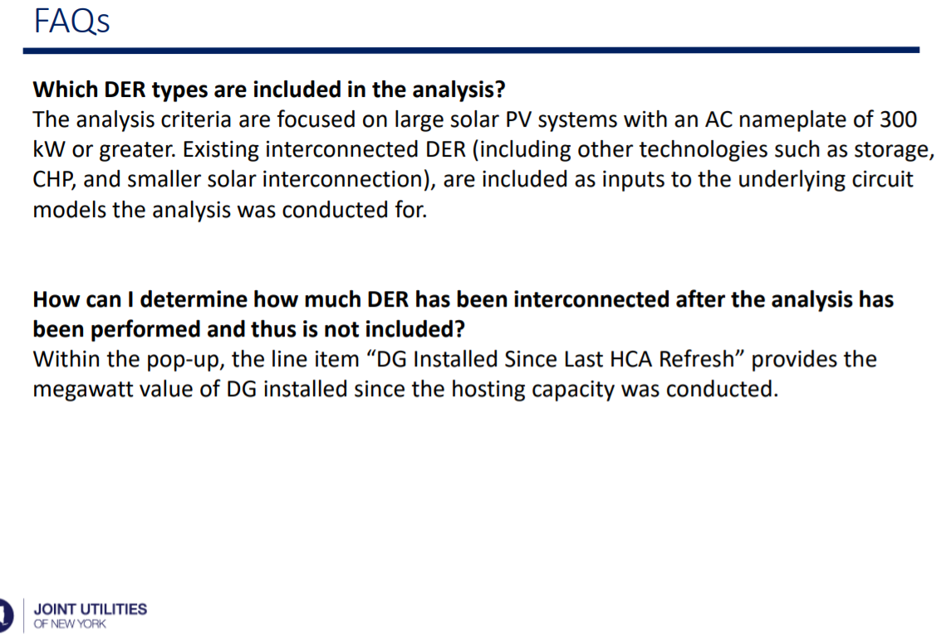
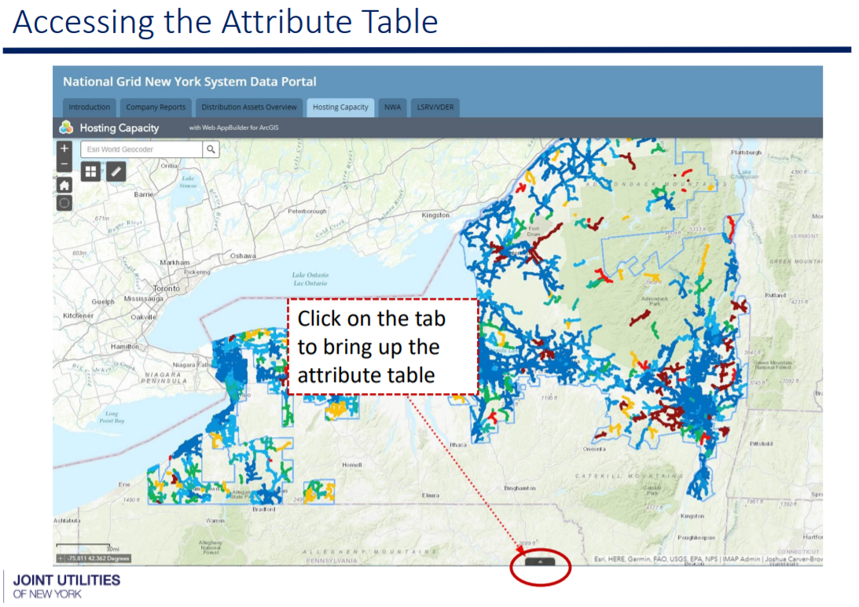
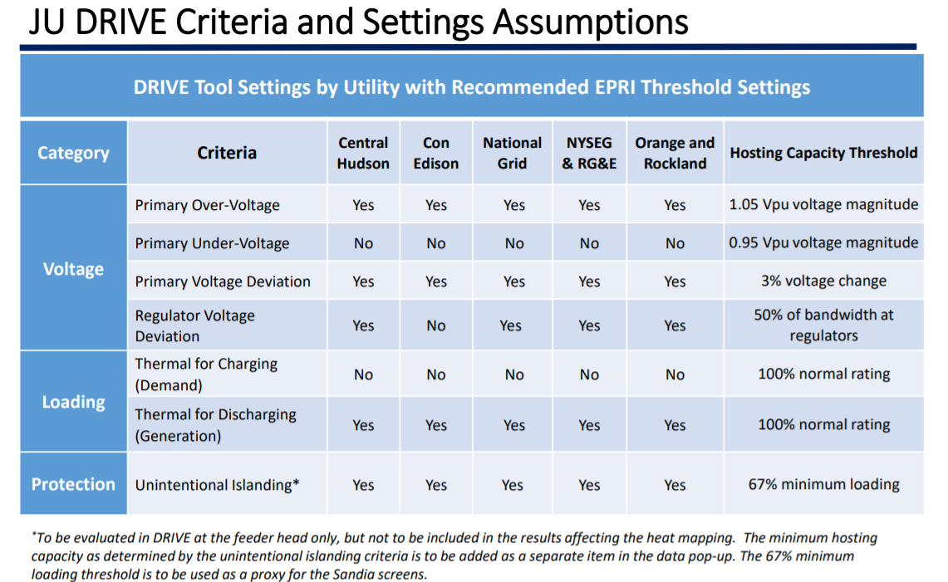
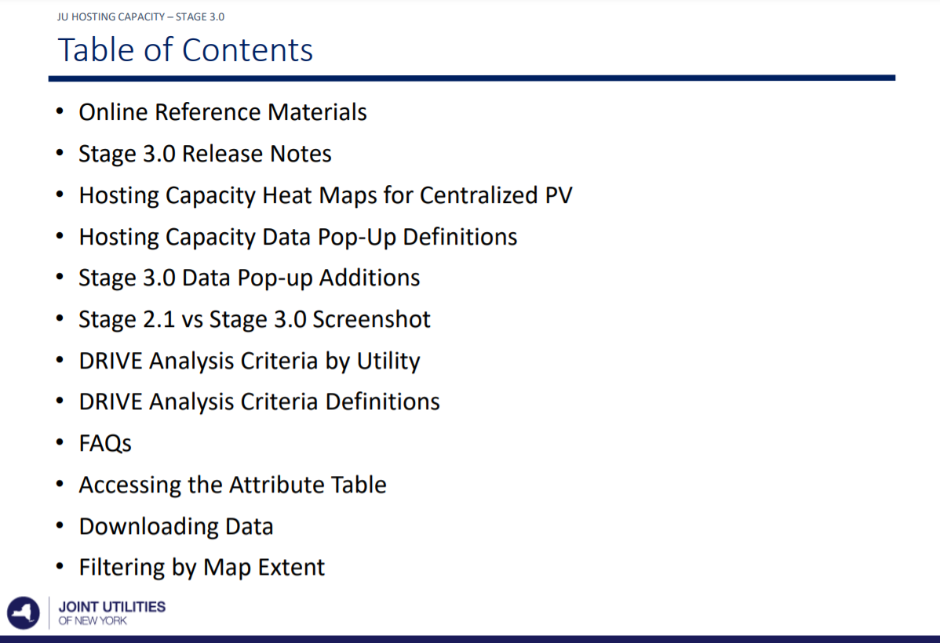
Hosting Capacity User Reference Materials
Reminder that more information on the analysis criteria, assumptions, FAQs and relevant background can be found here.
Source: https://jointutilitiesofny.org/utility-specific-pages/hosting-capacity

Slide 6
JU DRIVE Criteria and Settings Assumptions
JU Hosting Capacity – Stage 3.0
DRIVE Tool Settings by Utility with Recommended EPRI Threshold Settings
Category | Criteria | Central Hudson | Con Edison | National Grid | NYSEG & RG&E | Orange and Rockland | Hosting Capacity Threshold
Voltage | Primary Over-Voltage | Yes | Yes | Yes | Yes | Yes | 1.05 Vpu voltage magnitude
 | Primary Under-Voltage | No | No | No | No | No | 0.95 Vpu voltage magnitude
 | Primary Voltage Deviation | Yes | Yes | Yes | Yes | Yes | 3% voltage change
 | Regulator Voltage Deviation | Yes | No | Yes | Yes | Yes | 50% of bandwidth at regulators
Loading | Thermal for Charging (Demand) | No | No | No | No | No | 100% normal rating
 | Thermal for Discharging (Generation) | Yes | Yes | Yes | Yes | Yes | 100% normal rating
Protection | Unintentional Islanding* | Yes | Yes | Yes | Yes | Yes | 67% minimum loading
*To be evaluated in DRIVE at the feeder head only, but not to be included in the results affecting the heat mapping. The minimum hosting capacity as determined by the unintentional islanding criteria is to be added as a separate item in the data pop-up. The 67% minimum loading threshold is to be used as a proxy for the Sandia screens.

Slide 7
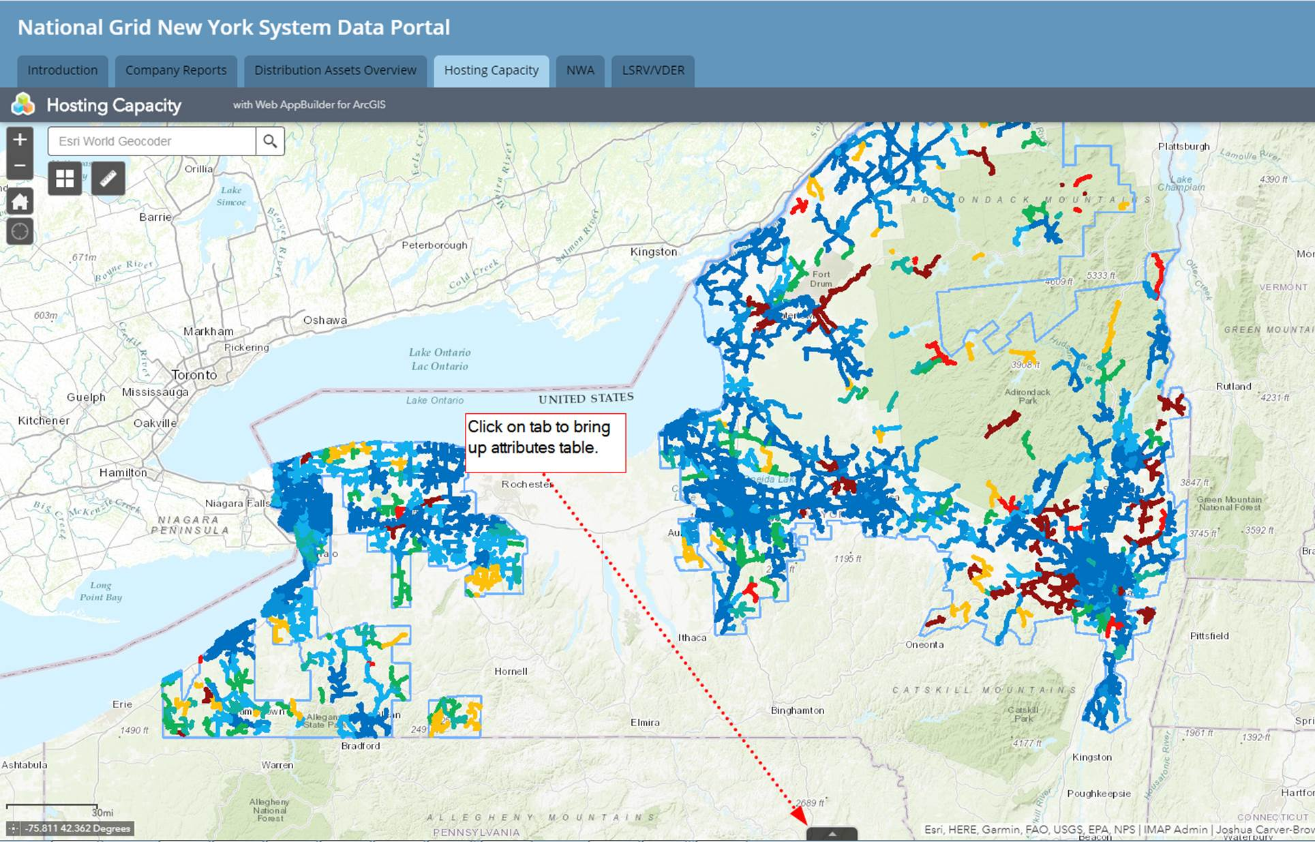
Accessing the Attribute Table
JU Hosting Capacity – Stage 3.0
Click on the tab to bring up the attribute table

Slide 8
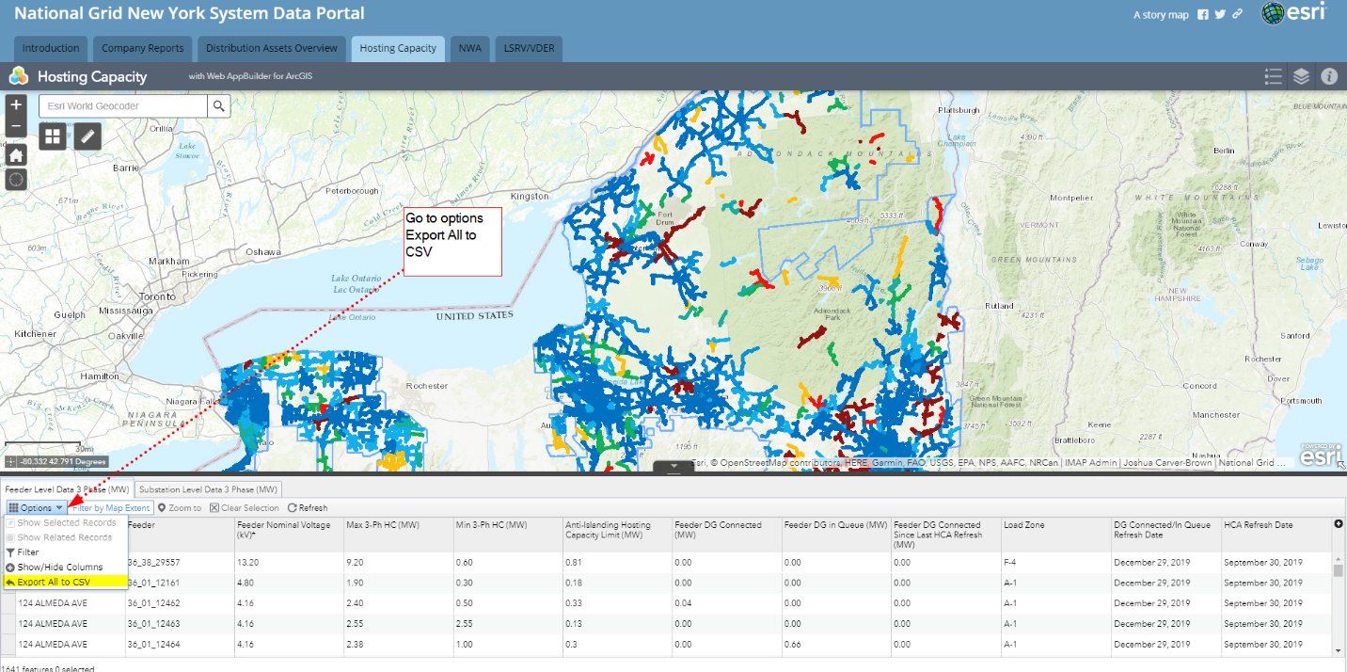
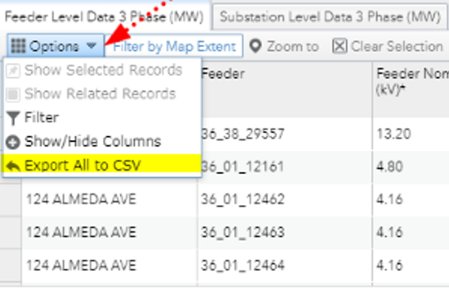
Downloading Data
JU Hosting Capacity – Stage 3.0
Go to options: Export All to CSV

Slide 9
Online Reference Materials
JU Hosting Capacity – Stage 3.0
Previous stakeholder engagement presentation slides and information on upcoming engagement sessions can be found at:
  https://jointutilitiesofny.org/joint-utilities-of-new-york-engagement-groups/
Links to each utility’s hosting capacity displays and common JU reference materials, such as descriptions of the analysis methodology and assumptions, as well as a tutorial of the Stage 3.0 displays, can be found at:
  https://jointutilitiesofny.org/utility-specific-pages/hosting-capacity/
A user demo and tutorial of the Stage 3.0 Maps can be found here:
  https://jointutilitiesofny.org/utility-specific-pages/hosting-capacity/
More information on the ERPI DRIVE tool can be found as part of a multi-part video series here: https://www.youtube.com/channel/UC4J6uTXtCGLkuNK8Xn_BQhA
The original white paper EPRI wrote on hosting capacity in New York State can be found here: https://www.epri.com/#/pages/product/000000003002008848/?lang=en-US
For additional information and questions, please email info@jointutilitiesofny.org

Slide 10
Recent Activities

Slide 11
Near-to-Medium Term Priorities
Consistent with the stakeholder survey results, the JU have focused on the following high priority and value-added enhancements.
Very Important 4.5 - 5
  Additional Map functionality (e.g. downloadability/filterability, API) – In-progress
  Hosting Capacity Analysis for Energy Storage – Partial progress per the EV Order
  Hosting Capacity for Hybrid Solar + Storage
  Upstream Substation/Bank-Level Constraints – Progress made in Stage 3.1
  Forecasted Hosting Capacity
Important 4.0 – 4.4
  Increased Analysis Refresh Rate – In-progress
  Circuit Equipment Ratings
  Hosting Capacity - Data Validation Efforts – Progress made in Stage 3.1
  Dynamic Hosting Capacity
Very
Important
(4.5 - 5.0)
Important
(4.0 - 4.4)
Somewhat
Important
(3.0 – 3.9)
Not Very
Important
(1.0 – 2.0)
A summary of the stakeholder survey results can be found in the May 2020 Stakeholder slides.

Slide 12




Recent Activities
Updated data pop-up notes section to alert developers to unique situations and potentially significant upgrades.
Began expanding REST URL access to all third-parties on March 1, 2021.
Analysis refresh completed on April 1, 2021 for circuits with a total increase of connected DG above 500 kW over the prior 6 months.

Slide 13
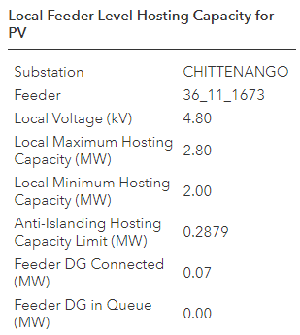
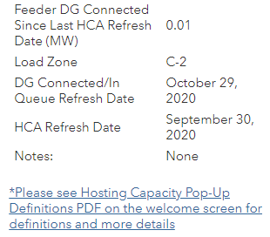
Example Notes
“Fed from neighboring utility”
“Substation configuration requires 3V0 / DTT”
“Pending upgrades eligible for cost-sharing”
Fed from
NYSEG/RG&E
Notes:
Hosting capacity is an estimate of the amount of DER that may be accommodated without adversely impacting power quality or reliability under current configurations and without requiring infrastructure upgrades.

Slide 14
Identifying Currently Encumbered Substations / Assets
Some substations / assets increasingly require significant interconnections upgrades to accommodate further DER.
The cost sharing petition under discussion may help make these upgrades economical for projects to interconnect at these locations.
The JU are working to identify additional mapping solutions to help identify these areas for developers.
Examples of why significant upgrades may be required include:
  When the amount of DER in queue exceeds the rating of the station transformer bank
  Additional DER creates potential overvoltage on the transmission system
  Backfeed begins to exceed acceptable protection limits

Slide 15
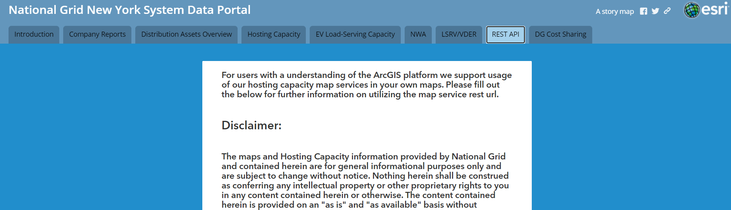
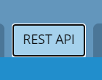
REST URL Access
Third parties can now overlay JU hosting capacity data within their own GIS systems and mapping tools.
REST URL access provides a live version of the current hosting capacity maps enabling access to the most up to date information.
Example of National Grid’s REST URL

Slide 16
Increasing Analysis Refresh Rate
The semi-annual refresh balances resource constraints with the need for providing relevant, up-to-date information.
The JU will review and update the criteria for significant circuit changes each refresh cycle as necessary to help capture major changes in hosting capacity throughout the year.
Oct. 1, 2020: Full HCA Refresh
Apr. 1, 2021: Refresh Circuits with a total increase of connected DG above 500 kW over the prior 6 months*
Oct. 1, 2021: Full HCA Refresh
*Additional criteria may be applied at the utility’s discretion

Slide 17


Considerations for Hosting Capacity Maps for Energy Storage Resources
William Acker
JU Hosting Capacity Stakeholder Meeting
May 13th, 2021

Slide 18
High Level Considerations
Energy Storage is a controllable asset
  It can consume hosting capacity, be neutral with respect to hosting capacity, or even increase hosting capacity for other assets.
  Because of the flexibility of the asset, further information is required to optimize.
  Need to consider both power injection and load
  Presently have unconstrained and constrained operation
  In the future may have dynamic control to increase hosting capacity

Slide 19
Specific Considerations
Include mid-voltage level on maps
  Maps show up to 13kV and occasionally some higher voltage feeders
  There is a gap in information between 13kV and 69kV
  Larger storage projects (5MW – 20MW) may bypass some of the constraints on maps, but need to understand primary distribution feeders, i.e. 27kV or 33kV.

Slide 20
Specific Considerations
Developers are interested in information that supports decisions on different operating modes
  Baseline information on unconstrained operation
  Information to evaluate specific operational modes, for example VDER profile operation
  Information to identify locations where energy storage would be helpful to the grid

Slide 21
Specific Considerations
Need for more temporal granularity of data
  Example: Low load times in the spring might limit solar hosting capacity whereas an energy storage device may not be affected by that time.
  Increased temporal information for both load and injected power.
  Granularity should be sufficient to allow evaluation and optimization of operating modes.

Slide 22
Specific Considerations
Need to provide data on limiting factors
  The properties of Energy Storage can be quite different from solar. For example, flicker or voltage violations can be significantly different.
  Providing more granularity of information will both catalyze more deployment and potentially more efficient solutions.
  In addition to storage, this information will be useful as we begin to deploy more smart inverters.

Slide 23
SoCal Edison Example
Provides significant temporal and limitation criteria information
  576 hours analyzed (lowest and highest load days for each month).
  Provide Criteria Violation Value for each criteria examined.
  Updated monthly (as needed).

Slide 24

NY-BEST Capture the Energy 2021Conference
June 22-24, 2021
Thank You

Slide 25
Storage Hosting Capacity Maps
The initial storage hosting capacity map will be at a feeder-level and will be updated on an annual basis.
The JU are targeting an April 2022 release date.
The JU will schedule a second stakeholder meeting in the Fall as part of the roadmap development process.
Similar to the solar PV hosting capacity maps, data validation and QA/QC are a major priority.
Important to have interconnection processes and requirements inform the hosting capacity analysis.

Slide 26
EPRI DRIVE Tool
For consistency, the utilities conduct their hosting capacity analysis using EPRI’s DRIVE tool and present their results in the ESRI mapping environment.
DRIVE allows each utility to calculate the hosting capacity for their distribution system using EPRI’s streamlined methodology.
DRIVE’s streamlined methodology is an accurate means for calculating hosting capacity and includes the functionality for evaluating storage.
DRIVE continues to be updated with input from the DRIVE User’s Group comprised of a broader group of utilities and EPRI.

Slide 27
Draft Storage Hosting Capacity Roadmap Priorities
Initial Release ~ April 2022
Increasing effectiveness, complexity, and data requirements
Future Releases
2023 +
Feeder-level analysis (Min / Max)
Focused on large, centralized systems (> 300 kW)
All applicable system data already provided
Rest URL access
Sub-feeder-level analysis
Increased temporal granularity
Additional roadmap items to be determined

Slide 28
"State of DER Dashboard" Industry Initiative
Ver 2021-05-13
Overview by Industry & NYSEIA for the 13 May 2021
JU Hosting Capacity Working Group Meeting
Note: This is a summary presentation; please see original source whitepaper & more information here or obtain a copy by emailing: itwg-liaison@nyseia.org.

Slide 29
A. Industry Position Summary
It is becoming increasingly challenging to connect DER to the grid,
which will only increase at an increasing rate. Evidenced by closed substations and other factors.
Industry is concerned that we are going to effectively run out of hosting capacity far sooner than any meaningful upgrades can be made via the CLCPA processes, putting thousands of jobs and hundreds of companies at risk.
Baseline public metrics are essential to understanding the fundamental state of affairs and making informed decisions. Presently no NYS regional/global benchmarks are available.
Presently there is no ability to assess the rate of change or trending over time; we cannot even predict if/when we will run out of hosting capacity. Using rates and trending we can create a timeline and estimates for when we expect major issues to arise, and can respond accordingly.
We request a collaborative joint effort to produce a "State of DER Dashboard" as soon as possible. Industry requests data collection the start of Q4, 1 October 2021, published on 1 November 2021.
The dashboard will provide critical data to inform all stakeholders of key areas of concern, trends, rates of change, and indications whether current or planned efforts are having any objective positive benefits.

Slide 30
B. Analogy: The current state of affairs is like a business without metrics
Imagine we are a large manufacturing company.
Management has a goal of increasing new widget production
There are many locations
And yet general management is blind to the general state of their equipment.
There is no public location to go to see total production across all factories
While you zoom in on each individual piece of equipment, of which there are literally thousands, there may be some additional capacity on each, but there is no way to know how much overall additional capacity may exist at a factory or regional level
Each piece of equipment is slowly losing its ability to produce widgets, but nobody is tracking how long it will be until widget production goes to zero
Some equipment is already shut down(!); it is unclear how many are shutdown and why
We are considering investment in upgrading equipment, but we cannot really tell what are the common trends
Existing activity is reactive, and not in a preventive/proactive

Slide 31
C. Key Dashboard Characteristics
Contains critical DER & grid metrics and benchmarks focused on hosting capacity.
Does not require login, allowing for ease of access for all types of stakeholders.
Provides "snapshots" of metrics recorded on exact dates with same interval between dates, thus allowing for tracking over time.
By ensuring detailed feeder/substation level data is downloadable from each utility's hosting capacity map
  Values can be independently verified by 3rd parties, and
  Advanced numerical analysis can be performed by stakeholders.
  (Note that this only shows current information, not trending over time,
  hence the need for snapshot data.)

Slide 32
D. Sample "State of DER Dashboard" Website
Following is a sample webpage, hosted at a central location (ex the JU or DPS website), with the following data.
Note that blue text below is explanation text and would not be on the actual webpage.
Introduction, Narrative, Definitions
[Mathematical definition of penetration ratio]
[Simple/clear definition of "hosting capacity" & links to same for how it is calculated]
[Simple/clear definition of what it means to have a "closed" feeder or substation]
[Link to definition of of standard deviation]
[etc.]

Slide 33
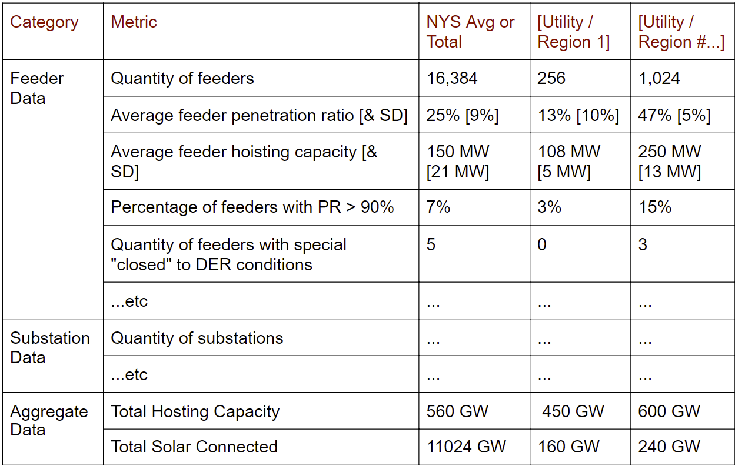
D. Sample "State of DER Dashboard" Website
Following is a sample webpage, hosted at a central location (ex the JU or DPS website), with the following data.
Note that blue text below is explanation text and would not be on the actual webpage.
Summarized, Quarterly, Snapshot Data
DER State of the Grid as of
1 October 2021
(a new table is produced based on data as of the first day of every quarter)
(Note this is not real data)
(Continue table with other metrics as listed on the next pages)

Slide 34
D. Sample "State of DER Dashboard" Website
Following is a sample webpage, hosted at a central location (ex the JU or DPS website), with the following data.
Note that blue text below is explanation text and would not be on the actual webpage.
See discussion and notes regarding each value calculation, etc, in the master whitepaper or on the JU website.
Feeder Data
Quantity of feeders
Average penetration ratio & SD
Average hosting capacity & SD
Percentage of feeders with PR > 90%
Quantity of feeders with special "closed" to DER conditions
Substation Data
Quantity of substations
Average penetration ratio & SD
Average hosting capacity & SD
Percentage of substations with PR > 90%
Quantity of substations with special "closed" to DER conditions

Slide 35
D. Sample "State of DER Dashboard" Website
Following is a sample webpage, hosted at a central location (ex the JU or DPS website), with the following data.
Note that blue text below is explanation text and would not be on the actual webpage.
See discussion and notes regarding each value calculation, etc, in the master whitepaper or on the JU website.
Aggregate
Total Hosting Capacity Avail
Total Solar Connected
Solar by Bucket
0kW to 50kW
>50kW to 5MW
>5MW to 10MW
>10 MW
Non-Solar
Total Non-Solar
ESS, Wind, Etc
Note: This is one of other related but separate data to possibly include on the dashboard. See whitepaper for more info.
IA & CESIR Fail Data
Solar or Solar+ESS
Quantity of new applications in quarter
Quantity of CESIR complete in quarter
CESIR Analysis Failure Percentage for each
Select app data for other
ESS only
Wind
etc.

Slide 36
D. Sample "State of DER Dashboard" Website
Following is a sample webpage, hosted at a central location (ex the JU or DPS website), with the following data.
Note that blue text below is explanation text and would not be on the actual webpage.
Utility/Region Narrative (if submitted)
Utility / Region 1 Notes & Commentary
(If submitted, utility would provide the latest commentary to help describe any key metrics, reasons for closed substations, or anything else that would provide meaningful insight to their data.)
Utility / Region # Notes & Commentary
(same)

Slide 37
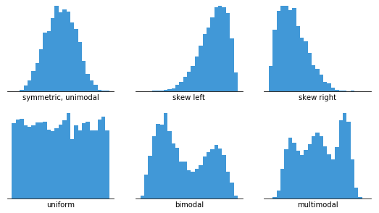
D. Sample "State of DER Dashboard" Website
Following is a sample webpage, hosted at a central location (ex the JU or DPS website), with the following data.
Note that blue text below is explanation text and would not be on the actual webpage.
Detailed Data (available from queue & HCM's)
Please proceed to the hosting capacity map (HCM) for each utility to download complete feeder or substation data. Much of this data can be used to reproduce various metrics above using spreadsheet analytical methods. Links to each utility HCM can be found here:
https://www3.dps.ny.gov/W/PSCWeb.nsf/All/6143542BD0775DEC85257FF10056479C?OpenDocument
Additionally, master interconnection queue data can be downloaded from the DPS website here:
https://www3.dps.ny.gov/W/PSCWeb.nsf/All/286D2C179E9A5A8385257FBF003F1F7E?OpenDocument
(Ideally all of the feeder and substation data can be reproduced by downloading the full dataset from each utility's hosting capacity map. Beyond averages and standard devion, developers and others can produce advanced population analysis. Ex.)
(Note that just providing access to this data is not the same as the snapshot summarized data. Among other reasons, this data will only provide information based on the last HCM refresh, and does not show trending over time.)

Slide 38
E. Additional Information Available on Whitepaper
More information on the below topics is available on the source whitepaper & more information here or on JU HCWG website.
Additional "use case" information
Comparison of this initiative with the NYSERDA IEDR initiative, and why they should be pursued separately.
Discussion about why it may be good to incorporate CESIR Analysis Fail Data, and other items, that are not directly derived from hosting capacity map data.
Reference information on existing/currently "Closed Substations".
Sample/Reference analysis following a download of National Grid substation information.

Slide 39
F. Implementation & Requested "Next Steps"
Start date - Industry requests a 1 November 2021 launching of the website, using 1 October 2021 data.
Focus Group - Start a focus group as soon as possible that meets every other week to make decisions and track progress.
Hosting location - What is the preferred location to host the dashboard? Note that queue data is already published on the DPS website. What entity will take responsibility for (a) collection, (b) webmaster services.
Frequency - Industry believes quarterly is the appropriate frequency for this information.
Metrics review - Detailed discussion about each of the individual metrics, how they would be calculated, and which will be in this initial launch, vs rolled out at future dates.
etc.

Slide 40
Q&A

Slide 41
Appendix

Slide 42
Longer-term Items Requiring Further Discussion
The following items are viewed as longer-term items to continue considering in the context of the broader hosting capacity roadmap:
  Hosting Capacity for Energy Storage
  Hosting Capacity for Hybrid Solar + Storage
  Upstream Substation/Bank-Level Constraints (Progress made in Stage 3.1)
  Forecasted Hosting Capacity
  Circuit Equipment Ratings
  Hosting Capacity - Data Validation Efforts (Progress made in Stage 3.1)
  Dynamic Hosting Capacity

Slide 43
Stage 3.X Survey Prioritization (1/2)
Stakeholders were asked to rate the level of importance of each of the following proposed enhancements to your business, using a five-point scale where 1 is “not at all important,” and 5 is “very important.”
Very Important 4.5 - 5
  Additional Map functionality (e.g. downloadability/filterability, API) – Progress made in Stage 3.1
  Hosting Capacity Analysis for Energy Storage
  Hosting Capacity for Hybrid Solar + Storage
  Upstream Substation/Bank-Level Constraints – Progress made in Stage 3.1
  Forecasted Hosting Capacity
Important 4.0 – 4.4
  Increased Analysis Refresh Rate
  Circuit Equipment Ratings
  Hosting Capacity - Data Validation Efforts – Progress made in Stage 3.1
  Dynamic Hosting Capacity
Very
Important
(4.5 - 5.0)
Important
(4.0 - 4.4)
Somewhat
Important
(3.0 – 3.9)
Not Very
Important
(1.0 – 2.0)

Slide 44
Stage 3.X Survey Prioritization (2/2)
Stakeholders were asked to rate the level of importance of each of the following proposed enhancements to your business, using a five-point scale where 1 is “not at all important,” and 5 is “very important.”
Mid 3.0 – 3.9
  Better Communication of Available Reference Materials and
  Supporting Documentation – Progress made in Stage 3.1
  Time-Varying Hosting Capacity (increased temporal granularity)
  Hosting Capacity Analysis Criteria Violation Transparency
  EPRI DRIVE Utility Inputs, Analyses Used, and Study Parameters Transparency – Progress made in Stage 3.1
Low 1.0 – 2.9
  Hosting Capacity for Electric Vehicles*
  Hosting Capacity for Combined Heat & Power**
Very
Important
(4.5 - 5.0)
Important
(4.0 - 4.4)
Somewhat
Important
(3.0 – 3.9)
Not Very
Important
(1.0 – 2.0)
*Survey did not include EV stakeholders
**Survey did not include CHP advocates

Slide 45
Meeting Notes

Slide 46
May 2021 Stakeholder Webinar Overview
Topic | Discussion Points | Follow-ups
Available Reference Materials | Stakeholders requested confirmation if there was a single location where certain policies or updates are captured. | The JU confirmed the existing “Reference Materials” slide deck is where this information is captured. The JU will update the current version with the latest policy announcements and updates, such as the REST URL functionality and analysis refresh rate changes.

Slide 47
May 2021 Stakeholder Webinar Overview
Topic | Discussion Points | Follow-ups
ESRI Map Environment | Stakeholders raised the question if the JU are aware of any inconsistencies, between utilities, in the available system data and the ability to export that data. | The JU confirmed that each utility is providing the same feeder and substation-level data within the maps. Any differences between utilities in available data was a known, limited issue, as a result of map updates and has since been resolved. The JU are aware that the ESRI map environment has limitations with exportability, e.g., 1000 lines of data. The JU will review if that can be resolved within the ESRI map environment or if they can make that data more accessible by other means.
REST URL Access | Stakeholders requested clarification on when the REST URL functionality would be common to each utility, and that the JU note specific dates when referencing timelines for new functionality. | The JU confirmed that each utility will provide REST URL access by June 1. The JU will be more mindful of messaging when certain functionality is available when referencing specific dates.

Slide 48
May 2021 Stakeholder Webinar Overview
Topic | Discussion Points | Follow-ups
Energy Storage Hosting Capacity Roadmap | Stakeholders requested that any future meetings, focused on the energy storage roadmap, be held sooner rather than later. Stakeholders expressed their interest in providing input to JU roadmap as part of that process. | The JU currently are planning to hold another stakeholder meeting, later this year in the Fall. The JU will review if this meeting should be moved up to the July/August timeframe, or if a separate additional stakeholder meeting focused on this topic is warranted.
State of DER Dashboard | Stakeholders requested the JU review their presentation on a potential “Dashboard” to include as part of the hosting capacity maps. Stakeholders requested a sub-group focused on this effort be set up to meet the requested November 2021 timeline. | The JU will review stakeholders’ request for the proposed dashboard and will follow-up with the lead stakeholders on this effort. As part of that determination, the JU will review the need for a sub-group or if this request can be addressed via the existing process/forum.

