Slide 1
Distributed System Platform (DSP) Stakeholder Webinar
June 2024

Slide 2
Welcome and Logistics
Welcome and thank you for joining!​
Webinars are open to the public and recordings will be posted following the webinar on the Joint Utilities website: www.jointutilitiesofny.org ​
Please contact info@jointutilitiesofny.org if you have any additional questions following the webinar
Notes:
Speakers are tentative

Slide 3
Agenda
Welcome and thank you for joining!
Agenda Item | Presenters
ISO-DSP | Bonnie Graziano (Con Ed)
Interconnection | Gabriele Viscariello (National Grid)
Integrated Planning | Alex Young (National Grid)
Information Sharing | Leon Bukhman (Con Ed)
EV | Christina Ficicchia (Avangrid)
Webinars are open to the public and recordings will be posted following the webinar on the Joint Utilities website: www.jointutilitiesofny.org ​
Please contact info@jointutilitiesofny.org if you have any additional questions following the webinar

Slide 4
ISO-DSP Presented by: Bonnie Graziano (Con Edison)

Slide 5
NYISO’s DER and Aggregation Market Model became Effective April 16, 2024
FERC approved NYISO’s DER and Aggregation Market Model in April 2024, which is basically its first iteration towards full compliance with FERC Order No. 2222. NYISO has told FERC that it expects to be fully compliant by the end of 2026.
Undertaking for Post Go-Live Activities
The JU continue to discuss with NYISO operational coordination and the interaction between utilities, NYISO, Aggregators, and individual DER customers, with the goal of utility systems effectively supporting NYISO's beginning-to-end process.
The JU are discussing the treatment of incremental costs directly associated with utility activities specifically attributable to support of this new NYISO model. Incremental costs include engineering studies, DER enrollment work, meter authority and settlement work, and real-time operations coordination and planning (Electric Control Center) work.
Continue to Coordinate with NYISO’s Development of a Fully Compliant FERC Order 2222 Market
Utilities will continue to coordinate with the NYISO as it develops its fully compliant FERC Order 2222 market for DER and Aggregations. To this end, NYISO intends to make one more Compliance Filing by the end of this year in which it will propose new tariff language to address the remaining gap with the tenets of FERC Order No. 2222. This major update will be that Aggregations consisting of different technology types will be allowed to provide an ancillary service product as long as one of the DER within an Aggregation can provide that product.

Slide 6
Interconnection Presented by: Gabriele Viscariello (National Grid)

Slide 7
Joint Utilities Continue Efforts on Several Fronts, Including Industry Collaboration and Updates to the SIR
Collaboration with Industry
The JU has been actively collaborating with members of Industry on the below topics over the last few months.
Each member of the JU has created utility-specific profiles to incorporate smart inverter settings that align with IEEE 1547-2018. The JU are working with device manufacturers and developers to encourage adoption and communication of inverter settings in standardized formats, which can help improve interconnection times.
The JU are working through considerations relevant to Industry’s request to study multiple project configurations/ options in a single CESIR study. The JU are aligning on a position in this regard and will include it in the SIR.
Earlier in the spring, the JU also responded to a query from Industry as to how minimum daytime load data is used in CESIR screens. In this response, the JU also provided information on updates to BESS daytime load periods for a few companies.
The JU also provided comments to Industry and Quanta on the proposed scope for an islanding assessment for wind generators. The scope of this study is to identify whether additional protection and anti-islanding guidelines should be imposed on non-certified wind generators.
Updates to the SIR
The JU has identified and been working on updates to the SIR on the following topics.
The JU has made edits to Appendix K in the SIR to help clarify BESS operating characteristics and to ensure that developers are submitting relevant data for study.
The JU are also making amendments to the SIR to include considerations relevant to UL 1741 CRD for Multimode, which will address the topic of DERs installed with microgrid interconnect devices (MIDs).
The JU are also making edits to the SIR to ensure that developers provide block and lot numbers for physical spaces early in the interconnection process to ensure that multiple projects are not proposing to be built on the same parcel of land.

Slide 8
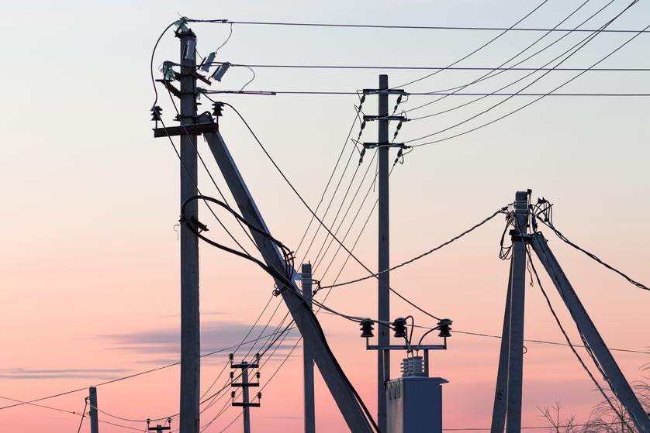
Integrated Planning Presented by: Alex Young (National Grid)

Slide 9
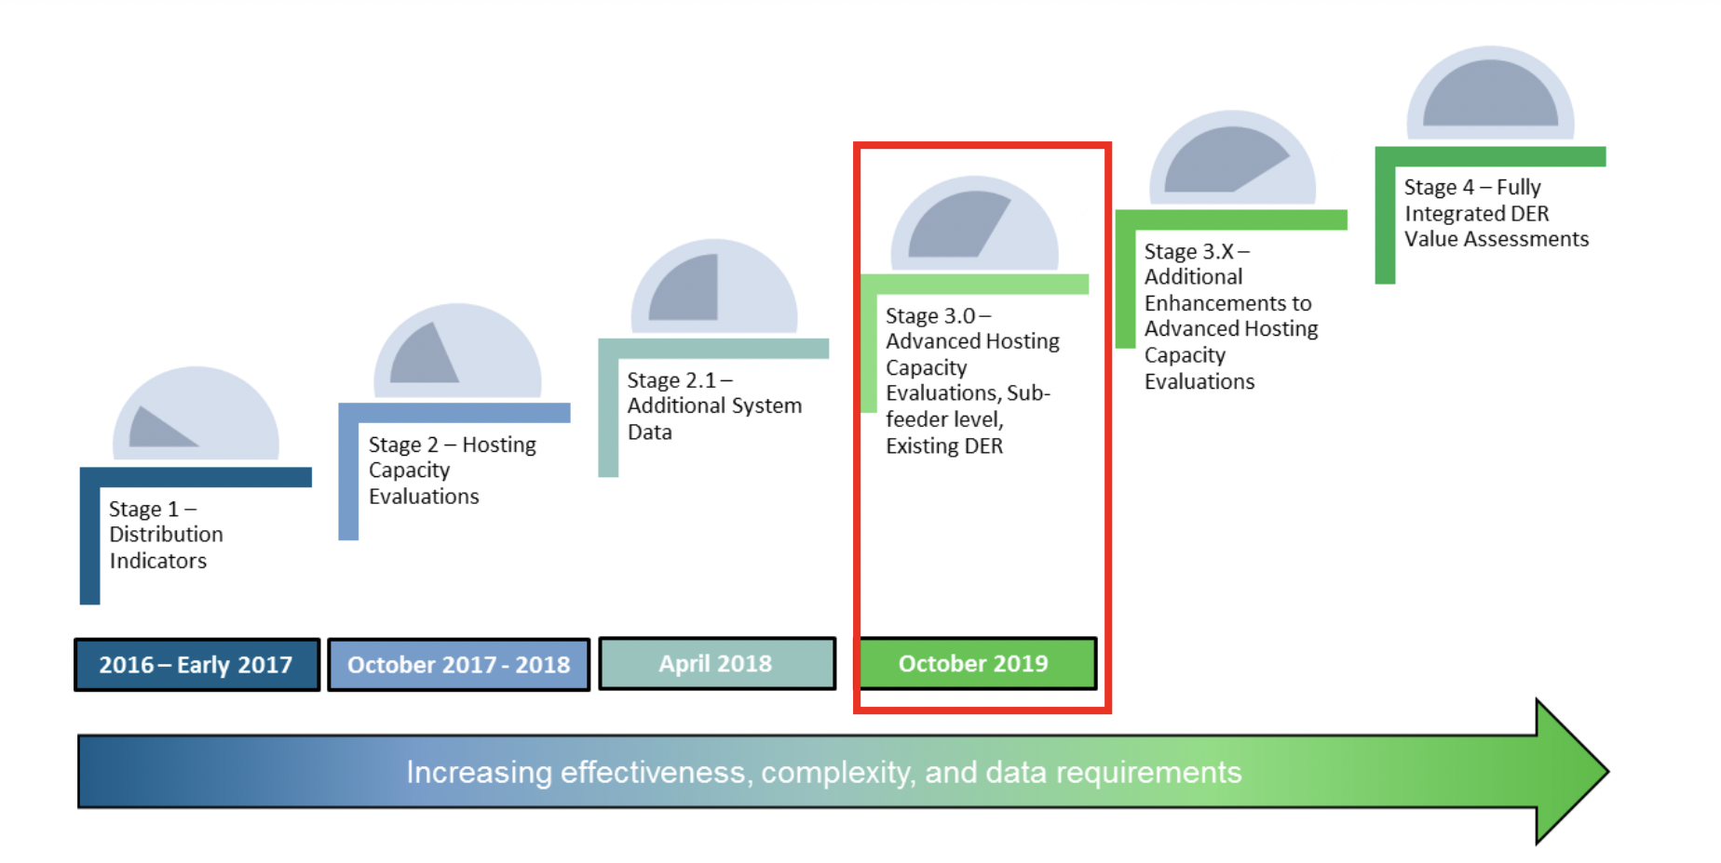
Evolution of the Roadmap
The Joint Utilities, with guidance from stakeholders developed a four staged Hosting Capacity implementation roadmap. This was incorporated into New York Utility filings.
Stage 4 –Advanced Scenarios and Increased Granularity
Stage 4.1 – advanced functionality
Stage 4.1+ - electrification maps, pending further functionality
Stage 3.5 – EV and Energy Storage Maps
2019 - 2020
2021 - 2022
2023
2023-2024

Slide 10
Overview: Stage 3.5 & 4.1
In 2022, the JU published Storage (ESS) HC maps showing… | In August, the JU presented
1 | Feeder-Level Hosting Capacity (min/max)
2 | Additional System Data
3 | Downloadable Feeder-Level Summary Data
4 | Reflect Existing DER in Circuit Load Curves and Allocations
In 2023, the JU published HC updates showing… | In August, the JU presented
1 | Sub Feeder Level for Storage HC Map
2 | DG Connected Since Last HCA Refresh
3 | Nodal Constraints (Criteria Violations on PV and Storage Maps)
4 | Cost Share 2.0 Items on PV and Storage Maps
Due to stakeholder feedback, all map views also showed…
post sub-transmission circuits that are available to host distributed generation on their individual portals to help developers best evaluate options for storage connections. Six-month update for circuits that increase in DG > 500kW on the PV maps Links and/or instructions to access 8760 data Storage HC data made available via the API

Slide 11
PTID Nodes
The utilities published PTID nodes at the end of 2023.
FERC approved NYISO’s go live of their DER participation market.
An aggregation needs to fall within the same pricing node in this market.
The nodes have been published in alignment with NYISO’s progress. This is another means by which aggregators can access this information.
Aggregators will be using the HC Maps as a means to access the proper PTID nodes

Slide 12
Synchronizing HC Map Updates
To streamline efficiency, the utilities have synchronized the release of updates to the PV and ESS HC Maps
Henceforth, the utilities will refresh their PV and ESS Maps each spring with approximately three to four weeks between map releases.
Utilities will continue to maintain a six-month update for circuits that increase in DG > 500kW on the PV maps

Slide 13
Electrification Maps
Two orders directed the evolution of the EV Load Capacity Map to an Electrification View.
Electric Vehicle Process Mid-point Review in 2023
Energy Efficiency and Building Electrification
Issued and Effective: July 20, 2023
Utilities “shall, within 180 days of this Order, consult with Department of Public Service Staff, and expand the Electric Vehicle Load Serving Capacity Maps into “Electrification Load Serving Capacity Maps,” as discussed in the body of this Order.”
Utilities collaborated with DPS Staff to develop functionality for the Electrification Maps.
The Maps were published on January 16, 2024, and show the following.
Feeder level data with capability of showing the winter peak and summer peak circuit-level data.
Environmental Justice locations.
For both summer and winter views, the Electrification Maps show the same color scheme and breakpoints as the EVs currently show.

Slide 14
ITWG Collaboration
We are seeking to update the HC portal to provide additional information that is valuable to the SIR and CESIR requirements.
Changes to the HC maps should align with information that developers require through the work in the ITWG.
As such, we initiated collaboration with the ITWG to request advancements in alignment with their stakeholder feedback and with the intention to update the maps to reflect updates to interconnection, SIR, CESIR, and other processes.
Through the ITWG, each utility has published tentative ESS schedules.
Utilities and industry will collaborate to determine the utilization of these schedules, i.e., how the schedules may inform updates to the interconnection process, CESIR, SIR, etc.
The Integrated Planning WG intends to update the storage HC map considering these changes, as information allows.

Slide 15
Information Sharing Presented by: Leon Bukhman (Con Edison)

Slide 16
Information Sharing – Supporting Access to Useful Data
The Joint Utilities are supporting customer access to information in several ways, including through the Integrated Energy Data Resource (“IEDR”) Program.
The IEDR is NYSERDA’S centralized, state-wide platform that provides access to energy data and information from New York's electric, gas, and steam utilities, and other sources.
Integrated Energy Data Resource (IEDR) Phase 1 has been completed
On March 28, 2024, NYSERDA released the Minimum Viable Product (MVP) version of the IEDR platform and officially announced the completion of Phase 1 of the program. The MVP is the second major public release of the IEDR platform. In addition to the three initial use cases covered in the Initial Public Version (IPV) release, the MVP release consists of five new foundational use cases, for a total of eight specifically targeted, but highly prioritized use cases that are now operational within the IEDR.
Moving forward, the Joint Utilities will continue to support the data delivery requirements for Phase 2 of the IEDR including further developing the Rate Plan Use Case.
For more information, visit https://iedr.nyserda.ny.gov/
Notes:
USE CASES DEFINED HERE: IEDR Stakeholder Use Case Development - NYSERDA
Consolidated Hosting Capacity Maps
Installed Distributed Energy Resources (DERs)
Planned Distributed Energy Resources (DERs) (Interconnection Queue)
DER Siting –Environmental, Community, Terrain, Land, and Property Assessment,
EIAT (Electronic Infrastructure Assessment Tool) Hosting Capacity & DER Map Enhancements,
Efficient and Effective Access to Existing Customer Billing Data*
Find and Filter Rate Options Across NYS IOU Utilities,
Access to Basic Rate Data and Tariff Book for Individual Rate

Slide 17
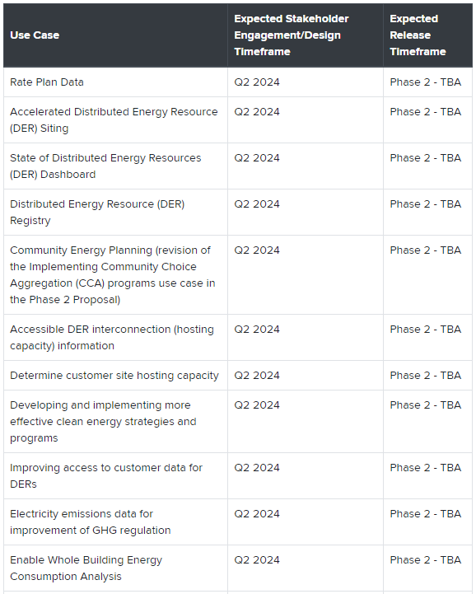
Information Sharing – Current Focus
Work continues on improving data sets and bulk data exchanges between IEDR Team and JU
Focus on data consistency and quality
IEDR development team and JU working on lessons learned from Phase 1
Phase 1 utility data provided the foundation for Phase 2 use case development
NYSERDA identified first priority phase 2 use cases shown at right, many of which expand phase 1 effort
JU and IEDR Team working on Rate Plan use case
Different utilities have different tariffs & starting points
Review of data schema underway
Excerpted from IEDR Stakeholder Use Case Development – NYSERDA:

Slide 18
Electric School Bus Study and EV Make-Ready Program Updates Presented by: Christina Ficicchia (Avangrid)
Image source: NYSERDA

Slide 19
Electric Schol Bus Capacity Study
In November 2023, the Make-Ready Program Midpoint Order directed the Joint Utilities to provide load-serving capacity for all public school bus facilities in the state.
The study includes public school bus sites identified from a combination of DPS, NYSERDA, and utility sources and provides an estimate of available electric service capacity at each school bus depot.
The Utilities presented the results of the utility capacity analysis to school districts in a technical conference on May 31, alongside presentations from NYSERDA and NYSED.
School bus sites evaluated by utility service territory
58
540
213
61
186
58

Slide 20
Analysis Results: Many school bus sites can support a pilot project today
Share of sites by ability to support electric school buses*
Recommend that school districts start with small pilots to gain experience with ESBs, often with no grid-side upgrades.
A small initial deployment is an excellent way to gain hands-on experience with the bus and charging equipment while additional utility upgrades are under construction to scale up (if needed).
Site capacity optimization (managed charging/charger sharing) can enable existing capacity to serve more buses and potentially avoid the need for additional grid upgrades.
A NYSERDA or utility fleet assessment study can help assess that for a district.
~75% of sites able to support at least 10 buses
~67% of sites able to support at least 25 buses
Utility advisory services & incentives available for school districts include:
Medium- and Heavy-Duty Make-Ready Pilot Incentives
Operating Cost Relief (Con Edison Managed Charging and 50% demand charge rebates available at each utility)
Fleet Assessments
Hosting Capacity Maps
Rates Tools (such as Con Edison Charging Cost Calculator)
EPA Grant Application Support
*Based on an estimated changing demand of 20 kW per bus

Slide 21
Joint Utilities Petition
In March, the Utilities submitted a petition for modification of two requirements introduced in the Midpoint Review Order
Communications Standards
Revised enforcement date for L2 chargers to meet ISO 15118 hardware and software requirements and OCPP 2.0.1 requirements
Application of new standards to only newly committed projects
Clarification that software and hardware conformance should apply to ISO 15118-2 OR 15118-20 (not both)
MHD Pilot Customer-Side Eligibility
Offer enhanced incentive level to pilot projects that are partially within a DAC and adjacent to a DAC
Comments in support of the communications standards request were filed by numerous industry stakeholders including ACE NY, Bright Energy Services, SWTCH, and the City of New York.
The JU later submitted a request for extension of time for the communication standards, which are set to take effect in November 2024. The request was approved and an extension granted until the Commission issues a decision on the petition's requests.
Key Takeaway: The JU seek to ease barriers to participation in the Make-Ready Program by supporting standards that reflect the market-readiness of available technology

Slide 22
Q&A Session Moderated by: Matt Robison, ICF

Slide 23
Q&A Session
Please submit questions via the ‘question function’ on the webinar interface
Additional questions may be emailed to info@jointutilitiesofny.org following the webinar
Visit www.jointutilitiesofny.org for more information
Quarterly Newsletter
Check out our quarterly newsletter with meaningful, substantive updates related to the DSIPs

Slide 24
Thank you!
Website: www.jointutilitiesofny.org
E-mail: info@jointutilitiesofny.org

