Slide 1
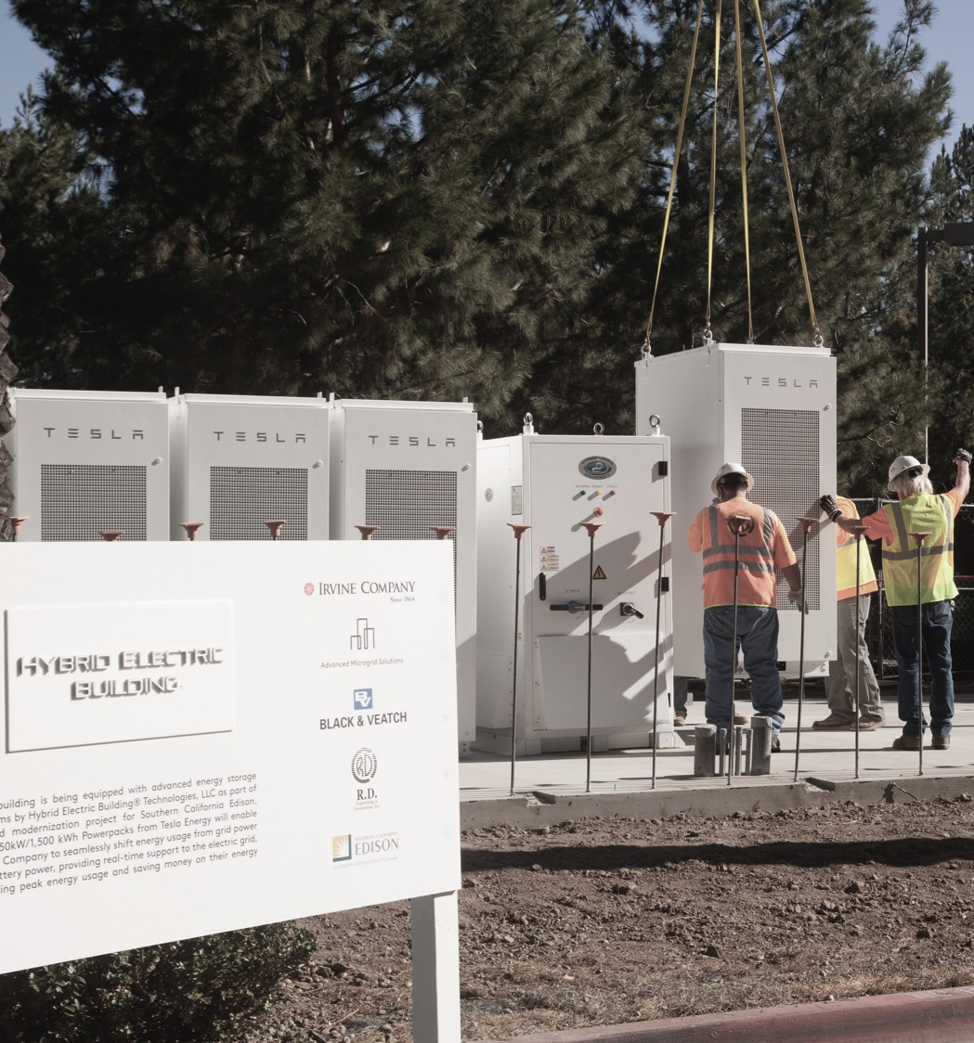
NWA Suitability: Resiliency & Microgrids
For Discussion Purposes:
NY Joint Utilities Distribution System Planning Engagement Group

Slide 2
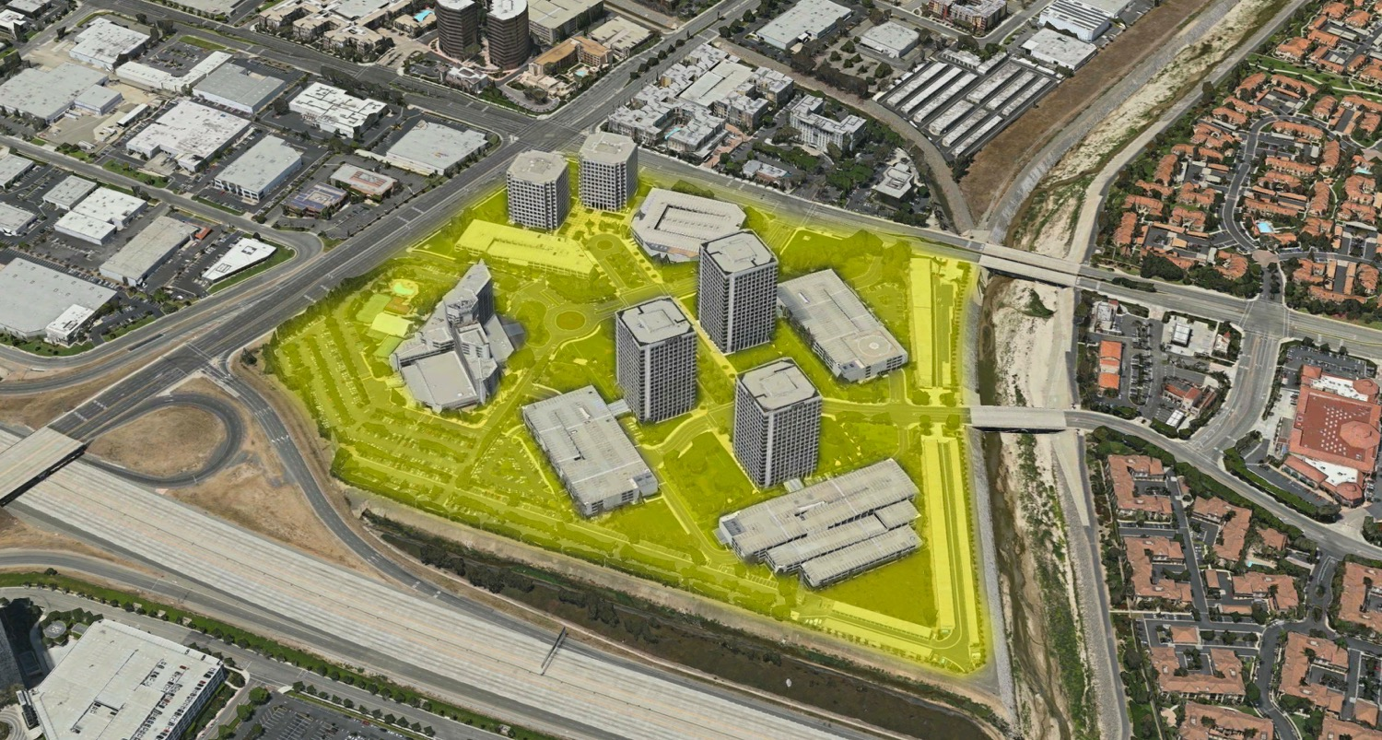
HYBRID ELECTRIC BUILDINGSTM AS VIRTUAL POWER PLANTS
BATTERIES & DG CLUSTERED IN STRATEGIC URBAN LOCATIONS FOR LOAD RELIEF
For Discussion Purposes: NY Joint Utilities Distribution System Planning Engagement Group

Slide 3
EXTEND HYBRID ELECTRIC BUILDINGS TO MICROGRID
LOAD RELIEF FOR THE UTILITY 99% OF THE TIME – ISLANDED 1% FOR RESILIENCY
For Discussion Purposes: NY Joint Utilities Distribution System Planning Engagement Group

Slide 4
BATTERY STORAGE – MULTIPLE USES AND USERS
APPLICABILITY FROM LOAD RELIEF TO RELIABILITY/RESILIENCY
LARGE POWER USERS
DISTRIBUTED RESOURCE AGGREGATOR
UTILITIES / GRID OPERATORS
GRID EDGE SERVICES
DISTRIBUTION SERVICES
AMS
ARMADA
SOFTWARE
DISTRIBUTION SERVICES
Demand Management
Energy Cost Reduction
GHG Reduction
Energy Islanding/
Critical Loads
Demand Response Revenue Generation
Solar Integration
EV Charging Integration
Firm, Dispatchable Capacity
Dynamic Load Management
Volt/VAR Optimization
Conservation Voltage Reduction (CVR)
Reliability/Resiliency
Wholesale Energy Market Products:
-Day Ahead
-Real-Time
-Frequency
Demand Management
Energy Cost Reduction
GHG Reduction
Energy Islanding/
Critical Loads
Demand Response Revenue Generation
Solar Integration
EV Charging Integration
For Discussion Purposes: NY Joint Utilities Distribution System Planning Engagement Group

Slide 5
THIRD PARTY PROJECT FINANCE
VENTURE INVESTORS
PROJECT INVESTORS
DBL
ENGIE
Other
Equity
Investor
Debt
Investor
LLC1
AMS
LLC1
LLC4
Utility
Contract
Resiliency
Payments
LLC2
LLC3
Incentives
Site
Lease
PROJECT ENTITIES
PROJECT REVENUES
For Discussion Purposes: NY Joint Utilities Distribution System Planning Engagement Group

Slide 6
LOCATIONAL VALUE OF RESILIENCY
Load Relief applicability during normal grid operations:
Microgrids can help utilities defer T&D upgrades and/or maintenance
Microgrids enable increased penetration of DG in general and specifically renewable generation which is monetizable with RECs, SRECs, RGGI, (and FLECs)
Resiliency value during grid disruption & emergency events:
Microgrids (assuming recip engine prime mover) can provide Ancillary services, including black start to the broader grid
Help critical customers/facilities stay operational in storm/resiliency events
For Discussion Purposes: NY Joint Utilities Distribution System Planning Engagement Group

