Slide 1
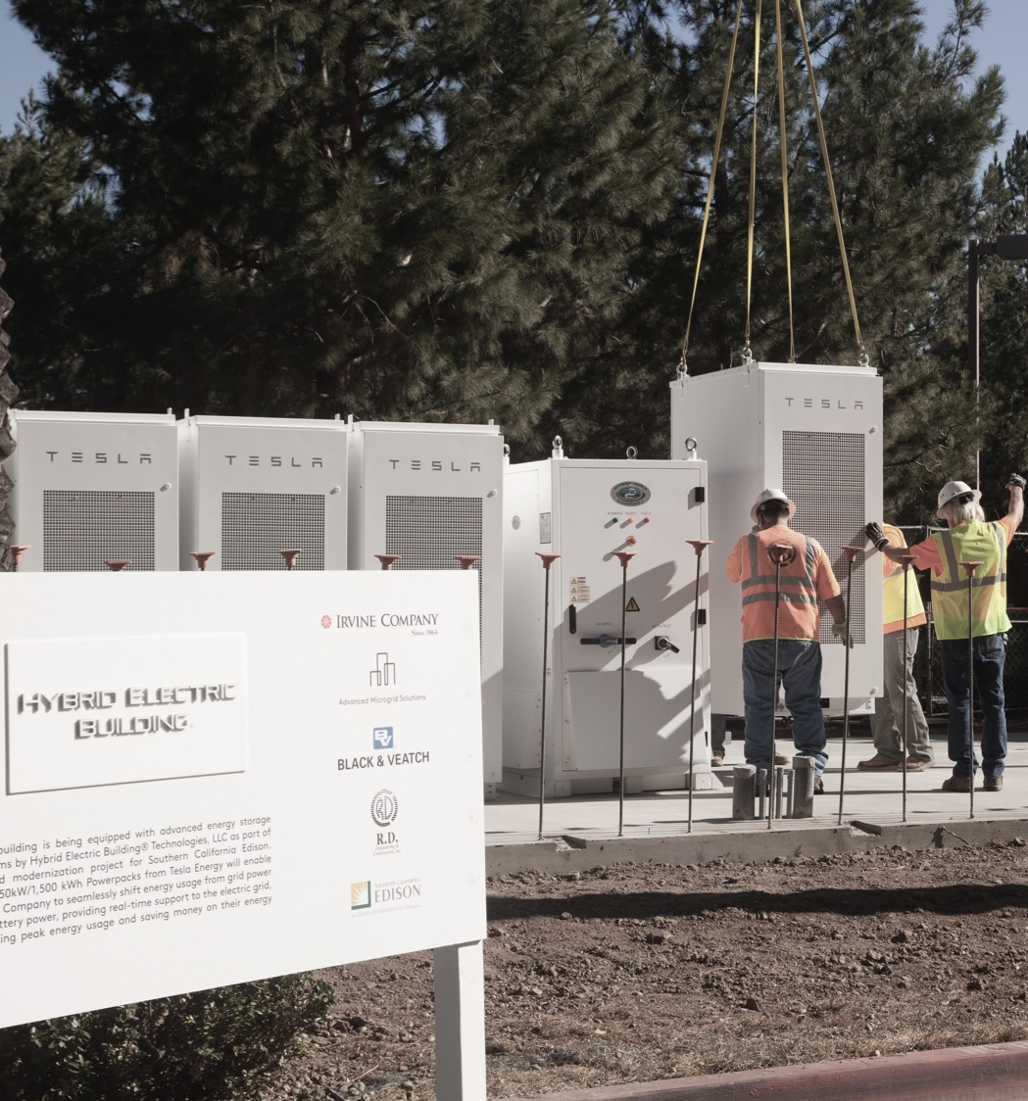
NWA AND STORAGE PROCUREMENT SUGGESTIONS
For Discussion Purposes:
NY Joint Utilities Distribution System Planning Engagement Group

Slide 2
NWA AND STORAGE PROCUREMENT SUGGESTIONS
Current Situation – BQDM example
Con Edison’s adjustment from 8-12hr resources to a portfolio of 2-4hr resources enabled broader, more robust participation by DER
The pending auction mechanism is a smart evolution of the initial BQDM resource procurement
However, limiting the procurement horizon to 2017 & 2018 means that storage and other high capital cost DERs are effectively out of BQDM completely or out at a meaningful scale
Expanding the procurement horizon is the next logical progression
For Discussion Purposes: NY Joint Utilities Distribution System Planning Engagement Group

Slide 3
NWA AND STORAGE PROCUREMENT SUGGESTIONS
Staggered Maturity Strategy
Staggered maturity is a foundational principal of financial and commodity portfolio management
For example, Fidelity’s “bond ladder“ strategy:
For Discussion Purposes: NY Joint Utilities Distribution System Planning Engagement Group
Source - https://www.fidelity.com/viewpoints/bond-ladder-strategy

Slide 4
NWA AND STORAGE PROCUREMENT SUGGESTIONS
Staggered Maturity Strategy
This is also a common practice in our own industry to manage energy commodity price risk management
NWA Portfolio Risk Management:
Utilities could apply staggered maturity to NWA portfolio procurements, or even to the BQDM auction, by adding the intermediate- and long-term dimension
Utilities could buy a portfolio of NWA solutions layered into a staggered maturity portfolio to manage risk by diversifying technology-type, and contract start dates and term
Storage plays well at today’s prices in a 10- to 15-year term
For Discussion Purposes: NY Joint Utilities Distribution System Planning Engagement Group

Slide 5
NWA AND STORAGE PROCUREMENT SUGGESTIONS
Staggered Maturity Procurement Benefits:
Market animation stimulus for capital-intensive DER to help cross the chasm to a post-REV world
Management of NWA portfolio technology and price risk
Dynamic adaptation well suited to the accelerating change at the grid-edge (smart grid/IoT)
For Discussion Purposes: NY Joint Utilities Distribution System Planning Engagement Group

