Slide 1
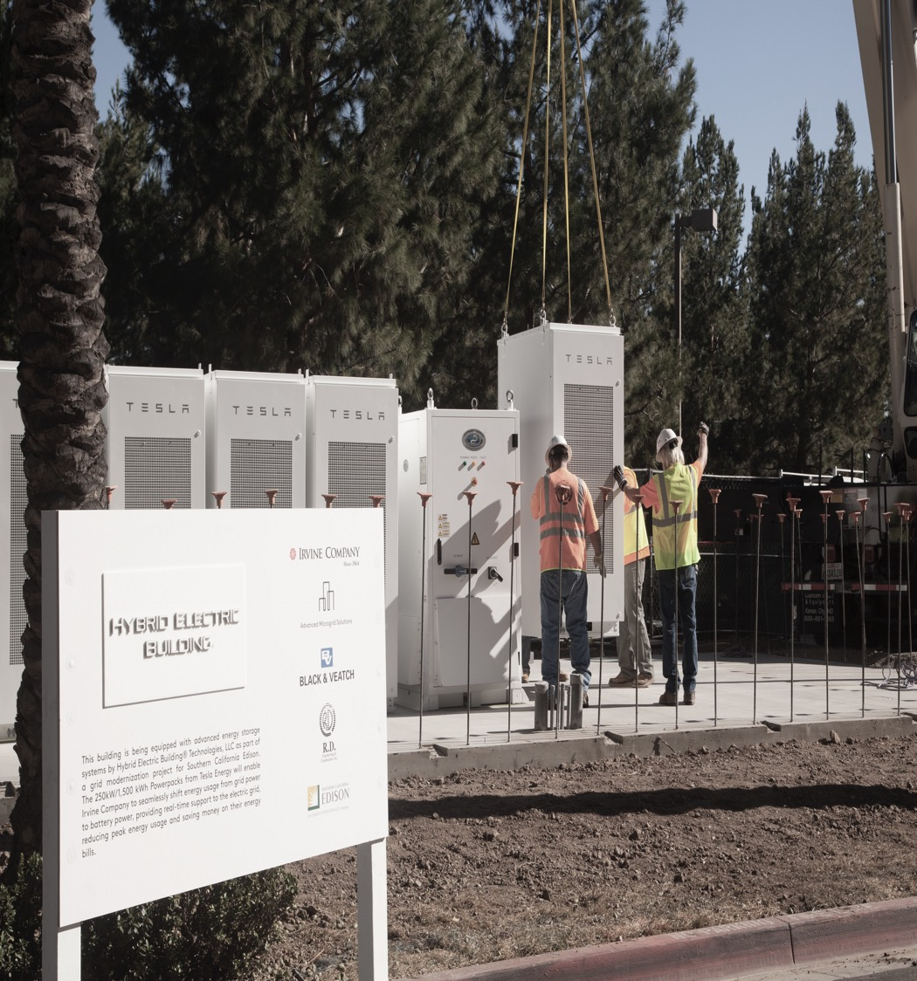
Mike Jackson
Market Development
mikej@advmicrogrid.com
508.259.0260
NWA AND STORAGE PROCUREMENT SUGGESTIONS
For Discussion Purposes – 6/13/16:
NY Joint Utilities Market Ops. Engagement Group – DER Procurement

Slide 2
NWA AND STORAGE PROCUREMENT CHALLANGES
#1 - Financeable Revenue Stream(s) for Development:
Long Term
Predictable
Current Situation – BQDM example
Con Edison’s adjustment from 8-12hr resources to a portfolio of 2-4hr resources enabled broader, more robust participation by DER
The pending auction mechanism is a smart evolution of the initial BQDM resource procurement
However, limiting the procurement horizon to 2017 & 2018 means that storage and other high capital cost DERs are effectively out of BQDM completely or out at a meaningful scale
Expanding the procurement horizon is the next logical progression
For Discussion Purposes: NY Joint Utilities Market Ops. Engagement Group – DER Procurement
Notes:
What types of NWA DER procurement processes are most important and valuable to Stakeholders?
What are the most important characteristics of those solicitation and procurement process for non-wires solutions?
What types of standardization in NWA procurement solicitations and contracts would Stakeholders like to see?
What are the key business drivers, from Stakeholders’ perspective, for the types of procurement approaches, standardization, timing and terms?
What are the most significant challenges you see associated with NWA DER procurement as we move forward in the REV process?

Slide 3
NWA AND STORAGE PROCUREMENT SUGGESTIONS
Staggered Maturity Strategy
Staggered maturity is a foundational principal of financial and commodity portfolio management
For example, Fidelity’s “bond ladder“ strategy:
For Discussion Purposes: NY Joint Utilities Distribution System Planning Engagement Group
Source - https://www.fidelity.com/viewpoints/bond-ladder-strategy

Slide 4
NWA AND STORAGE PROCUREMENT SUGGESTIONS
Staggered Maturity Strategy
This is also a common practice in our own industry to manage energy commodity price risk management
NWA Portfolio Risk Management:
Utilities could apply staggered maturity to NWA portfolio procurements, or even to the BQDM auction, by adding the intermediate- and long-term dimensions
Utilities could buy a portfolio of NWA solutions layered into a staggered maturity portfolio to manage risk by diversifying technology-type, and contract start dates and term
Storage plays well at today’s prices in a 10- to 15-year term
For Discussion Purposes: NY Joint Utilities Market Ops. Engagement Group – DER Procurement
Notes:
Laying in staggered maturity for commodity price risk management:
e.g., strategic objective – 80% hedged 1 yr prior, for budget certainty
Quarterly electricity hedge buys – dollar cost averaging:
20% through end of yr 4
40% through end of yr 3
60% through end of yr 2
80% through end of yr 1

Slide 5
NWA AND STORAGE PROCUREMENT SUGGESTIONS
Staggered Maturity Procurement Benefits:
Market animation stimulus for capital-intensive DER to help cross the chasm to a post-REV world
Management of NWA portfolio technology and price risk
Dynamic adaptation well suited to the accelerating change at the grid-edge (smart grid/IoT)
For Discussion Purposes: NY Joint Utilities Market Ops. Engagement Group – DER Procurement

