Slide 1
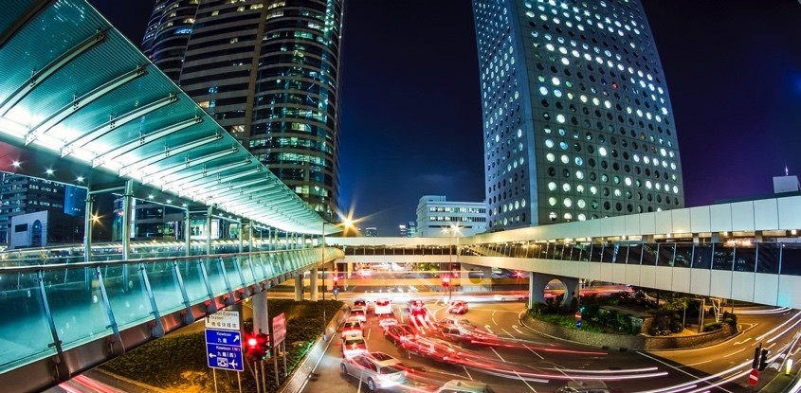
NY Joint Utilities Grid Operations Engagement Group July 28, 2016
Automated and Integrated DER Management
Grid Operations and Planning
Scott Koehler – VP Global Strategy, SGIT
scott.koehler@schneider-electric.com

Slide 2
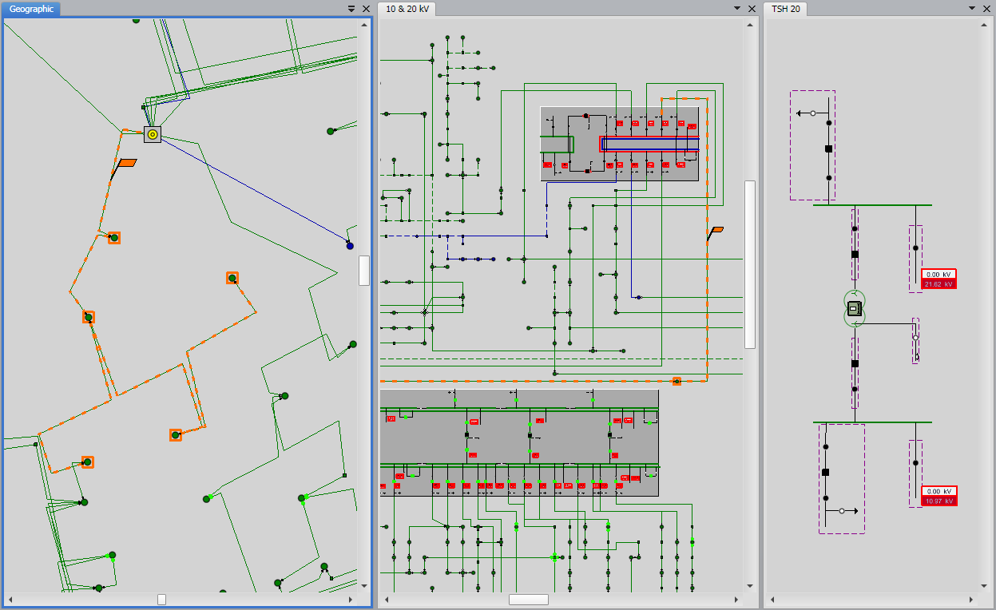
Situational Awareness
Network visualization
Realtime and offline
Simulation scenarios
Power forecasting
Historical analysis
Dashboard reporting
Geographic View
Schematic View
Station View

Slide 3
Unified Application Examples
Optimize
Operate
Analyze
Monitor
Plan
Simulate
Real-time Simulation
Off-line Simulation
What-if Analysis
Historical Playback
Network Reinforcement
Optimal Device Placement
DG & EV Connections
Medium & Long-term Power Forecasting
Load Flow
State Estimation
Fault Analysis
Reliability Analysis
Relay Protection
Energy Losses
Historical Analysis
Volt/VAR Optimization
Network Reconfig
Near & Short-term Power Forecasting
Demand Response
Distributed Energy
Telemetry
Alarming
Tagging
Trending
Reporting
Fault Management
Switch Management
Crew Management
Under-load Switching
Large Area Restoration
Load Shedding

Slide 4
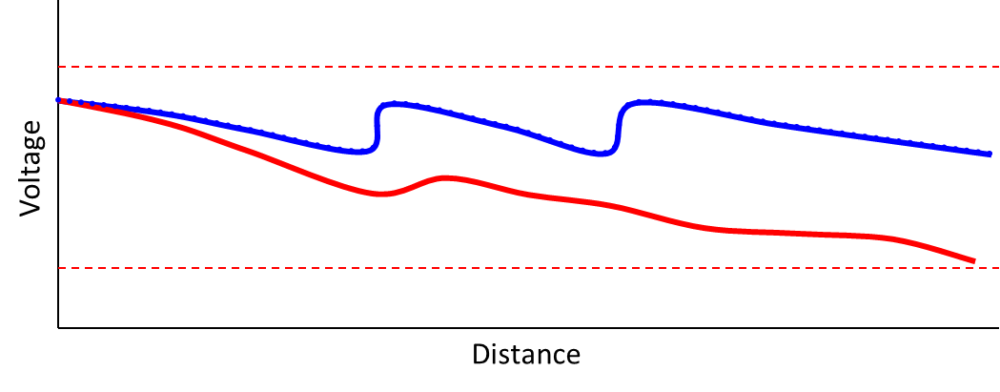
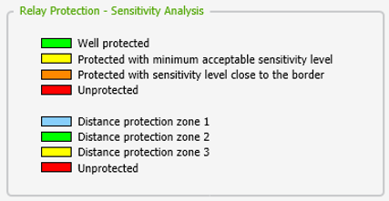
DER in Advanced Operations Applications
Network Reconfiguration
Objectives – Feeder load balancing, Transformer load balancing, Minimize energy losses, Reliability
Volt/VAR Optimization
Objectives - Power consumption reduction, Energy losses reduction, Customer voltage improvement, Medium voltage improvement, Power factor improvement, Minimized operations cost
FLISR and Large Area Restoration
Planned and unplanned switching operations
Adaptive Relay Protection
Protection Relays – Overcurrent, Distance, Differential, Reclosers and Fuses
Modes – Operation, Sensitivity, Coordination and Settings
Distributed Energy Resources Management
Modeling, monitoring and optimized dispatch of DER
Network Planning
Applications – DER Connections, Power Forecasting, Network Reinforcement, Network Automation, Capacitor and Voltage Regulator Placement

Slide 5
DER Operations Planning Analysis
S1 - State DG_{max}L_{max}
No problem
Cost = 0
S2 - State DG_{min}L_{min}
No problem
Cost = 0
S3 - State DG_{max}L_{min}
S3.1 Volt/VAR Optimization
Cost = $50,000
Voltage problem
S4.1 Conductor Reinforcement
Cost = $620,000
S4 - State DG_{min}L_{max}
S4.2 Reconfiguration & Load Shed
Cost = $1,300,000
Overload problem
S4.3 Volt/VAR/Watt Optimization
Cost = $250,000
S4.4 Energy Storage
Cost = $1,400,000

Slide 6
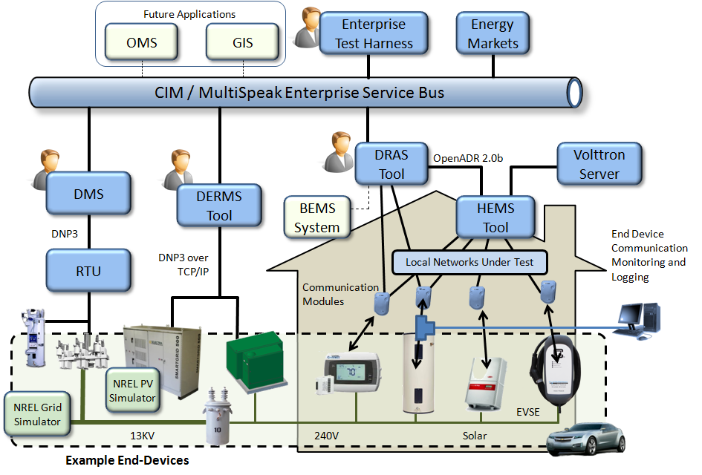
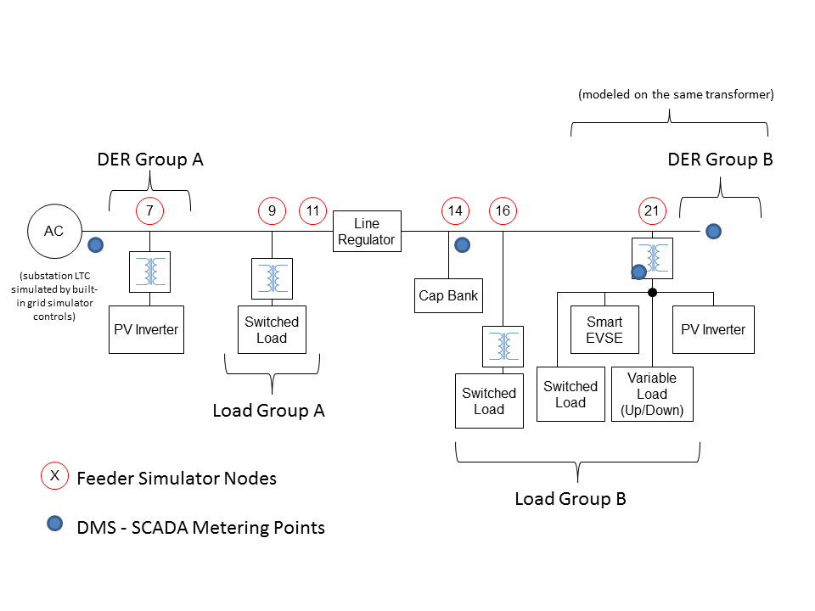
NREL INTEGRATE Project Dispatch of traditional and new grid edge devices
Integrated Network
Testbed for Energy
Grid Research
and Technology
Experimentation
Schematic view with resource grouping
Current Use Cases
Over voltage
Under voltage
Reverse power flow
Excessive load
VAR support
Future Use Cases
Phantom load
Voltage flicker
Abnormal switching
Voltage hunting
Regulator runaway

Slide 7
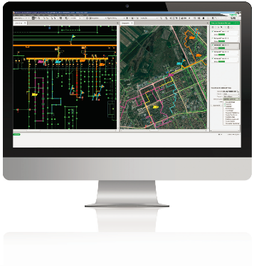
Operations and Demand Response Evolution of Demand Management
Peak load events
Fast-acting DR switching scenarios
DR coordinated with utility operations
Restoration events
Planned and unplanned outages
Cold load pickup
Heat resistive loads
Water heaters
Pre-cooling houses
Isolation switching
Reduce load in targeted areas
Architecture examples
Utility direct load control (i.e. SCADA comms)
Integration with utility DRMS
Integration with 3rd party DRMS solutions
Integration examples
Maintain DR customer list/groups
Communicate when DR events are occurring
M&V reporting of demand response events
DRMS sharing DR forecasts (contract limitations)

Slide 8
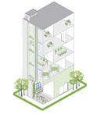
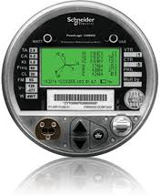
Operations and DER/DR Value Chain Control Center to Customer
C&I DER/DR
-C&I event management
-Load profiling
-Energy reporting and analysis
-Bill estimation and scenario modeling
-Realtime pricing programs
-AutoDR signaling via open standards
-Signaling, settlement, reporting
Aggregated DER/DR
-DR portfolio management
-Residential event management
-Customer interaction tracking
-Rules-based control engine -Customer settlement & M&V
-Coordinate disparate systems
-Capacity forecasting
-Optimized program utilization
-Machine-learning algorithms
Control Center
-Situational awareness
-Network modeling & analysis
-Load & generation forecasting
-Operational dispatch of DR & DER
-Realtime & historical reporting of operational performance
-Coordination with VVO & FLISR
-Management of work orders issued to the field
Commercial & Industrial
-Signaling
-Real-time feedback
-Load status
-Price conveyance
-Grid connectivity via open standards
-Facility automation for DR
-Grid-optimized facilities & processes
-DR strategy development
C&I
$
$
ISO
SGIT Platform
Aggregated
Residential
Residential
-Operational energy management
-Benchmarking, performance, planning

Slide 9
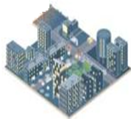
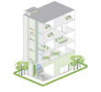
Managing Microgrids Support for varying microgrids sizes and customer types
“Central” Microgrid Control
“Local” Microgrid Control
ADMS with DERMS
-Network modeling & analysis
-Situational awareness
-Load & generation forecasting
-Operational dispatch
-DER & DR events
-Coordinated with VVO, FLISR, Relaying
-Realtime & historical reporting
-Management of field work
-Large microgrids (i.e. >10MW)
-Utility owned & managed microgrids
-Automatic generation control, economic dispatch, unit commitment, interchange transaction scheduler, load and generation forecasting, load shedding
-Grid connectivity via open standards
-Grid-optimized facilities & processes
-Operational energy management
-C&I and residential events
-Portfolio management
-Load profiling and capacity forecasting
-Optimized program utilization
-Price signaling
-Event reporting
-Customer interaction tracking
-Customer settlement & M&V
DSO
-Small microgrids (i.e. <10MW)
-C&I building microgrids
-Customer owned & managed microgrids
-Optimization of DER for C&I sites
-Automatic, tailored for site managers and microgrid managers
-Economic dispatch and predictive analysis
-Provide flexibility as an aggregation layer of prosumer sites
MGC
DRMS

Slide 10
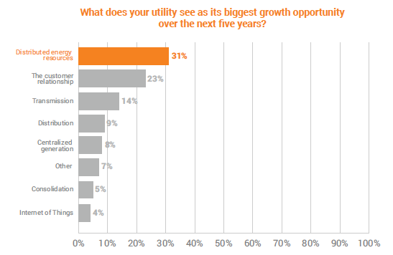
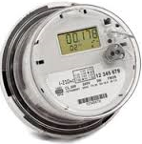
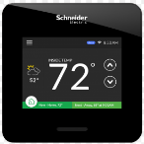
Rich and Meaningful Customer Engagement
Engaging and actionable visualization technologies
Enables customers to be active participants in new energy economy
Automated and responsive facilities with customers in control
Smart thermostats, building automation systems, prosumer technologies
Targeted demand response
Limit customer exposure to unnecessary events
Benefits
Improved customer satisfaction scores and relationships
More accurate and effective load management programs
Enables service model for “utility of the future”
“Utilities will move away from the traditional, vertically integrated utility model towards a more distributed, service-based model.”

