Slide 1
JU Market Ops EG – EVSE Presentation
August 30, 2016

Slide 2
ChargePoint Policy Activity in New York
ChargePoint has been engaged in New York EV policy development since its inception, including:
NYPSC’s first Declaratory Ruling on an exemption from regulation of EV Charging services
REV Comments, Reply Comments
Clean Energy Fund Comments, Reply Comments
NY Green Bank Support Funding Comments
NYSERDA Grant programs, including recent collaboration with CalSTART Cleaner Greener Communities; partnership with National Grid
NYSERDA letter of support for E3 Cost benefit analysis for Utility role in EV Charging/NYS
NYSERDA NYS Grid- Interactive Vehicle Study Vermont Energy Investment Corporation
ChargePoint America ARRA funding to NYC Fleet
ChargePoint has recently helped to raise the profile of EV/EVSE issues through:
Collaborating with intra-industry stakeholders with a letter to legislators supporting the recent EV rebate in the NYS Budget;
Publishing op-eds highlighting the need to expand support for EVs and EVSE with EV Rebate (Albany Times Union; Crain’s)

Slide 3
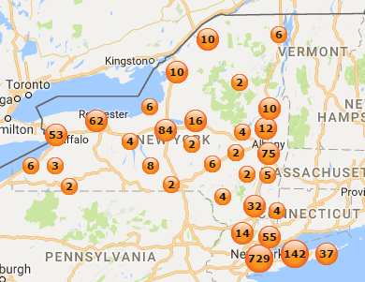
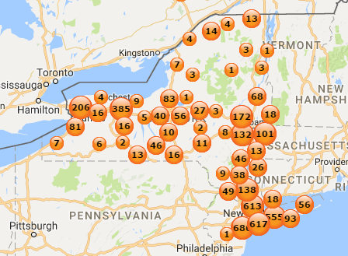
ChargePoint Stations & Drivers in New York
1,409 charging ports
4,555 ChargePoint drivers
Why People Register:
Cards come with vehicles
Easy access to charging stations
Easy payments Alerts for:
Vehicle charged
Plug out
Ground fault

Slide 4
BMW/VW Express Corridor Program: UN Award

Slide 5
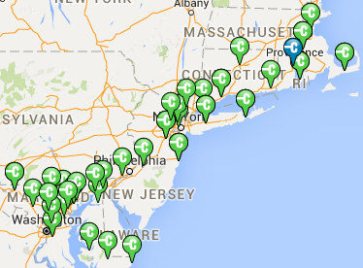
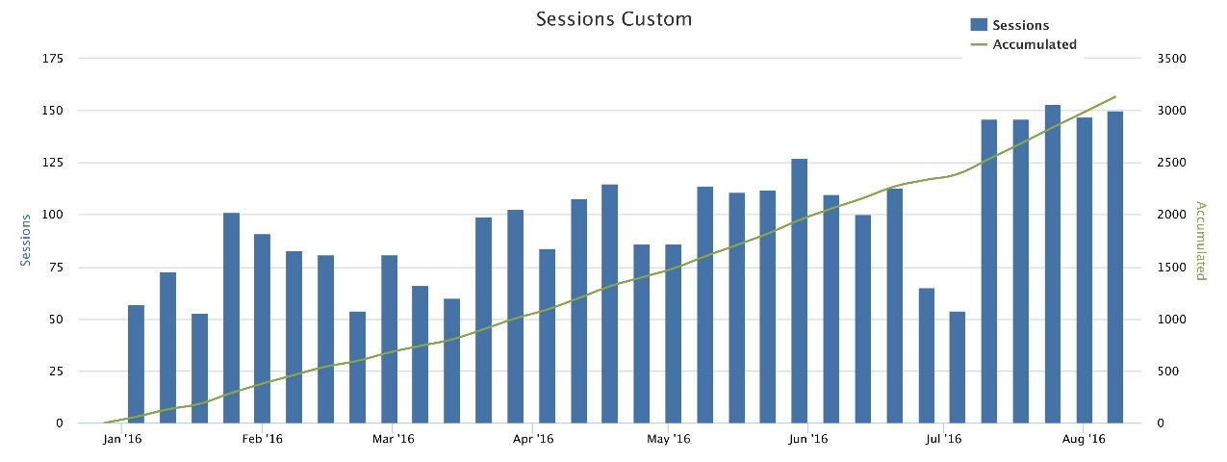
BMW / VW East Coast Corridor Statistics
Total Sites | 35
Total Stations | 45
24KW Stations | 26
50kW Stations | 19
East Coast Sessions Since 1/1/16

Slide 6
NYPSC – Case 13-E-0199
ELECTRIC VEHICLE CHARGING STATIONS ENCOURAGED
PSC Removes Obstacle to New Investments in Charging Stations —Albany, NY—11/14/13
NYPSC Found that Commission does not have jurisdiction over:
Charging stations;
The owners or operators of charging stations;
The Transaction between such owners or operators of charging stations and members of the public
The Commission’s determination, however, does not diminish its ability to respond to changes in the market in which charging stations operate.

Slide 7
States with Utility Exemption for Charging
Washington
Montana
North Dakota
Maine
Oregon
Idaho
Minnesota
Vermont
New
Hampshire
South Dakota
Wisconsin
Massachusetts
New York
Wyoming
Michigan
Rhode Island
Connecticut
Nebraska
Iowa
Pennsylvania
New Jersey
Nevada
Ohio
Maryland
Utah
Illinois
Indiana
Delaware
Colorado
West
Maryland
California
Kansas
Missouri
Virginia
Virginia
District of Columbia
Kentucky
Tennessee
North Carolina
Arizona
Oklahoma
Arkansas
South Carolina
New Mexico
Mississippi
Alabama
Georgia
Allowed
Docket Opened
Targeted for 2016-2017
TBD
Hawaii
Texas
Hawaii
Louisiana
Florida
0
500 Miles
0
500 KM

Slide 8
Guidelines/Opportunities REV Demo Projects
#1: REV demonstrations should include partnership between utility and third party service providers. These partnerships may be unique to each demonstration depending on the situation
#3: Demonstrations should delineate how the generated economic value is divided between the customer, utility, and third party service provider(s). The demonstrations should propose how much of the projected capital expense needs to go into the rate-base versus competitive markets
#8 : Utilities should explore opportunities in their demonstrations to work with and include various residential, commercial, institutional and industrial customer participants
#6: Demonstrations should inform pricing and rate design modifications. For example, a component of a trial can test demand response, real time, or time of use pricing to better understand how to motivate different consumers
Partnership will bring business experience that will accelerate the adoption of electric vehicles, provide products and services that will present value to the customer as well as accelerate the development of a market for EV Charging services
One objective of the demonstration will be to bring a proposed cost allocation methodology and cost recovery to the NY PSC for consideration to scale EV adoption in New York going forward
Proposals to enable residential, Multi-Dwelling, workplace customer and low income community participation and target the most critical markets for EV Adoption
EV Charging Demonstration should consider piloting Rate Plans to enable grid efficiencies and participation in Demand Response
It is important to frame this partnership in terms EV Adoption, EV Infrastructure market development and customer needs, as well as, customer choice as both policy outcomes and addressing the need to support EV Infrastructure deployment to scale in the State.

Slide 9
ChargePoint’s Guiding Principles
Utilities should enable customer choice in charging equipment and services. The site host must have the ability to choose, from a list of multiple qualified vendors, the technology they want installed on their own site.
Utilities should set requirements for chargers and grid management capabilities (including demand response) but allow for future innovation by creating a “rolling” vendor certification program. By allowing new technologies to apply for certification mid-program, additional features for network and chargers can be brought to market by vendors to enable competition and differentiation.
Site host should have the ability to control pricing for charging services. This allows pricing to be tailored to the specific driver behavior unique to that site. (Example: free workplace charging vs. need to move drivers at retail sites.)
Site hosts should be required to have “skin in the game” – with the exception of underserved markets or disadvantaged communities. This ensures effective siting and efficient use of ratepayer funding.
Utilities should avoid creating island networks given that a drivers’ network is always going to be larger than a utilities’ territory or a single Commission’s jurisdiction.

Slide 10
White House National Guiding Principles to Promote Electric Vehicles and Charging Infrastructure
Nearly 50 industry members are signing on to the following Guiding Principles to Promote Electric Vehicles and Charging Infrastructure. This commitment signifies the beginning of a collaboration between the government and industry to increase the deployment of electric vehicle charging infrastructure.
Drive the market transformation to electric vehicles by making it easy for consumers to charge their vehicles with grid-connected infrastructure that is accessible, affordable, available and reliable, and interconnected with other low carbon transportation options where feasible
Promote electric vehicle adoption by increasing access to charging infrastructure and supporting the development of plug-in electric vehicles that are as accessible, available, and convenient as gasoline-powered vehicles.
Promote a robust market for vehicle manufactures, utilities, equipment service providers and support industries that ensures a consistent user experience, customer choice, and allows for a streamlined permitting process.
Enhance American manufacturing competitiveness, innovation, and the development of advanced technology.
Attract and leverage private, State, and Federal investment in electric drive vehicle deployment, infrastructure, research and development, and education and outreach.
Enable smart charging and vehicle grid integration through solutions such as demand response, and other energy storage and load management strategies.

Slide 11
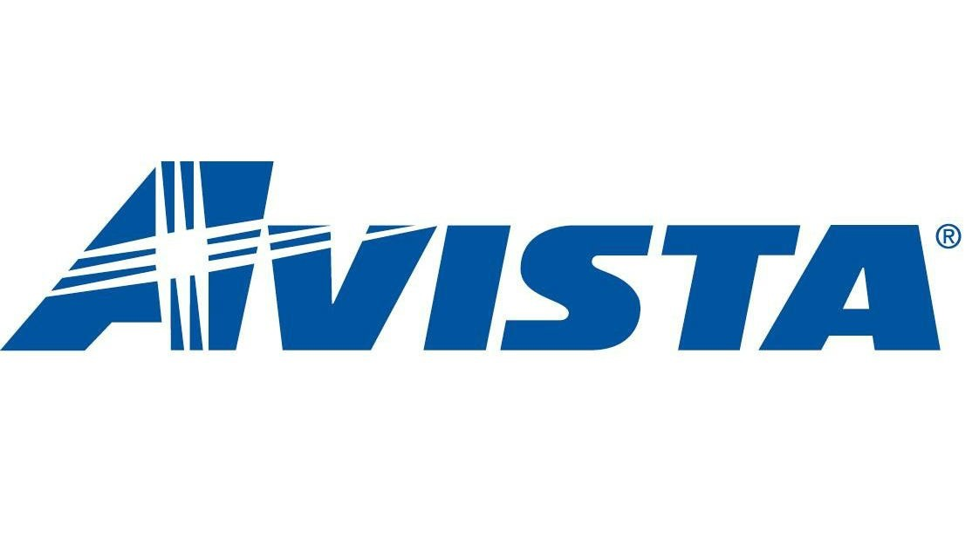
Industry Coalition for EV Charging Principles

Slide 12
Industry Association Created
EVCA is a California-based advocacy organization representing the companies leading EV charging infrastructure, technology and services and working to grow clean transportation.
EVCA represents the companies who are leading the growth of the electric vehicle charging infrastructure, technology, and services industry.

Slide 13
Federal Activity: VW “Dieselgate” Leads to Billion Dollar Opportunity
Administered by Independent Trust for States
Administered by VW
$800 million in ZEV
in California
L2, DCFC, Heavy Duty, High Speed Charging Stations and “Brand-neutral” Education Campaign
$1.2 billion in ZEV Outside of CA
L2, DCFC, Heavy Duty, High Speed Charging Stations and “Brand-neutral” Education Campaign
$2.7 billion Mitigation State Funds
Up to 15% of each state’s allocation on EV charging stations, the rest on ZEV buses, clean trucks and fleet conversions

Slide 14
Appendix D – State Funds for Charging Stations
In addition to the $2 billion in Appendix C for ZEV investments, the VW settlement includes a SEPARATE $2.7 billion for diesel emission mitigation.
This funding is administered by an independent trustee, not VW.
Each state has an allocation ranging from $7.5 million for least impacted states to $381 million for California.
Up to 15% of this funding per state can be used to incentivize the installation of EV charging stations, with priority given to charging installed on government property.
The rest of the “Appendix D” funding can be used to convert or purchase new alternate fueled heavy duty trucks, school buses, transit buses, freight switchers, ferries/tugs, shorepower for ocean going vessels, local fright trucks, airport ground equipment, and forklifts.

Slide 15
Federal Activity FAST Act Corridor Nominations
FHWA requested State and local officials to nominate alternative fuel corridors by August 22nd
Internal task force encouraged State’s and local officials to nominate alt fuel corridors and offer support
Congestion Mitigation and Air Quality Improvement (CMAQ) Program funds will be prioritized for alt fuel corridor deployment
CA, CO, CT, DE, DC, IL, IN, IA, KS, ME, MD, MA, MI, MN, MO, MT, NV, NH, NJ, NY, NC, ND, OK, OR, PA, RI, TN, VT, VA, WI submitted nominations

Slide 16
Pending Activity in New York
Supplemental DSIP
REV Demonstration Projects
FAST ACT DCFC CORRIDOR DESIGNATIONS
ChargePoint grant with CalSTART, Autos, NYC, on urban workplace charging
NYSERDA Vehicle Rebate Program
NYSERDA EV Charging Infrastructure Program
DEC Municipal EV/EVSE Program
Potentially Establishing a New NYPSC Matter

Slide 17
2016: Activity in 32 States & Canada
Washington
Utility role
Grants and financing opportunities
Minnesota
Utility role
Michigan
Utility role
New Hampshire
Authorize charging for charging
Washington
New York
Grants and financing opportunities
EVSE & vehicle incentive
Montana
North Dakota
Maine
Idaho
Utility role
Grants
Minnesota
Massachusetts
Utility role, vehicle incentives
Oregon
Idaho
Vermont
New
Oregon
Utility role
Hampshire
Massachusetts
South Dakota
Wisconsin
Pennsylvania
Vehicle incentive, utility role
CT
Vehicle incentives authorize charging for charging
Utah
Utility role
Vehicle incentive
Iowa
Financing
New York
Wyoming
Illinois
Utility role
Michigan
Rhode Island
Connecticut
Nebraska
Iowa
Pennsylvania
New Jersey
Nevada
Kansas
Utility role
Maryland
State taskforce
Rhode Island
Authorize charging for charging
Nevada
Authorize charging for charging
Utility role
Missouri
Utility role
Vehicle incentive
Ohio
Delaware
Utah
Colorado
Vehicle incentive
Illinois
Indiana
Maryland
Colorado
West
Virginia
Vehicle incentive
California
Virginia
Delaware
Grants
Kansas
Missouri
Virginia
New Jersey
EVSE incentives
California
Utility role
Grants and financing opportunities
Charging station incentive
Vehicle incentive (HOV lane access)
Building codes
Kentucky
Kentucky
Utility role
North Carolina
Arizona
Oklahoma
Tennessee
South Carolina
Utility role
Vehicle incentive
Arkansas
Alabama
Utility Role
South Carolina
New Mexico
Mississippi
Alabama
Georgia
Louisiana
Authorize charging for charging
Georgia
Utility role
Vehicle incentive
Texas
Hawaii
Texas
Utility role
Louisiana
Hawaii
Utility role
Florida
0
500 Miles
Florida
Utility role
Vehicle incentive
0
500 KM

Slide 18
Appendix – Examples of Applied Guiding Principles

Slide 19
Examples of Applied Guiding Principles (1)
Principle | Reference | Date Approved | Language
Minimize cost and maximize benefits to all ratepayers | Utah SB 115 | Signed into law on March 29, 2016 | 54-20-103. (2) The commission may review the expenditures made by a large-scale electric utility for the program described in Subsection (1) in order to determine if the large-scale electric utility made the expenditures prudently in accordance with the purposes of the program.
 | Oregon SB 1547 | Signed into law on March 8, 2016 | (3) of this section, the commission shall consider whether the investments and other expenditures: (b) Are prudent as determined by the commission;
 | California SB 350 | Signed into law on Oct 7, 2015 | Sec 32 (2)(b) Programs proposed by electrical corporations shall seek to minimize overall costs and maximize overall benefits.
 | Washington HB 1853 | Signed into law on May 11, 2015 | Sec 2 (1) the commission may allow an incentive rate of return on investment on capital expenditures for electric vehicle supply equipment that is deployed for the benefit of ratepayers, provided that the capital expenditures do not increase costs to ratepayers in excess of one-quarter of one percent.
 | MA EV Charging Stakeholders | Letter signed Nov 9, 2015 | The DPU should request that utilities submit proposals...to install electric vehicle charging infrastructure...that... [a]llocate infrastructure investment costs through properly designed distribution rate structures that recognize grid and customer benefits that will lead to lower overall costs...

Slide 20
Examples of Applied Guiding Principles (2)
Principle | Reference | Date Approved | Language
Enable customer choice in EV charging equipment and services | Utah SB 115 | Signed into law on March 29, 2016 | 54-20-103. Electric vehicle incentive program. (1) The commission shall, before July 1, 2017, authorize a large-scale electric utility to establish a program that promotes customer choice in electric vehicle charging equipment and service
 | Oregon SB 1547 | Signed into law on March 8, 2016 | Section 20(3)(f) Are reasonably expected to stimulate innovation, competition and customer choice in electric vehicle charging and related infrastructure and services.
 | California SB 350 | Signed into law on Oct 7, 2015 | Public Utilities Code 740.12 (F) Widespread transportation electrification should stimulate innovation and competition, enable consumer options in charging equipment and services, attract private capital investments, and create high-quality jobs for Californians, where technologically feasible.
 | Massachusetts EV Charging Stakeholders | Letter signed Nov 9, 2015 | The DPU should request that utilities submit proposals...to install electric vehicle charging infrastructure...that... enable customer choice in charging equipment and services..."

Slide 21
Examples of Applied Guiding Principles (3)
Principle | Reference | Date Approved | Language
Promote competition | Utah SB 115 | Signed into law on March 29, 2016 | 54-20-103.(1)(c) any measure that the commission determines is in the public interest that incentivizes the competitive deployment of electric vehicle charging infrastructure.
 | Oregon SB 1547 | Signed into law on March 8, 2016 | Section 20(3)(f) Are reasonably expected to stimulate innovation, competition and customer choice in electric vehicle charging and related infrastructure and services.
 | California SB 350 | Signed into law on Oct 7, 2015 | Public Utilities Code 740.12 (F) Widespread transportation electrification should stimulate innovation and competition, enable consumer options in charging equipment and services, attract private capital investments, and create high-quality jobs for Californians, where technologically feasible.
 | Washington HB 1853 | Signed into law on May 11, 2015 | Sec 2. The commission must consider and may adopt other policies to improve access to and promote fair competition in the provision of electric vehicle supply equipment.
 | Massachusetts EV Charging Stakeholders | Letter signed Nov 9, 2015 | The DPU should request that utilities submit proposals...to install electric vehicle charging infrastructure...that... [s]timulate innovation and competition…

Slide 22
Examples of Applied Guiding Principles (4)
Principle | Reference | Date Approved | Language
Support EV adoption for all income levels | Oregon SB 1547 | Signed into law on March 8, 2016 | Sec 20(2)(c) Widespread transportation electrification requires that electric companies increase access to the use of electricity as a transportation fuel in low and moderate income communities;
 | California SB 350 | Signed into law on Oct 7, 2015 | PUC Code 740.12 (C) Widespread transportation electrification requires increased access for disadvantaged communities, low- and moderate-income communities, and other consumers of zero-emission and near-zero-emission vehicles, and increased use of those vehicles in those communities and by other consumers to enhance air quality, lower greenhouse gases emissions, and promote overall benefits to those communities and other consumers.

Slide 23
Examples of Applied Guiding Principles (5)
Principle | Reference | Date Approved | Language
Attract and leverage private investment | Oregon SB 1547 | Signed into law on March 8, 2016 | Sec 20(2)(d) Widespread transportation electrification should stimulate innovation and competition, provide consumers with increased options in the use of charging equipment and in procuring services from suppliers of electricity, attract private capital investments and create high quality jobs in this state;
 | California SB 350 | Signed into law on Oct 7, 2015 | Public Utilities Code 740.12 (F) Widespread transportation electrification should stimulate innovation and competition, enable consumer options in charging equipment and services, attract private capital investments, and create high-quality jobs for Californians, where technologically feasible.
 | Massachusetts EV Charging Stakeholders | Letter signed Nov 9, 2015 | The DPU should request that utilities submit proposals...to install electric vehicle charging infrastructure...that... leverage private capital investment..

Slide 24
Examples of Applied Guiding Principles (6)
Principle | Reference | Date Approved | Language
Innovation | Oregon SB 1547 | Signed into law on March 8, 2016 | Sec 20(2)(d) Widespread transportation electrification should stimulate innovation and competition, provide consumers with increased options in the use of charging equipment and in procuring services from suppliers of electricity, attract private capital investments and create high quality jobs in this state;
 | California SB 350 | Signed into law on Oct 7, 2015 | Sec 32 (F) Widespread transportation electrification should stimulate innovation and competition, enable consumer options in charging equipment and services, attract private capital investments, and create high-quality jobs for Californians, where technologically feasible.
 | Massachusetts EV Charging Stakeholders | Letter signed Nov 9, 2015 | The DPU should request that utilities submit proposals...to install electric vehicle charging infrastructure...that... [s]timulate innovation ..

