Slide 1
Grid Operations Engagement Group
June 30, 2016
Presentation material does not represent the views of the Joint Utilities Engagement Group as the group is still in discussion on these topics. Please do not redistribute this deck.

Slide 2
Agenda
Time | Topic
1:00 – 1:10 | Introductions - Review Purpose & Objectives - Review Ground Rules
1:10 – 1:20 | Review of 6/16 Meeting Highlights - Emerging Themes
1:20 – 2:05 | JU Presentation and Discussion on System Data Security and Confidentiality
2:05 – 2:20 | Break
2:20 – 2:40 | JU Presentation and Discussion - Value Added Information
2:40 – 3:00 | Stakeholder Presentation and Discussion - Value Added Information – NRG
3:00 – 3:45 | System Data areas of potential convergence
3:45 – 4:00 | Summary & Next Steps

Slide 3
Engagement Group Ground Rules*
All stakeholder engagement (Advisory Group and Engagement Group) meetings, webinars and information exchange are designed solely to provide an open forum or means for the expression of various points of view in compliance with antitrust laws.
Under no circumstances shall stakeholder engagement activities be used as a means for competing companies to reach any understanding, expressed or implied, which tends to restrict competition, or in any way, to impair the ability of participating members to exercise independent business judgment regarding matters affecting competition or regulatory positions.
Proprietary information shall not be disclosed by any participant during any stakeholder engagement meeting or its subgroups. In addition, no information of a secret or proprietary nature shall be made available to stakeholder engagement members.
All proprietary information which may nonetheless be publicly disclosed by any participant during any stakeholder engagement meeting or its subgroups shall be deemed to have been disclosed on a non-confidential basis, without any restrictions on use by anyone, except that no valid copyright or patent right shall be deemed to have been waived by such disclosure.
AG & EG discussions will be open forums without attribution and no public documents by the AG or EG will be produced unless publication is agreed upon by the group.
*Ground Rules adapted from the JU Advisory Group

Slide 4
Supplemental DSIP Topics—Based on Final Order
Engagement Groups
Distribution System
Planning
Grid Operations
Market Operations
Interconnection
Hosting
Capacity
System Data
Monitoring &
Control
Granular
Pricing
Customer Data
Demand
Forecasting
NWA
Suitability
Cyber
Security
ISO/DSP Roles, Responsibilities, Interaction
DER Sourcing - Procurement
Electric Vehicle Supply Equipment
Topics
DER Forecasting
Load Flow
Analysis
Probabilistic
Planning
Interconnection Technical Working Group
Currently scheduled Engagement Group topics
Currently scheduled Advisory Group topics

Slide 5
Near Term Schedule (subject to revision)
5/16
5/23
5/30
6/6
6/13
6/20
6/27
7/4
7/11
7/18
8/1
8/8
8/15
8/22
AG
6/1 Albany
7/12 NYC
8/10 NYC
Grid Operations Engagement Group
System Data
5/23
(By Phone)
Kick-off Meeting
6/2 Albany (afternoon)
Types of information most useful to stakeholders
6/16 NYC
Providing useful information,
what and how
6/30 NYC
Addressing
security concerns
7/14 NYC
Monitoring
&
Control*
7/28 Albany
Monitoring
&
Control
8/11 NYC
ISO/DSP Roles, Responsibilities, and Interactions
*Possibility of conference call prior to F2F to provide an additional opportunity for a fuller discussion of this topic

Slide 6
Emerging Themes from Engagement Group
System Data
DER providers expressed a desire for the JU to provide detailed and granular system data, and as frequently as possible to support integration of possible DER solutions
  DER provider system data requests range from more general criteria of needing the right data to enable the provider to plan for, site, and operate to significantly more comprehensive, highly detailed, very granular requests with rationales for the use of the data
JU data availability varies by individual utility, system configuration, technologies employed, and planning needs
  The individual utilities currently do not collect all of the data requested by DERs, nor at the level of detail or frequency requested
  Individual utilities have a significant amount of system data in a variety of formats in filings with the PSC and in various planning documents, for example in individual utility PAR documents filed with the PSC. Some of this data is machine readable This data is not all in machine readable formats
  Individual utility DSIP filings do provide indications of what data is available and where it is available, and in some cases provide the data
  Given non-disclosure agreements, the JU are generally more comfortable providing the available system data to DER providers
The JU have noted that in addition to providing system data to DER providers, safe and reliable grid operation for which they are responsible will necessitate sharing of information and data from DER providers, and that in general the data requested is driven by the specific DER resource(s) connected to the grid

Slide 7
Emerging Themes from Engagement Group
System Data
General agreement that data security and confidentiality are legitimate considerations accompanying provision of some system data
  System data availability can enable malicious actors to attack physical infrastructure or engage in targeted cyber attacks that damage equipment or compromise service reliability, safety, and resilience
  Availability of some types of system and planning data may reveal confidential business plans of key utility customers, and therefore utilities may have business confidentiality reasons to temporarily withhold certain types of data that may be available at another time
  The EG discussed models and protocols for sharing system data to vetted stakeholders but no consensus was reached on how to make data available while still ensuring data security
General agreement that enhancing the transparency of modeling or planning methodologies may reduce the need for specific data request
General agreement that system data collection and provision will be an evolving process over time as the individual utilities make various capital and other investments to collect and standardize data

Slide 8
Emerging Themes from Engagement Group
System Data
General agreement that DSPs are responsible for system planning and maintaining the reliability, resilience, and safety of the grid, while providing opportunities for DER providers to connect to the grid and offer services
In response to DER provider requests for some data, understanding the need behind the data request can facilitate the JU in responding.
  In some cases specific data requested my not be available, may not be available at the level of detail requested, or at the frequency requested. Understanding the driver behind the request may enable the JU to provide alternate data or information to support the intent behind the specific request

Slide 9
Emerging Themes from Engagement Group
System Data
General agreement that JU may provide value-added services or information to DERs
  Definition of ‘value added’ information and services is not firm at this time.
    The PSC has encouraged utilities to seek additional revenue streams, and value added information or services may be responsive to PSC intent.
    Stakeholders, particularly DER providers, have concerns that much of the data they request could be viewed as ‘value added’ and subject to a price in order to obtain it
    There was a general agreement that what is considered “value added” information at one point in time may at a later point evolve into ‘routine’ data or information
  Discussion of pricing ‘value added’ information or services revolved around a cost basis and a market basis. It was agreed that both bases could be used depending on the data, information, or service requested
  DER providers would like some level of predictability with respect to what data, information, and services would be considered “value added” and what the price would be
    The JU are currently considering approaches on this issue and are not yet able to provide this information

Slide 10
System Data Security and Confidentiality
Grid Operations Stakeholder Engagement Group
June 30, 2016

Slide 11
Outline
Overview of System Data Security and Confidentiality Concerns
Evolution of Risks Expected Under a REV Environment
  Technology advancements and greater system connectivity
  Potential increased risk to physical security of infrastructure and possible responses
  System data security concerns, potential cyber solutions, and implications for system data security

Slide 12
Overview of Security and Confidentiality Concerns Related to System Data
Damian Sciano, ConEd

Slide 13
What This Presentation will Address
System Data - YES
System Cyber Architecture/Connectivity - LIMITED
Customer Data - NO

Slide 14
Why is this topic important?
Broad availability of system data combined with ease of access creates vulnerabilities, increases risk to the entire grid system.
Vulnerabilities and risks can be mitigated – but not completely – this presentation will highlight potential measures to reduce vulnerability and risk, while making system data available to DERs.

Slide 15
Evolution of Risks Expected Under REV
Maria Scheller, ICF
Terry Walsh, ConEd

Slide 16
Promise of Advanced Technologies and Greater System Connectivity
Data availability
  More data
  More accessible data
Targeted analysis
Enhanced system control
Greater system efficiency

Slide 17
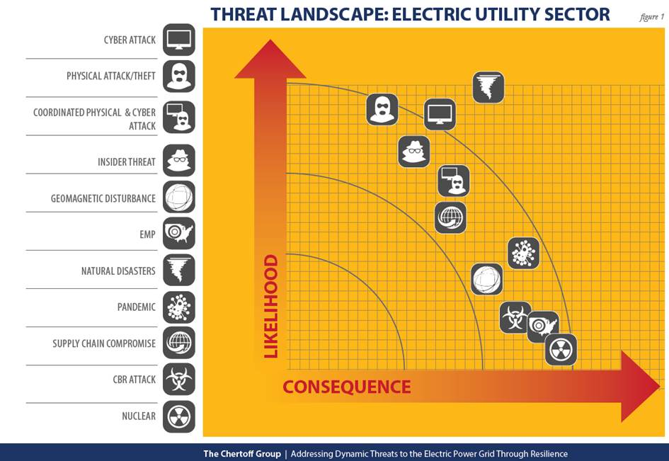
A Breadth of Threats affect the Distribution System

Slide 18
Promise and Peril of Advanced Technologies and Greater System Connectivity
Increased risk associated with ease of access to widely available data on interconnected networks.
  Physical – targeted attacks on specific area and neighborhoods, or critical facilities (e.g. police/fire stations)
  Cyber – cyber attacks and combined cyber/physical attacks targeting physically connected Grid assets
  Confidentiality and Privacy – Own and customer business planning; customer data
Potential consequences of an attack
  Recovery risks (length of time, cost)

Slide 19
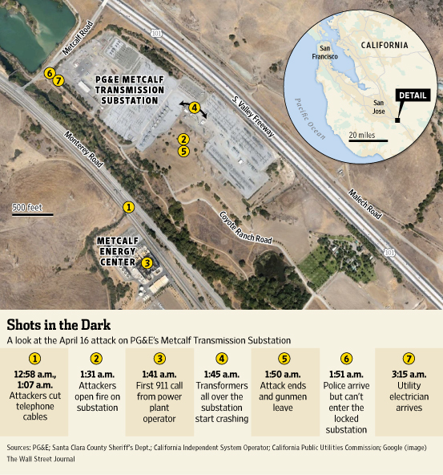
Physical Risk – Metcalf Substation Attack April 16, 2013
Awareness of system and circuit information opens doors to harmful situations.
Preventative measures help limit exposure
  Monitoring physical assets
  Limit data access
Responsive measures help limit consequences
  17 transformers were damaged, requiring over $15 million worth of repairs
  No loss of power

Slide 20
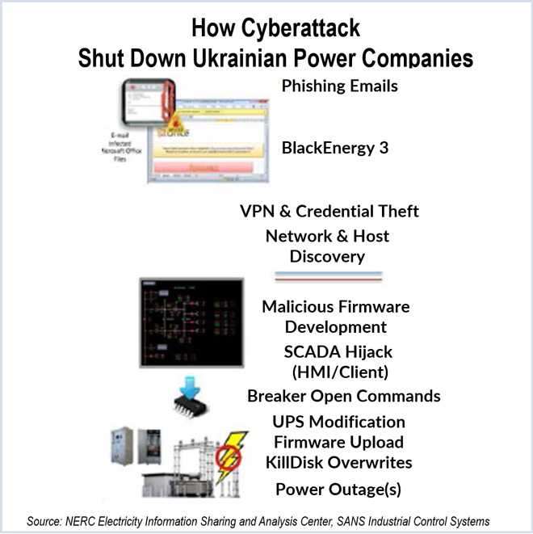
Cyber Risk - Attack on Ukrainian Power Grid December 2015
Event Sequence on December 23, 2015
Attackers entered the SCADA network through hijacked VPNs
Issued commands to disable UPS
Initiated Telephone DoS
Overwrote firmware on sub-station serial-to-Ethernet converters, preventing remote M&C
Began opening breakers on the system and took substations off
Used KillDisk Malware to wipe files from operator stations at around 5 pm

Slide 21
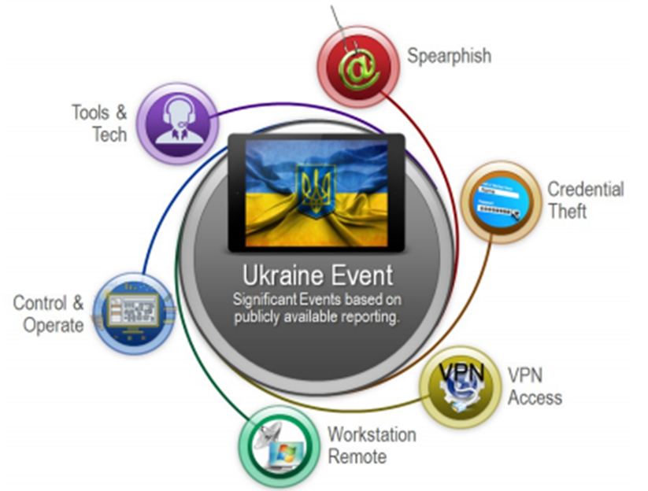
Cyber Risk - Attack on Ukrainian Power Grid December 2015
Multiple Systems Impacted
Coordinated attack on 3 distribution companies
225,000 customers lost power for up to 6 hours
Restoration efforts were admirable
Preventative and detective efforts were lacking
  The companies’ firewalls allowed the adversaries to exercise remote control
  Lack of basic two‐factor authentication
  No system traffic monitoring

Slide 22
Distribution System Data Access Increases Exposure
Targeted attacks:
  Political or personal attacks
  Business anti-competitive attacks
Confidential / competitive information
  Info regarding competitor’s business planning
  Customer data / privacy

Slide 23
Options for Minimizing Vulnerability
Area | Selected Currently Available Options | Selected Options That R&D Could Make Available
Physical vulnerability | Hardening of key substations and control centers | Improved intrusion sensors
 | Increased physical surveillance | Development of strategies to provide greater system capacity
 | Addition of networked lines/radial loops that can prevent domino-like collapse | Greater use of distributed generation and micro-grids
 | Limit access
Cyber vulnerability | Elimination of all non-essential pathways to external systems | Improved cyber security for sensors, communication, and control systems
 | Use of high-quality cyber security on all links | Systems to monitor for, and help avoid, operator error
 | Improved personnel training | Improved training simulations
 | Standardized use of risk assessment application | Improved standards and guidelines
 | Limit access; strong authentication where access exists
Increased Resiliency / Accelerated Restoration | Expanded and more selective demand-side management | Lower-cost undergrounding
 | Expanded use of distribution automation | Improved probabilistic vulnerability assessment
 | Expanded planning for large outages | Improved sensors, communication, real-time analysis, and system visualization
 | Designate utility employees as first responders. | Improved automatic control
 |  | Improved capability for islanding and self-healing
 |  | Improved energy storage
 |  | Development and stockpiling of restoration transformers and other key equipment of long lead time
 |  | Improved assessment and planning tools
Source: Adapted from Terrorism and the Electric Power Delivery System, National Academy of Sciences.

Slide 24
JU Team Established to Address Cyber Risk
National Grid, Central Hudson, Consolidated Edison, and O&R participated
Mission and Vision
  Develop JU REV Cybersecurity & Privacy Framework
  Provide appropriate advice & guidance to the supplemental DSIP working groups on matters concerning cybersecurity and privacy
Team Strategy
  Incorporate risk assessments as a core principal
  Utilize best practices from existing standards and frameworks to ensure all elements or domains of security and privacy are addressed
  Incorporate vendor assessments on a regular basis
  Framework is at a high level and each utility will include a description of it’s implementation of that framework in the DSIP filing.

Slide 25
Current State
Initial framework has been developed
  References NIST Cybersecurity Framework for risk
  References multiple frameworks for cybersecurity policy
  References Fair Information Practice Principals (FIPPs) for privacy
Each member utility responding with their implementation of this framework
Team will implement updates as DSIP response feedback from stakeholders offers opportunities
Work toward November 2016 Supplemental DSIP submission

Slide 26
Challenges
Energy assets not owned by utilities
Energy assets not located on utility property
The use of the Internet in communicating with energy assets
The use of cloud computing for vendor offerings
Ensuring the protection of customer information while sharing with vendors

Slide 27
Examples of Common Cyber Attacks and Defenses
Need for common or coordinated security and data access protocols as well as standardized practices across all organizations seeking access to the grid
  Public internet access to industrial control system (ICS) facilitated a breach of systems – example high profile breaches occurred at a US Crime Lab, a Dam, the Sochi Olympic stadium, and numerous water utilities
    Solution: isolate ICS networks from public and business operations networks
  Failure to segregate the corporate and control networks caused a security breach at a pipeline operator
    Solution: isolate ICS networks from business networks
  Failure to require secure remote access enabled BlackEnergy intrusions onto various ICSs
    Solution: require remote access to be operator controlled, time limited, and procedurally similar to ‘lock-out, tag-out’

Slide 28
Risk Reduction Model: Application, Adoption of IT System Protocols, and NDA
Application to access system data and non-disclosure agreement
  Pre-identified data for which application is required
  Provides identity of requestor and the requestor’s organization affiliation
  Defines the data for which access is being requested and requests specific information from the requestor depending on the data requested
  Requests the intended use of the data from a standardized list of uses
  Requires adoption of certain cybersecurity protocols and standards
  Requires signed NDA to process the application

Slide 29
Discussion Questions
For DER Providers and Other Stakeholders
  As a DER what potential advantages and/or challenges do you foresee with this type of approach to granting access to certain system data?
For DSPs
  What are the advantages and potential challenges/disadvantages to the DSP of implementing this type of model?
  What system data would potentially be covered?

Slide 30
JU Presentation and Discussion
Value Added Information
Grid Operations Stakeholder Engagement Group
June 30, 2016

Slide 31
Outline and Agenda
What is value added information?
Examples of Value Added Information in Context of System Data
  Examples of value added information
Process Options for Sharing Value Added Information
Summary JU Position

Slide 32
What is Value Added Information?
One Definition
  Data that has been aggregated, analyzed, and/or transformed into a higher order product to answer identified questions or solve identified problems
Questions
  Does this definition get to the core concept of ‘value added’ information?
  Are there alternate definitions that are substantially different?

Slide 33
Why Value Added Information Instead of Raw System Data?
Value added information is inherently more useful for many applications
Fewer security and confidentiality concerns compared to raw systems data
Factors that require interpretation and context are identified and incorporated in value added information
  Raw system data, by definition does not include the potentially critical component of context

Slide 34
NY Prize Examples
NY Prize helps communities reduce costs, promote clean energy, and build reliability and resiliency into the electric grid. NY Prize is a part of a statewide endeavor to modernize New York State’s electric grid, spurring innovation and community partnerships with utilities, local governments, and private sector. Our mission is to enable the technological, operational, and business models that will help communities reduce costs, promote clean energy, and build reliability and resiliency into the grid.

Slide 35
Considerations for Preparing and Sharing Value Added Information
“Off the Shelf” value added information products
  Based on known recurring DER information needs
Customized value added information products
  Project driven
Managing security and confidentiality
Level of transparency in how value added information is processed and prepared
  Transparency improves confidence in the value of value added information and DER further analysis and decisions based upon that information

Slide 36
Questions for Stakeholders
Do these examples highlight information that would be of value to you?
  If not, why not?
Please provide one or more examples of what you would consider to be value added information provided by the JU or individual DSPs
  How would you use this value added information?

Slide 37
NRG Presentation/Discussion on
Value Added Information

Slide 38
Value-Added Information
Data vs. Information. What is the value-add?
  “Static” Data: 8760 system/meter data, system limitations, pricing, (avoided) costs
  “Dynamic” Data: System operations – real-time load/generation data, load/generation forecasts
Static and Dynamic Data at the circuit level, with geo-locational information is useful.

Slide 39
Value-Added Information
Providing Value-Added Services should be a short-term transition to a full platform market
  Information provided in the early years may become more common
With AMI, more detail will be available, and third parties will likely have access to “static” data
Development of an API platform? (providing “dynamic” data)
  Receiving and storing operational data from DER providers and the distribution system
  Enabling forecasting, optimization, and DER dispatch
Timely and Efficient access to Static/Dynamic Data could enable third parties to “add value” to data

Slide 40
System Data Areas of Convergence

Slide 41
Identifying Information for Data Requests
Data Request Category | Data Request | Availability
Project Specific Data | Planned project name, location and need served (Primary grid needs) | Annual Investment Plan/ Rate case filing with NYPSC. Each utility files a five year investment forecast annually.
 | DER project impact | SIR pre-application document
Planning Data | Reliability Statistics | SAIFI/CAIDI typically available in annual rate case filing for select points
 | Power Quality | Generally not available
 | Forecast Load Profiles | Expected to be available
Market based data | Circuit Loading – Customer Type Data | To be addressed in Stakeholder Engagement discussion dedicated to customer data in Market Operations area
 | Circuit Information – Detailed Equipment Description | Not available (not used in planning) also raises security concerns

Slide 42
Convergences on System Data Level of Detail
Question: Under what conditions could the JU and DER positions show greater convergence?

Slide 43
JU System Data Summary Context
The New York JU have developed at different paces; Information available today is highly variable across utilities
Identifying areas of need and value on the distributed grid requires use of insightful information versus raw data
Stakeholder engagement discussions should drive data acquisition and data sharing
System information will be used to enhance value to DER providers and benefit the utility distribution system
Security issues must be considered in sharing information
The JU recognize that creating useful and insightful system information will be a stepwise process and our goal is to work toward this expansion
This will be a continuing and evolving process which will take time
The JU supports sharing insightful information to achieve increased participation of third parties toward establishing sustained investments which will benefit the grid.

Slide 44
Review of Emerging Themes
from Engagement Group System Data

Slide 45
Emerging Themes from Engagement Group
System Data
DER providers expressed a desire for the JU to provide detailed and granular system data, and as frequently as possible to support integration of possible DER solutions
  DER provider system data requests range from more general criteria of needing the right data to enable the provider to plan for, site, and operate to significantly more comprehensive, highly detailed, very granular requests with rationales for the use of the data
JU data availability varies by individual utility, system configuration, technologies employed, and planning needs
  The individual utilities currently do not collect all of the data requested by DERs, nor at the level of detail or frequency requested
  Individual utilities have a significant amount of system data in a variety of formats in filings with the PSC and in various planning documents, for example in individual utility PAR documents filed with the PSC. Some of this data is machine readable This data is not all in machine readable formats
  Individual utility DSIP filings do provide indications of what data is available and where it is available, and in some cases provide the data
  Given non-disclosure agreements, the JU are generally more comfortable providing the available system data to DER providers
The JU have noted that in addition to providing system data to DER providers, safe and reliable grid operation for which they are responsible will necessitate sharing of information and data from DER providers, and that in general the data requested is driven by the specific DER resource(s) connected to the grid

Slide 46
Emerging Themes from Engagement Group
System Data
General agreement that data security and confidentiality are legitimate considerations accompanying provision of some system data
  System data availability can enable malicious actors to attack physical infrastructure or engage in targeted cyber attacks that damage equipment or compromise service reliability, safety, and resilience
  Availability of some types of system and planning data may reveal confidential business plans of key utility customers, and therefore utilities may have business confidentiality reasons to temporarily withhold certain types of data that may be available at another time
  The EG discussed models and protocols for sharing system data to vetted stakeholders but no consensus was reached on how to make data available while still ensuring data security
General agreement that enhancing the transparency of modeling or planning methodologies may reduce the need for specific data request
General agreement that system data collection and provision will be an evolving process over time as the individual utilities make various capital and other investments to collect and standardize data

Slide 47
Emerging Themes from Engagement Group
System Data
General agreement that DSPs are responsible for system planning and maintaining the reliability, resilience, and safety of the grid, while providing opportunities for DER providers to connect to the grid and offer services
In response to DER provider requests for some data, understanding the need behind the data request can facilitate the JU in responding.
  In some cases specific data requested my not be available, may not be available at the level of detail requested, or at the frequency requested. Understanding the driver behind the request may enable the JU to provide alternate data or information to support the intent behind the specific request

Slide 48
Emerging Themes from Engagement Group
System Data
General agreement that JU may provide value-added services or information to DERs
  Definition of ‘value added’ information and services is not firm at this time.
    The PSC has encouraged utilities to seek additional revenue streams, and value added information or services may be responsive to PSC intent.
    Stakeholders, particularly DER providers, have concerns that much of the data they request could be viewed as ‘value added’ and subject to a price in order to obtain it
    There was a general agreement that what is considered “value added” information at one point in time may at a later point evolve into ‘routine’ data or information
  Discussion of pricing ‘value added’ information or services revolved around a cost basis and a market basis. It was agreed that both bases could be used depending on the data, information, or service requested
  DER providers would like some level of predictability with respect to what data, information, and services would be considered “value added” and what the price would be
    The JU are currently considering approaches on this issue and are not yet able to provide this information

Slide 49
Summary & Next Steps

Slide 50
Grid Ops Stakeholder Pulse Check Questionnaire
Thanks to those who responded
  Generally positive feedback regarding EG process and logistics –
    Emphasis on continuing to provide opportunities for discussion, dialogue, and stakeholder feedback during presentations and EG meetings
    Request for improved microphones for benefit of those participants who are calling in
  Generally good representation in terms of organizations, with recommendation on possible tweaks to representation
    CHP community – different interconnection and control options
    State and local planning offices with mix of rural and urban representatives

Slide 51
Stakeholder Pulse Check Questionnaire
  Suggestions on topics for discussion
    System Data (general)
      Summary report of system data discussion to date
      Plans for AMI rollout and more granular data
      Benchmarking and community choice aggregation from perspective of local governments and communities
    System Data Security/Confidentiality
      Categories of data considered sensitive
      Coordination of policies among the JU
    Value Added Data
      Definition, mechanisms for providing, and pricing

Slide 52
Stakeholder Pulse Check Questionnaire
  Suggestions on topics for discussion
    Monitoring and Control
      What do DSPs and ISO need from DERs for M&C purposes?
      Barriers to smart inverter adoption/IEEE standards
      Cost allocation of advanced monitoring and control on the customer side
      Customer outreach/education strategies
    ISO/DSP coordination
      Resource coordination between NYISO wholesale and DSP markets, and coordinated planning
      NYISO/DSP coordination on resources that
        Participate only in DSP programs
        Participate simultaneously in both NYISO and DSP programs

Slide 53
Near Term Schedule (subject to revision)
5/16
5/23
5/30
6/6
6/13
6/20
6/27
7/4
7/11
7/18
8/1
8/8
8/15
8/22
AG
6/1 Albany
7/12 NYC
8/10 NYC
Grid Operations Engagement Group
System Data
5/23
(By Phone)
Kick-off Meeting
6/2 Albany (afternoon)
Types of information most useful to stakeholders
6/16 NYC
Providing useful information,
what and how
6/30 NYC
Addressing
security concerns
7/14 NYC
Monitoring
&
Control*
7/28 Albany
Monitoring
&
Control
8/11 NYC
ISO/DSP Roles, Responsibilities, and Interactions
*Possibility of conference call prior to F2F to provide an additional opportunity for a fuller discussion of this topic

Slide 54
July 14 Monitoring and Control EG Meeting
Language from Grid Operations EG Charter:
    Determine monitoring requirement of DERs
    Explore the impact of DERs on real-time operations of the grid that include scheduling, operation and dispatch
    Discuss DER response to emergency and contingency events
  Are there specific questions or issues you would like the JU to address in their presentation on the above Monitoring and Control topics on July 14?
  We invite Stakeholder presentations on these topics

Slide 55
Appendix & Reference Materials

Slide 56
Overall Engagement Group Purpose & Objectives
Purpose
The Grid Operations Stakeholder Engagement Group (EG) is an open forum for stakeholders who are actively engaged in the REV process and the Distributed System Implementation Plan (DSIP) filings to provide input to, and exchange ideas with, the Joint Utilities of New York (JU) on topics related to grid operations as identified by the Joint Utilities Stakeholder Advisory Group (AG).
Objectives
Exchange information, ideas, and perspectives of mutual interest to grid operations.
Facilitate JU understanding of the grid operations business needs of Stakeholder participants.
Facilitate Stakeholder understanding of the scope of JU grid operations.
Discuss identified topics to achieve shared understanding, identify areas of convergence and clarify areas of differences.

Slide 57
Engagement Process Overview
Stakeholder Engagement Schedule
Jan 2016
Feb
Mar
Apr
May
Jun
Jul
Aug
Sep
Oct
Nov
Dec
2017
DSIP Final Guidance
Initial DSIP Filings
Supplemental DSIP Filing
Advisory Group Mtgs
Initial DSIP
Stakeholder Engagement*
Supplemental DSIP
Engagement Groups
Distribution Planning**
Grid Operations
Market Operations
Stakeholder
Technical Confs***
*Initial DSIP engagements dates based on individual JU workshop schedule during this period. **ITWG beginning in March, EG begins in May.
*** Stakeholder technical conferences to engage a wider set of participants to inform technical discussions and share Engagement Group results, as needed and in consultation with the Advisory Group…dates TBD.
Source: Plan for stakeholder engagement process as reflected in May 5th DSIP filing

Slide 58
Grid Operations Engagement Group Charter
Purpose: Explore JU common approaches for continued secure, safe and reliable operation of the distribution system under increased penetration of Distributed Energy Resources (DER) while enhancing DER participation opportunities and move towards a future utility role as Distributed System Platform (DSP).
Topics and Scope: System Data; Monitoring and Control; NYISO/DSP Interaction and Coordination.
System Data
Discuss the type of system data that the stakeholders would require to make investment decisions on the NY grid
  Identify the highest value information for DER providers to make effective decisions
  Identify the granularity of the information required for specific planning and analysis purposes
  Identify the frequency of the information required
Discuss methods for overcoming limitations related to security and confidentiality
Discuss the process for providing value added information to stakeholders
Monitoring and Control
Determine monitoring requirement of DERs
Explore the impact of DERs on real-time operations of the grid that include scheduling, operation and dispatch
Explore potential control signals to align NYISO and DSP generation or needs for load reduction.
Discuss standards and protocols for DER aggregation
Discuss DER response to emergency and contingency events.
NYISO/DSP Interaction and Coordination
Describe the extent to which retail and wholesale operations are currently coordinated within existing programs.
Explore the evolution in assumptions necessary to align ISO and DSP operations.
Determine whether further analysis of DER is necessary for more accurate estimation of DER contribution to serving grid needs for planning and operations.
Explore the visibility required for DER on the distribution system for the ISO to accurately reflect and align their forecasts

Slide 59
Grid Operations Topic Descriptions
System Data
System data includes grid information such as power consumption, power quality, and reliability at various granularities (system-wide, substation, feeder, etc.). The data is used to generate insightful information that is used by the utilities to support the planning and operation of the distribution system. Insightful information derived from system data would also enable DER providers to make investment and operational decisions that would be beneficial to the overall system thereby increasing societal benefits. The utilities would provide the information necessary for developers to offer solutions that can improve the efficiency of the system and add value to customers.
Cyber Security
Cyber security measures are essential for maintaining the confidentiality, integrity, and availability of information. With increased communication and information exchange between the grid entities, cyber security is a critical issue that must be addressed by the utilities. Cyber security plans account for protection of all and any communication of data within the utility and between the utility and third party facilities.

Slide 60
Grid Operations Topic Descriptions continued
Monitoring and Control
  Monitoring
  Monitoring of the distribution assets and DERs in the distribution system is essential for maintaining the reliability of the grid. As distributed energy resources have considerable impact on the distribution grid operation, the need for advanced monitoring capability increases with the penetration of distributed energy resources. The topic focuses on the needed expansion and improvement in visibility and communication protocols to interact with and observe DER providers.
  Control/Dispatch
  Control at the distribution level refers to signaling and mobilization of distribution assets to satisfy system operational goals in real-time. The ability to control distribution system assets is vital to the reliable and efficient operation of the distribution grid. The term ‘control’ signifies the utility having complete discretion over operation of the asset. Whereas, the term ‘dispatch’ indicates that the utility sends control signals to the asset owner who have discretion over operation of the asset. The term ‘dispatch’ is used for signals sent to DER providers.

Slide 61
Grid Operations – Participants
Contact | Organization | Title | Email
Scott Graves | ICF | Facilitator | Scott.Graves@icfi.com
Irina Rodina | Acadia Center | Staff Counsel | irodina@acadiacenter.org;
Anthony Fiore | City of NY | Director, Office of Energy | afiore@cityhall.nyc.gov
Damian Sciano | ConEdison/O&R | Director, Distributed Resource Integration | scianod@coned.com
Isaac Liberman | Cypress Creek Renewables |  | liberman@ccrenew.com
Chris Kallaher | Direct Energy | Director, Government & Regulatory Affairs | chris.kallaher@directenergy.com
Ronny Sandoval | Environmental Defense Fund | Director, Grid Modernization Climate & Energy Program | rsandoval@edf.org
Greg Geller | EnerNOC | Director, Regulatory & Government Affairs | ggeller@enernoc.com
Tori Ballif Gibbons | IREC | Attorney | Gibbons@smwlaw.com
Miles Farmer | NRDC | VP, Market & Regulatory Affairs | mfarmer@nrdc.org
Peter Fuller | NRG Energy | Director, Market & Regulatory Affairs NY | Peter.Fuller@nrg.com
Kelli Joseph, Ph.D | NRG Energy | Executive Director | Kelli.Joseph@nrg.com
Bill Acker | NY-BEST | Executive Director | acker@ny-best.org
Vijaya Ganugula | NYISO | Manager, Demand Response Operations | vganugula@nyiso.com
Mike DeSocio | NYISO | Senior Manager, Market Design | mdesocio@nyiso.com
Dave Crudele | NYSERDA | Project Manager – Smart Grid Team | Dave.Crudele@nyserda.ny.gov
Mike Razanousky | NYSERDA | Manager of Distributed Resource Integration | Mike.Razanousky@nyserda.ny.gov
Roni Epstein | Pace Energy and Climate Center | Director of Strategic Engagement | repstein@law.pace.edu
Christian Bonvin | NY Department of Public Service | DPS Staff | Christian.Bonvin@dps.ny.gov
Scott Higgins | Schneider Electric | Director, Utility Distributed Energy & Microgrids | scott.higgins@schneider-electric.com
Carlos Gonzalez | SolarCity | Director, Grid Engineering Solutions | cgonzalez3@solarcity.com

Slide 62
Advisory Group Members
 | Contact | Organization | Title
NY DPS | Tammy Mitchell | Dept. of Public Service | Chief, Electric Distribution Systems
DER Provider | Carlos Gonzalez | SolarCity | Director, Grid Engineering Solutions
DER Provider | Pete Fuller | NRG | VP, Market & Regulatory Affairs
DER Provider | Bill Acker | NY-BEST | Executive Director
DER Provider | Greg Geller | EnerNoc | Director, Regulatory & Government Affairs
Large Customer | Mike Mager | Couch White, LLP | Partner
Large Customer | Anthony Fiore | City of NY | Director, Office of Energy
Small Customers & Consumer Groups | Erin Hogan | Dept. of State Utility Intervention Unit (UIU) | Senior Project Manager at NYSERDA
State/Public power | Maryam Sharif | NYPA | Program Manager, Clean Energy Technology
Environmental | Miles Farmer | NRDC | Legal Fellow
Environmental | Rory Christian | EDF | Director, NY Clean Energy
Marketers | Chris Kallaher | Direct Energy | Director, Government & Regulatory Affairs
Wholesale market | Mike DeSocio | NYISO | Senior Manager, Market Design at NYISO
NYSERDA | John Saintcross | NYSERDA | Assistant Director, Smart Grid Research
IPPNY | Chris Wentlent | Exelon | VP, Energy Policy
Joint Utilities | Tom Mimnagh | ConEdison | Department Manager
Joint Utilities | Damian Sciano | ConEdison | Director, Distributed Resource Integration
Joint Utilities | John Leana | National Grid | Director, Strategy
Joint Utilities | Lori Cole | Avangrid | Manager, Regulatory & Tariffs
Joint Utilities | John Borchert | Central Hudson | Senior Director of Energy Policy and Transmission Development
Facilitator | Paul De Martini | ICF International | AG Facilitator

Slide 63
Thank you for joining us!
Please contact info@jointutilitiesofny.org
or
visit our website www.jointutilitiesofny.org for more information

