Slide 1
Defining a Roadmap for Successful Implementation of a Hosting Capacity Method for NY
Jeff Smith, Manager
Power System Studies,
jsmith@epri.com
Lindsey Rogers, Technical Lead
Distributed Renewables
lirogers@epri.com
Joint Utility Workshop, Distribution System Planning – Hosting Capacity
Thursday, July 28, 2016
Defining a Roadmap for Successful Implementation of a Hosting Capacity Method for New York State, EPRI, Palo Alto, CA: 2016. 3002008848

Slide 2
What is Hosting Capacity and Why is it So Important?
Definition:
  Hosting Capacity is the amount of DER that can be accommodated without adversely impacting power quality or reliability under current configurations and without requiring infrastructure upgrades.
Hosting Capacity is
  Location dependent
  Feeder-specific
  Time-varying
Hosting capacity considers DER interconnection without allowing
  Voltage/flicker violations
  Protection mis-operation
  Thermal overloads
  Decreased safety/reliability/power quality
Hosting capacity evaluations require precise models of entire distribution system
Hosting Capacity can be used to inform utility interconnection processes and to support DG developer understanding of more favorable locations for interconnection
A feeder’s hosting capacity is not a single value, but a range of values

Slide 3
Challenge: Distribution Area-Wide Models are “Immense” in Scale
Typical Distribution Utility | Count
Distribution Service Territory | 1
Distribution Planning Area | 1’s - 10’s
Distribution Substations | 10’s - 100’s
Distribution Feeders | 100’s -1000’s
Distribution Transformers | 1000s - 1,000,000’s
Distribution Customers | 100,000’s - 1,000,000’s
Distribution diagrams courtesy of Salt River Project

Slide 4
Industry Status – Distribution Modeling
Perception is Often Not Reality
Many distribution-focused demonstration projects illustrate use of detailed distribution models
Full representation of all distribution-connected elements
  Secondaries/services modeled
  Regulation equipment and settings modeled w/ field settings
  Substation transformer (+LTC)
  Full models of all feeder connected to substation
  “dynamic” modeling of distribution system and controls

Slide 5
Industry Status – Distribution Modeling
Reality is that Utility Models Vary and this holds true in New York
In some cases, models were required, in other cases they were not
Most utilities have models of portions of their distribution system
Vast majority of distribution models
  contain only medium voltage
  assets and all else is an
  equivalent or approximation
  Have fixed controls
  Asset and hourly load
  data is not always available
Time and effort will need
to be put forth in order
to develop effective
models of every distribution
feeder

Slide 6
Industry Status – Distribution Modeling
Still Work to be Done
Illustration of Where Utilities Reside on the “Spectrum” of Distribution System Modeling
EPRI Experience
Significant variance regarding use of distribution models throughout US and abroad
Distribution Modeling Guidelines: Recommendations for System and Asset Modeling for Distributed Energy Resource Assessments, EPRI, Palo Alto, CA: 2015. 3002006115.

Slide 7
Hosting Capacity Implementation Roadmap
Increasing effectiveness, complexity, and data requirements

Slide 8
Hosting Capacity Implementation Roadmap
Stage | Consideration | Data Requirements | Output
1 – Distribution Indicators | Possible indicators such as Estimated Minimum load levels Voltage class Substations over a MW threshold typically indicative of substation backfeed | Currently available data Understanding the interconnection queue | Provides an indication where certain substations/feeders may have high costs associated with interconnecting DER
2 – Hosting Capacity Evaluations – Radial Systems | Feeder-level hosting capacity calculations based on power system impact evaluations Impact factors include voltage, thermal, and protection, safety/reliability | All feeders modeled in service territory with regular updates for existing DER and queued DER mapped into planning models | Feeder-level hosting capacity determinations
3 – Advanced Hosting Capacity Evaluations | Refined nodal/section-based hosting capacity Possible substation/transmission constraints Operational and planning flexibility for changing configurations | Transmission assessments and mapping of distribution-level impacts to transmission Normal and reconfigured system models | Refined hosting capacity evaluations that take into account additional criteria
4 – Fully Integrated DER Value Assessments | Deferred or avoided planned capital upgrades Improve system efficiency Enhanced power quality, reliability, and resiliency | Increased level of detail regarding distribution constraints, asset performance, and DER performance metrics | Comprehensive hosting capacity and DER value assessments considering both distribution and transmission

Slide 9
Key Components of an Effective Hosting Capacity Method

Slide 10
Comprehensive Criteria for Hosting Capacity Evaluations
Power System Criteria
Thermal
Power Quality/Voltage
Protection
Reliability/Safety
Substation transformer
Primary conductor
Service Transformer
Secondary Conductor
Sudden (fast) voltage change
Steady-state voltage
Line regulator or substation LTC
Capacitor switching
Relay reduction of reach
Sympathetic tripping
Unintentional islanding
Operational flexibility
Element fault current
Reverse power flow (backfeed)

Slide 11
Detailed Implementation of Hosting Capacity Assessments
Method Overview
Select specific locations for DER
“Iterate” through each case
Solve 1000’s of load flows
Findings
Results similar to detailed impact studies
  Accurate
  Time-consuming/data intensive
  Applicable to specific scenarios
Difficult to consider range of possible DER scenarios
  All locations (three-phase and single-phase)
  Feeder reconfigurations
  DER types
Not easily replicable across entire system
  Typically have to limit the cases/locations/scenarios considered
  Can take hours to days to simulate a single feeder depending upon feeder complexity
Analysis of High-Penetration Solar PV Impacts for Distribution Planning: Stochastic and Time-Series Methods for Determining Feeder Hosting Capacity. EPRI, Palo Alto, CA: 2012. 1026640

Slide 12
Streamlined Implementation of Hosting Capacity Assessments
Method Overview
Solve base load flow/short-circuit cases
Increase DER at each location on feeder
Apply advanced algorithms to calculate hosting capacity at each location
Findings
Close approximation of DER impact
  Less time/data intensive
  Not a replacement for detailed studies
Full range of possible DER scenarios can be considered
  All locations (three-phase and single-phase), feeder configurations, DER technologies and types (centralized vs distributed)
Easily replicable across entire system
  Typically 3-5 minutes per feeder when automated
Integration of Hosting Capacity Analysis into Distribution Planning Tools. EPRI, Palo Alto, CA: 2016. 3002005793

Slide 13
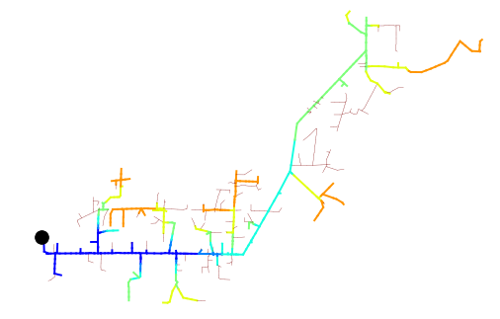
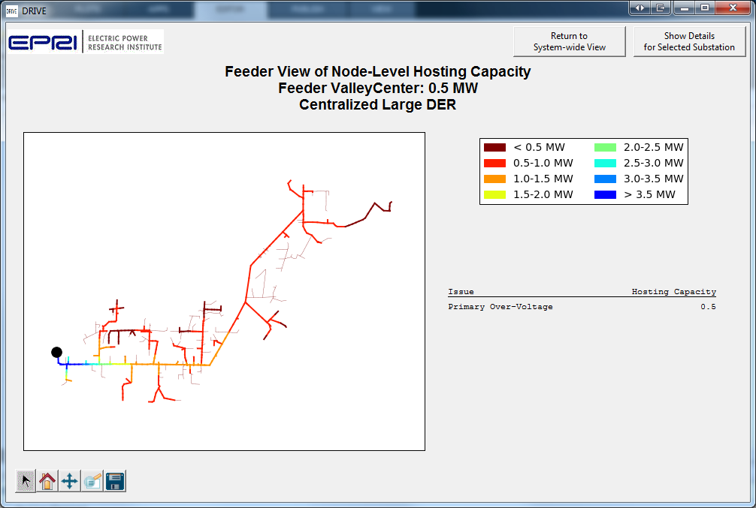
Example Case Study
Hosting capacity is calculated on each feeder node
Evaluations consider
  Local constraints
  Upstream constraints
Substation
Substation LTC: 123V
Modeling data and assumptions have impact on hosting capacity
Substation LTC: 125V
*Illustration of DER (PV) hosting capacity based on evaluating overvoltage

Slide 14
Distribution Modeling Requirements for Hosting Capacity Evaluations
Model Depth – Individual Feeder Requirements
Medium-voltage assets modeled
Peak-load models represented (current capability for most utilities)
Off-peak models of distribution system
  To consider different times of day/load levels
  Typically not available, requires additional considerations
Model Breadth - Distribution models of entire service territory
All feeders/network systems modeled

Slide 15

Additional Consideratrions: Hosting Capacity on Meshed Low Voltage Systems
Differs from radial modelling analysis
Must model to low voltage assets
Early approach could consider low daytime transformer loading
Off-peak models of distribution system
  To consider different times of day/load levels
  Typically not available, requires additional considerations
No extensive studies exist to represent impacts
Con Edison has considered required modeling
Williamsburg Network
CHP
DR
PV
Network Grid
DR
DR

Slide 16
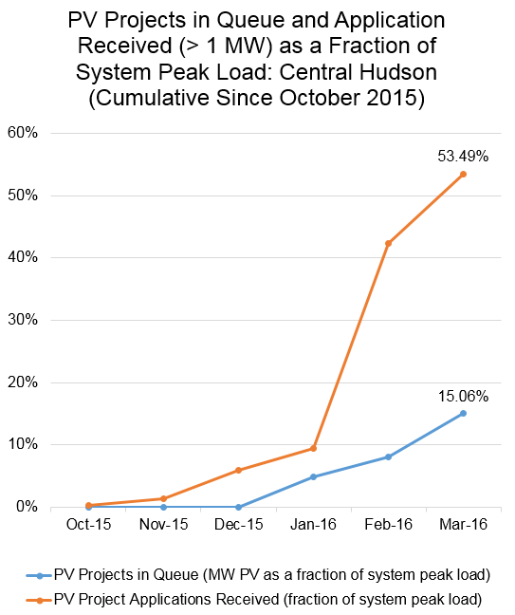
Additional Considerations: Existing DER and Interconnection Queue
Issue
Hosting capacity should consider
  Connected DER (existing)
  Approved DER (in interconnection queue - this can be very difficult to manage)
Requires significant amount of data upkeep
Solution
Mapping of existing and newly approved DER into planning models. Requires new processes to be in place
Distribution models updated on regular basis (refresh cycle determined based upon need)

Slide 17
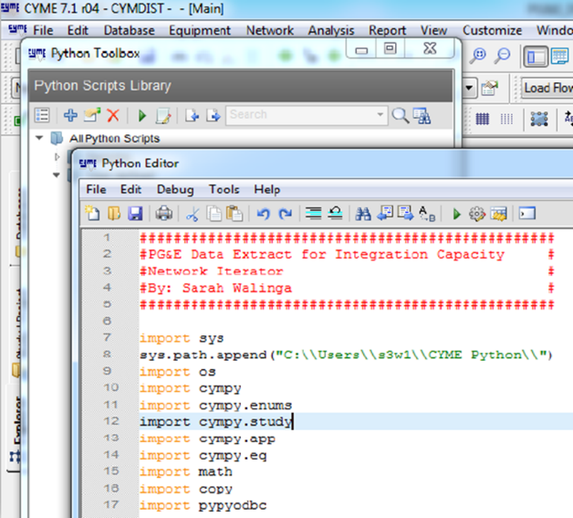
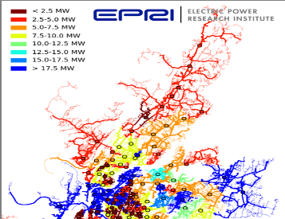
Tools for Hosting Capacity Analysis
Implement hosting capacity methods using existing planning tools
Required capabilities reside within existing planning tools
  Distribution models
  Analysis mechanics (load flow, short-circuit)
Alleviates unnecessary model translation to other software platforms
  Improving data management/upkeep efficiency
  Captures changes in distribution system
One platform for all planning functions and models
  Traditional distribution planning
  Hosting capacity evaluations
  Grid modernization assessments
EPRI and it’s utility members are working with major software vendors to incorporate hosting capacity method (CYME: 2016, Milsoft/Synergi: 2016/17)
Incorporating hosting capacity methods into existing utility planning tools – no need to re-invent the wheel
Existing Distribution Planning Tools
(CYME, Milsoft,
Synergi, DEW)
Hosting Capacity Module

Slide 18
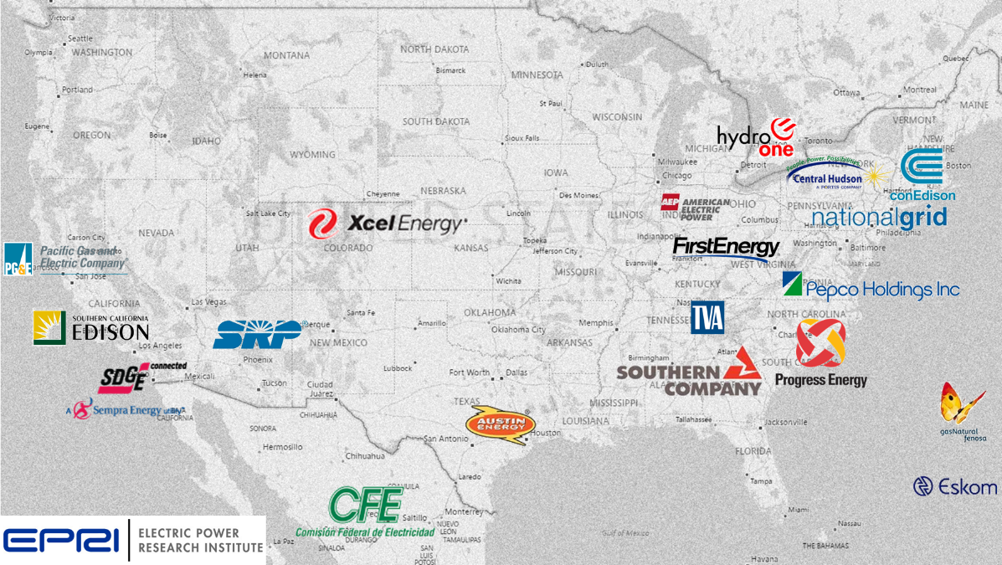
Industry Applications of Hosting Capacity
Broad application throughout the industry
  Distribution Resource Plans
  DG Screening
  Locational value assessment of DER
  System-wide cost-benefit assessments
Criteria for Analysis
Voltage
Protection
Power Quality/Voltage
Reliability/Safety

Slide 19
Methods for Increasing Distribution Hosting Capacity
Methods for increasing hosting capacity depend upon many factors
  Limiting power system criteria
  Distribution system design and operating characteristics
  DER capabilities
A single solution/technology does not resolve all issues
  Voltage
  Thermal
  Protection
Solutions can be situation-specific
  E.g., smart inverters and reconductoring can help with voltage issues but not protection
Solutions for increasing hosting capacity can have other benefits as well
  Reconductoring and voltage uprating can reduce losses and increase load-serving capability
  Comm/control of DER coordinated with existing controls can help regulate voltage

Slide 20
Methods for Increasing Distribution Hosting Capacity
Utility Solutions
Grid-Side Enhancements/Changes
  Reconductoring
  Voltage uprating
  Transformer replacement
  Additional voltage regulator
  Comm/control (curtailment)
  Additional relaying
  Storage
Operational Changes
  Voltage regulation changes (LTC setpoint adjustment, etc.)
  Relay setting modification
Challenges
  Can result in high costs
  May require considerable lead time
The Integrated Grid: A Benefit-Cost Framework. EPRI, Palo Alto, CA: 2015. 3002004878.

Slide 21
Methods for Increasing Distribution Hosting Capacity
Customer Solutions
Using Smart Inverters for Increasing Hosting Capacity
Solutions
  Smart inverters
  Distributed var control
  Energy storage
  PV panel orientation
  DSM
Challenges
  Determining proper settings for DER control
  Coordination with existing control
  Determining proper location for dispatchable DER
No smart inverter
With smart inverter
Using Storage for Increasing Hosting Capacity

Slide 22
Summary
Hosting capacity is a complex analysis requiring models of entire distribution area
  Most utilities have modeled a portion of the system – still work to be done
  Distribution metering data must be more granular
Roadmap to implementation
  Provides staged approach for development
  Delivers near and long-term solutions
  Allows for refinement of models and methods over time
  Leverages EPRI work regarding use of existing planning tools for hosting capacity assessments
Defining a Roadmap for Successful Implementation of a Hosting Capacity Method for New York State, EPRI, Palo Alto, CA: 2016. 3002008848

Slide 23
Additional References
Detailed Hosting Capacity Method
Impact of High-Penetration PV on Distribution System Performance: Example Cases and Analysis Approach. EPRI, Palo Alto, CA: 2011. 1021982
Analysis of High-Penetration Solar PV Impacts for Distribution Planning: Stochastic and Time-Series Methods for Determining Feeder Hosting Capacity. EPRI, Palo Alto, CA: 2012. 1026640
Rylander, M., Smith, J., “Comprehensive Approach for Determining Distribution Network Hosting Capacity for Solar PV”, 2nd International Workshop on Integration of Solar Power Into Power Systems, Lisbon, Portugal, Nov 2012.
Rylander, M., Smith, J., "Stochastic Approach for Distribution Planning with Distributed Energy Resources", 2012 CIGRE Grid of the Future Symposium, Kansas City, MO, 2012
Rylander, M., Smith, J., "Comprehensive Approach for Determining Distribution Network Hosting Capacity for Solar PV", 2nd International Workshop on Integration of Solar Power Into Distribution Systems, 12-13 November, 2012
Distributed Photovoltaic Feeder Analysis: Preliminary Findings from Hosting Capacity Analysis of 18 Distribution Feeders. EPRI, Palo Alto, CA: 2013. 3002001245.
Alternatives to the 15% Rule: Modeling and Hosting Capacity Analysis of 16 Feeders. EPRI, Palo Alto, CA: 2015. 3002005812.
Streamlined Hosting Capacity Method
Integration of Hosting Capacity Analysis into Distribution Planning Tools. EPRI, Palo Alto, CA: 2016. 3002005793
A New Method for Characterizing Distribution System Hosting Capacity for Distributed Energy Resources: A Streamlined Approach for Solar Photovoltaics. EPRI, Palo Alto, CA: 2014. 3002003278.
Rylander, M., Smith, J., Sunderman, W., “Streamlined Method For Determining Distribution System Hosting Capacity”, 23rd International Conference on Electricity Distribution, CIRED, Lyon, France, 2015
Rylander, M., Smith, J., Sunderman, W., “Streamlined Method For Determining Distribution System Hosting Capacity”, Rural Electric Power Conference, Asheville, NC, 2015 (accepted for IAS Transactions)
Distribution Feeder Hosting Capacity: What Matters When Planning for DER?. EPRI, Palo Alto, CA: 2015. 3002004777
Smith, J., Rylander, M., Rogers, L., Dugan, R., “It’s All in the Plans: Maximizing the Benefits and Minimizing the Impacts of DERs in an Integrated Grid”, Power and Energy Magazine, March/April 2015.

