Slide 1
Market Operations Engagement Group DER Sourcing - Procurement
July 13, 2016
Presentation material does not represent the views of the Joint Utilities Engagement Group as the group is still in discussion on these topics. Please do not redistribute this deck.

Slide 2
Agenda
Time | Topic
1:00 – 1:15 | Introductions
1:15 – 2:00 | Stakeholder Presentation & Q/A
2:00 – 3:00 | Joint Utilities Presentations
3:00 – 3:15 | Break
3:15 – 3:45 | Deep Dive Discussion
3:45 – 4:00 | Summary & Next Steps

Slide 3
Engagement Group Ground Rules*
All stakeholder engagement (Advisory Group and Engagement Group) meetings, webinars and information exchange are designed solely to provide an open forum or means for the expression of various points of view in compliance with antitrust laws.
Under no circumstances shall stakeholder engagement activities be used as a means for competing companies to reach any understanding, expressed or implied, which tends to restrict competition, or in any way, to impair the ability of participating members to exercise independent business judgment regarding matters affecting competition or regulatory positions.
Proprietary information shall not be disclosed by any participant during any stakeholder engagement meeting or its subgroups. In addition, no information of a secret or proprietary nature shall be made available to stakeholder engagement members.
All proprietary information which may nonetheless be publicly disclosed by any participant during any stakeholder engagement meeting or its subgroups shall be deemed to have been disclosed on a non-confidential basis, without any restrictions on use by anyone, except that no valid copyright or patent right shall be deemed to have been waived by such disclosure.
AG & EG discussions will be open forums without attribution and no public documents by the AG or EG will be produced unless publication is agreed upon by the group.
*Ground Rules adapted from the JU Advisory Group

Slide 4
Overall Engagement Group Purpose & Objectives
Purpose
The Market Operations Stakeholder Engagement Group (EG) is an open forum for stakeholders who are actively engaged in the REV process and the Distributed System Implementation Plan (DSIP) filings to provide input to, and exchange ideas with, the Joint Utilities of New York (JU) on topics related to grid operations as identified by the Joint Utilities Stakeholder Advisory Group (AG).
Objectives
The AG will advise the JU on the sequence and priorities of topics that Engagement Groups should discuss.
The AG will also provide input on Engagement Group members, discussion scope, and any output documents that would advance greater shared understanding.
The Engagement Groups will hold discussions on identified topics in order to achieve greater shared understanding of issues covered in the DSIP filings, and to build toward common ground through iterative discussion and feedback.

Slide 5
Market Ops - Near term schedule (subject to revision)
7/11
7/18
7/25
8/1
8/8
8/15
AG
July 12 NYC
August 10 NYC
Customer Data
(Tuesday mornings)
DER Sourcing
(Tuesday afternoons)
Granular Pricing
EVSE (scheduling TBD)
July 13
NYC
Collection Frequency, Reporting Frequency and Availability of Usage Data
July 19
(By Phone*)
July 26
Albany
Aggregation of Usage Data
August 2
(By Phone*)
August 9
NYC
Additional Data Needs
July 13
NYC
Share Existing NWA Plans and Lessons Learned
July 19
(By Phone*)
July 26
Albany
Dependencies With Other REV and Related Proceedings
August 2
(By Phone*)
August 9
NYC
Potential Refinements to NWA Procurement Approach
End of July
(By Phone*)
TBD
*Additional phone sessions will be held as needed

Slide 6
DER Sourcing Topic Description
DER Sourcing: market actions taken by the utility to increase the amount of installed DER on its system. This may be done to address specific system deficiencies (i.e. Non-Wires Alternatives), and/or to secure the environmental or other attributes of DERs. The chief mechanisms for DER Sourcing are Pricing (e.g. Net Energy Metering tariffs, TOU pricing), Programs (e.g. distribution-level Demand Response tariffs) and Procurement (e.g. bilateral contracts, RFPs/RFIs/RFOs).

Slide 7
Market Operations Engagement Group Topic
Purpose: Explore the Joint Utilities' approaches for facilitating market mechanisms that effectively support and encourage the adoption of Distributed Energy Resources while meeting customers’ needs and complying with the DSIP Guidance Order.
Topic & Scope: Distributed Energy Resources (DER) Sourcing
DER Sourcing
DER Sourcing - Describe and discuss dependencies with other REV and REV-related proceedings Share existing NWA plans and challenges/lessons learned Discuss potential refinement of the NWA Procurement approaches to improve efficiency and effectiveness and the potential for common implementation by the Joint Utilities

Slide 8
Stakeholder Presentations

Slide 9
Joint Utilities Presentations

Slide 10
AVANGRID
Java and Station 43 NWA programs
Joni Fish-Gertz
Manager, Non-Wires Alternatives

Slide 11
NYSEG/RG&E NWA
Summary of approach
Build a portfolio of Non-Wires Alternatives (NWA) DER projects which are cost effective for customers, provide reliable alternatives to traditional capital investment projects, and provide full cost recovery and earnings opportunities for our Companies, while we comply with regulatory directives and learn from and work cooperatively with other utilities and stakeholders.
In 2016 we have or will release 2 NWA RFPs for projects identified in 2015 REV filings: Java Station (NYSEG) and Station 43 (RGE)
In the 2016 DSIP filing we have identified an additional 7 projects which may have potential for future NWA RFPs

Slide 12
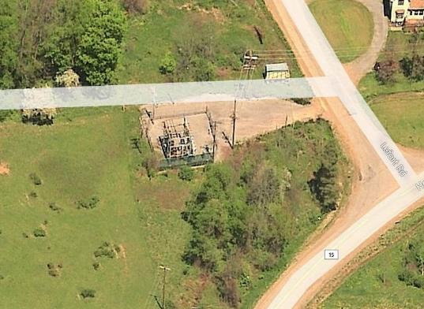
NYSEG/RG&E NWA
Java Station NWA RFP
Java NWA RFP released February 8, 2016
Reduce peak load on Substation
Provide contingency in case of transformer failure
If possible, provide power quality improvement on one circuit
Received bids from 11 Developers
Currently in process of technical review
Next steps include:
Final BCA analysis
Negotiation with Developer(s)
File Implementation Plan with PSC
Project Construction/Commissioning

Slide 13
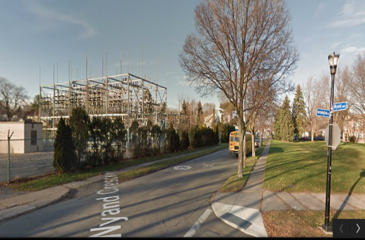
NYSEG/RG&E NWA
Station 43 NWA RFP / Lessons Learned
Station 43 NWA RFP to be released mid - July 2016
Reduce peak load on Substation
Provide additional contingency in case of transformer failure
Will follow schedule similar to Java with in-service date expected to be 1/1/2019
Early Lessons Learned Include:
Developers require additional time to develop bids
Early RFP review process requires significant review and analysis time

Slide 14
Central Hudson
NWA overview
Mark Sclafani
Senior Program Coordinator – Demand Response
Energy Transformation & Solutions

Slide 15
Central Hudson’s General Non-Wires Process
Identification of future Capital projects that may be deferred through a non-wires alternative project
Request for Proposal (RFP) sent out, which includes a detailed description of the system need
Third Party Evaluation – assists in analyzing the proposed solutions for effectiveness and cost
Revise traditional benefit cost model to allow for innovative projects
Select winning proposal(s) – enter into contract negotiations

Slide 16
NWAs
Three existing (In Progress):
Northwest Area (Transmission Area)
Philips Road (Substation Area)
Merritt Park (Distribution Area)
One new (Expecting late 2016):
Coldenham (Distribution Area)

Slide 17
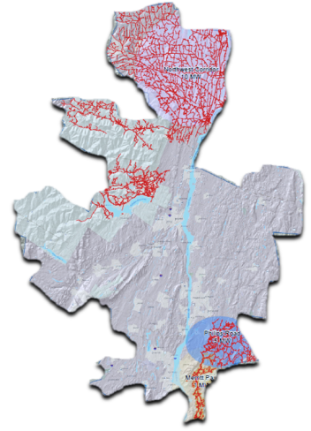
Non-Wires: System Need
North West Area 10MW by 2019
Shenandoah/ Fishkill Plains
5MW by 2020
Merritt Park
1MW by 2020

Slide 18
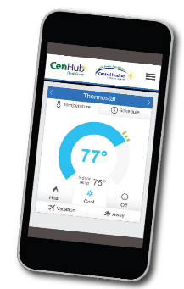
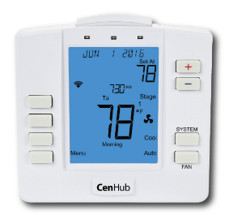
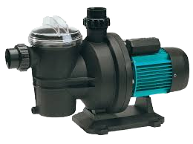
Targeted Demand Response Solution

Slide 19
Central Hudson NWAs
Status of Existing:
Developed RFP in 2014/15
3rd Party Evaluation
Started with 4 Areas and one area was dropped
Contracted in late 2015
Program Launch April 2016
Lessons Learned:
Solidify Contract Terms
Compensation schedule
Cyber Security
Broaden Customer Segments
Coordination with Tariff Program
Establish Available Data and Data Needs
Formalize M&V
BCA Handbook

Slide 20
National Grid
Baldwinsville and Kenmore NWA programs
Stacey Hughes
Project Manager, New Energy Solutions

Slide 21
Loading Problems/Alternative Solutions
Baldwinsville
Contingency load at risk – two stations/9 feeders
Sorrell Hill
Lysander
6.6% load growth – 2016-2029
Need 6 MW of DER resources
Need peak shaving and contingency solutions
Estimated DR/DER dispatches: 7-14 times/year
Dispatch duration estimates 6-11 hours
Area Profile
13,000 customers
Population: 92% Resi. – 8% SMB - .001% Ind.
Loads: 61% Resi. – 17% SMB – 21% Ind.
Kenmore
500MCM 23kV cables supplying Stations 22, 23 and 24 from Sawyer Station are projected to exceed emergency ratings in the summer of 2018
1 MW of relief is needed by 2018 and another 1 MW by 2020
Proposed wires solution: install 2 new cables from Sawyer Station to each of the three distribution substations
Wires solution cost ~$9.5 million
Area Profile
18,000 customers
Population: 94% Resi. – 6% SMB - .001% Ind.
Loads: 51% Resi. – 31% SMB – 18% Ind.

Slide 22
NWA Solutions/Procurements
Baldwinsville
NWA project order (14-M-0101)
6 MW needed
$5M traditional project cost
Two tiered procurement
Analysis
DER Solutions
Hired analysis vendor– mid-late July target start date
Kenmore
DLM program designated area
2 MW needed
$9.5M traditional project cost
Residential area
DLC vendor hired
Started mid Sept 2015
Ongoing recruitment

Slide 23
Procurement Process
Baldwinsville
2 tiered solicitation
Analysis
DER solution
Vendor evaluation
Ability to provide area analysis, PM and M&V
Ability to apply reliable DER solution or group of solutions
16 respondents – 10 analysis/~6 solution (1 both)
Kenmore
Sole sourced DLC Vendor
Timing
Area profile
BYOT state wide program will apply in Kenmore
DR Platform Vendor hired
Can currently pull in two t-stat manufacturers
Faster procurement/contract process

Slide 24
Orange & Rockland
Pomona NWA program
Kristen Barone
Project Specialist, Utility of the Future

Slide 25
Pomona DER Program Overview
Primary residential area in Rockland County currently served by:
Two substations with relatively long distribution circuits
Tail end of two additional circuits from adjacent substations
Electric load growth including plans for large subdivisions consisting of residential single and multi-family units will require new infrastructure to meet planning criteria and reliability needs:
138kV underground transmission feed
Two 50 MVA – 138/13.2kV transformers with LTCs
Switchgear with 10 circuit positions
6 initial distribution circuits and 4 future
Pomona DER program to defer substation and transmission infrastructure was approved in October 2015 as part of O&R’s last rate case

Slide 26
Pomona DER Program Procurement Approach
O&R issued RFI for solutions to achieve up to 6 MW reduction and defer capital investment by up to 4 years
Received 30 RFI responses including:
DR, Energy Storage, Microgrids, Solar, VVO
Plans to issue subsequent RFPs for solutions identified in Portfolio Development

Slide 27
Pomona DER Program Portfolio Development
Key to the process is:
Understanding potential changing grid needs
Determining variations in load among the various customer demographics
Aligning solutions to target the appropriate customers and load

Slide 28
Pomona DER Program Portfolio Development
Customer availability and intent
Timeliness
Efficiency of resources
Reliability of load reduction
Flexibility of resources
Availability of resources
Commercially proven technology

Slide 29
Pomona DER Program Next Steps
Continue to review and refine forecast need
Incorporate RFI solutions as part of Portfolio Development
Leverage existing EE and DR programs as part of the Portfolio process
Issue Demand Response RFP
Apply lessons learned from REV demonstration projects
Community Engagement
AMI deployment to enable solutions

Slide 30
Con Edison
Brooklyn Queens Demand Management Neighborhood Program
Greg Elcock
Section Manager – Targeted Demand Management

Slide 31
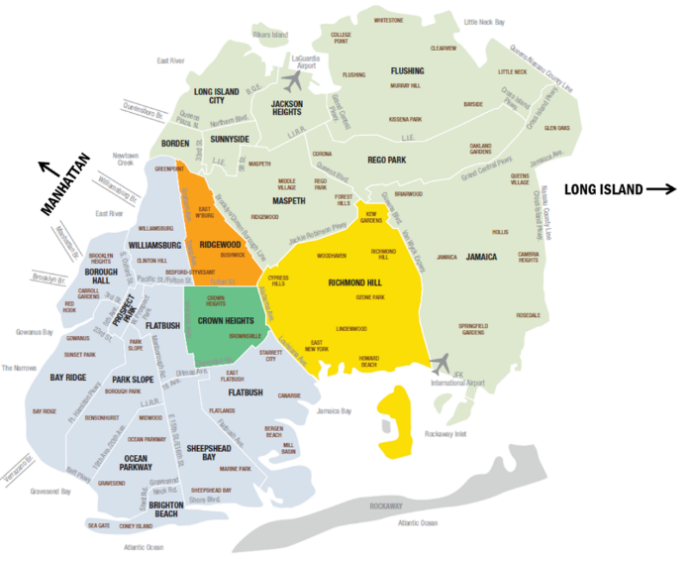
Deferral of ~$1 billion in traditional solutions
Brooklyn Queens demand management (“BQDM”)
BQDM Program
BQDM Geography
BQDM Filing submitted on July 15, 2014
Order approving BQDM issued on December 12, 2014
Utility expenditures treated as 10-year capital assets with regulated return, with performance incentive on ROE.
The Con Ed 2016 DSIP filing identified approximately 9 projects with potential for future NWAs

Slide 32
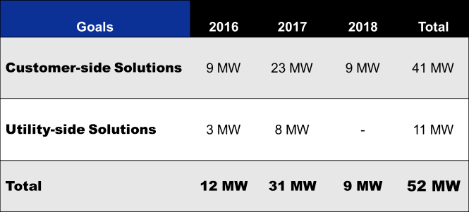
The BQDM Challenge
Solution Must Address 12 Hours

Slide 33
BQDM Procurement Strategy
To achieve timely reductions, Con Ed evaluated potential solutions based on:
Customer availability and intent
Timeliness
Efficiency of resources
Reliability of load reduction
Flexibility of resources
Availability of resources
Commercially proven technology

Slide 34
BQDM Procurement Strategies
Existing Programs
Commercial & Industrial (“C&I”)
Request for Information
Request for Proposals (“RFP)
Request for Clarification (“RFC”)
Final BQDM Portfolio Results
New and varied DER solutions
Multifamily Energy Efficiency (“MFEE)
Test competitive market via DR auction
Request for Quotation (“RFQ”)
Vendor Partnerships
NYSERDA CHP
Residential
Program Adders
Small Business Direct Install (“SBDI”)
Demand Response
Engage 6500+ customers
The Company has developed a diverse set of solutions through different procurement methods

Slide 35
Lessons to Date: The BQDM Experience
Company has met reliability needs for 2016
RFI provided Con Ed with input from the marketplace
Increased specificity associated with RFI
Opportunities face complex path to execution
Practical implications, like space constraints, present challenges
Multiple procurement and budgetary cycles
Negotiations and non-traditional agreements
Execution faces persistent risks

Slide 36
Break

Slide 37
Deep Dive Discussion

Slide 38
Summary & Next Steps

Slide 39
Thank you for joining us!
Please contact info@jointutilitiesofny.org
or
visit our website www.jointutilitiesofny.org for more information

Slide 40
Appendix

Slide 41
Advisory Group Members
 | Contact | Organization | Title
NY DPS | Tammy Mitchell | Dept. of Public Service | Chief, Electric Distribution Systems
DER Provider | Carlos Gonzalez | SolarCity | Director, Grid Engineering Solutions
DER Provider | Pete Fuller | NRG | VP, Market & Regulatory Affairs
DER Provider | Bill Acker | NY-BEST | Executive Director
DER Provider | Greg Geller | EnerNoc | Director, Regulatory & Government Affairs
Large Customer | Mike Mager | Couch White, LLP | Partner
Large Customer | Anthony Fiore | City of NY | Director, Office of Energy
Small Customers & Consumer Groups | Erin Hogan | Dept. of State Utility Intervention Unit (UIU) | Senior Project Manager at NYSERDA
State/Public power | Maryam Sharif | NYPA | Program Manager, Clean Energy Technology
Environmental | Miles Farmer | NRDC | Legal Fellow
Environmental | Rory Christian | EDF | Director, NY Clean Energy
Marketers | Chris Kallaher | Direct Energy | Director, Government & Regulatory Affairs
Wholesale market | Mike DeSocio | NYISO | Senior Manager, Market Design at NYISO
NYSERDA | John Saintcross | NYSERDA | Assistant Director, Smart Grid Research
IPPNY | Chris Wentlent | Exelon | VP, Energy Policy
Joint Utilities | Tom Mimnagh | ConEdison | Department Manager
Joint Utilities | Damian Sciano | ConEdison | Director, Distributed Resource Integration
Joint Utilities | John Leana | National Grid | Director, Strategy
Joint Utilities | Lori Cole | AVANGRID | Manager, Regulatory & Tariffs
Joint Utilities | John Borchert | Central Hudson | Senior Director of Energy Policy and Transmission Development
Facilitator | Paul De Martini | ICF International | AG Facilitator

Slide 42
Engagement Process Overview
Stakeholder Engagement Schedule
Jan 2016
Feb
Mar
Apr
May
Jun
Jul
Aug
Sep
Oct
Nov
Dec
2017
DSIP Final Guidance
Initial DSIP Filings
Supplemental DSIP Filing
Advisory Group Mtgs
Initial DSIP
Stakeholder Engagement*
Supplemental DSIP
Engagement Groups
Distribution Planning**
Grid Operations
Market Operations
Stakeholder
Technical Confs***
*Initial DSIP engagements dates based on individual JU workshop schedule during this period. **ITWG beginning in March, EG begins in May.
*** Stakeholder technical conferences to engage a wider set of participants to inform technical discussions and share Engagement Group results, as needed and in consultation with the Advisory Group
Source: Plan for stakeholder engagement process as reflected in May 5th DSIP filing

Slide 43
Supplemental DSIP Topics—Based on Final Order
Engagement Groups
Distribution System
Planning
Grid Operations
Market Operations
Interconnection
Hosting
Capacity
System Data
Monitoring &
Control
Granular
Pricing
Customer Data
Demand
Forecasting
NWA
Suitability
Cyber
Security
ISO/DSP Roles, Responsibilities, Interaction
DER Sourcing
- Procurement
Electric Vehicle Supply Equipment
Topics
DER Forecasting
Load Flow
Analysis
Probabilistic
Planning
Interconnection Technical Working Group
Currently scheduled Engagement Group topics
Currently scheduled Advisory Group topics

