Slide 1
Distributed System Platform (DSP) Stakeholder Webinar
July 2023

Slide 2
Welcome and Logistics
Welcome and thank you for joining!​
Webinars are open to the public and recordings will be posted following the webinar on the Joint Utilities website: www.jointutilitiesofny.org ​
Please contact info@jointutilitiesofny.org if you have any additional questions following the webinar
Notes:
Speakers are tentative

Slide 3
Agenda
Welcome and thank you for joining!
Agenda Item | Presenters
Distributed System Implementation Plans (DSIP) | Matthew LaFlair
DSIP alignment with Coordinated Grid Planning Process (CGPP) | Tom Vaccaro
ISO-DSP | John Baudanza
Interconnection | Aaron Anaya
Hosting Capacity Maps and Analysis | Joe White
Information Sharing | Leon Bukhman
Electric Vehicle Make-Ready Program | Joshua Kaplan
Webinars are open to the public and recordings will be posted following the webinar on the Joint Utilities website: www.jointutilitiesofny.org ​
Please contact info@jointutilitiesofny.org if you have any additional questions following the webinar

Slide 4
Distributed System Implementation Plan (DSIP) Presented by: Matthew LaFlair

Slide 5
2023 DSIP Update
Within the 2023 DSIP Updates, the utilities:
Report on Distributed System Platform (DSP) actions and progress since the 2020 DSIP Update
Describe the utilities’ future five-year plans*
Identify how distributed energy resources (DER) developers and other third parties can access available tools, information and potential business opportunities
Provide useful links to frequently updated data so stakeholders have access to the latest information
Describe upcoming new programs, projects and procurements to enable greater levels of DER
Jun 2016
Oct 2016
Jul 2018
June 2020
June 2023
Initial DSIP
Supplemental DSIP
2018 DSIP Update
2020 DSIP Update
2023 DSIP Update
* All the future plans and investments presented in the DSIP are subject to rate case approval with corresponding impacts to timing

Slide 6
The DSP Offers Three Core Interrelated Services
Market Services Utility programs, procurement, wholesale market coordination, tariffs, and other services that create value for DER customers and providers through market mechanisms
Market
Services
Information Sharing Services Information and communications systems and processes that collect, manage, and share granular customer and system data, enabling customer choice and expanding participation of third-party vendors and aggregators in markets for DER
DER Integration Services Planning and operational enhancements that promote streamlined interconnection and efficient integration of DER, while maintaining safety and reliability
DER
Integration
Services
Information
Sharing
Services

Slide 7
DSIP Alignment with Coordinated Grid Planning Process (CGPP) Presented by: Tom Vaccaro

Slide 8
The DSIP helps align Dx planning with Tx CGPP
CGPP Stages Dx Integration
Capacity Expansion and Scenario Development
Database (Power flow) Development
Local Assessment, Project development
Review of Solutions
Least Cost Planning Assessment (Project selection)
Alignment of load forecasts and scenarios
1
2
DER forecasts and distribution across the system, how much is assumed to be distribution sited
3
Identification of solutions and assessing possible influence to transmission solutions
4
5
Inclusion in Least Cost Planning review

Slide 9
ISO-DSP Presented by: John Baudanza

Slide 10
Joint Utilities Prepare for NYISO DER and Aggregation Market
The Joint Utilities continue to work in support of a future energy marketplace where competitive market signals play a greater role and provide opportunity for DER. Recent utility efforts in this regard include supporting the New York Independent System Operator (NYISO)’s implementation of its new market for the participation of DER and Aggregations.
Preparing for Go-Live
The NYISO is expected to open its enrollment process for the DER and Aggregation market in August, with market participation expected to go live later in the year. The JU has been engaging with the NYISO to gain the information, process walk-throughs, and trainings required by utility staff to effectively support registration, safety & reliability review, and operational coordination of DER aggregations that will be participating in the new NYISO market.
Providing Input on NYISO Manuals and Tariff Filings
The JU has been coordinating with the NYISO so that it can appropriately capture relevant utility information, process, and coordination requirements in NYISO documentation. This includes collaboration on the NYISO DER Aggregation Manual.
Finalized Operational Coordination Requirements and Communicated these to NYISO Stakeholders
The JU developed and communicated the DER Day Ahead Operating Plan template and requirement that the “DDAOP” be submitted to the utilities prior to the day of market dispatch. Template will be made available here: https://jointutilitiesofny.org/day_ahead
Next: Continue to Coordinate with NYISO’s Development of a Fully F2222 Compliant Market
Utilities will continue to coordinate with the NYISO as it develops its fully compliant FERC-2222 market for DER and Aggregations, launch expected in 2026.

Slide 11
Interconnection Presented by: Aaron Anaya

Slide 12
Joint Utilities Assist Rollout of IEEE 1547-2018 Compliant Inverters and Facilitate Storage Interconnections
Rollout of IEEE 1547-2018 Compliant Inverters
The JU have collaborated extensively with Industry and DPS staff to prepare for the rollout of UL 1741-SB and IEEE 1547-2018 inverters
The JU made appropriate edits to the NY SIR, published an FAQ document, and provided links to each utility’s preferred settings for inverter – based DER
Facilitation of Battery Storage Interconnections
JU are working collaboratively with developers to explore options for facilitating diverse use cases and applications for battery energy storage systems (BESS) assets
Items that the JU have discussed include
Provision of hourly load data so that BESS can be sized appropriately
Operating windows and BESS use cases
Aligning BESS operating windows with time periods that could provide developers and their storage assets with the most economic value
The JU are also exploring the feasibility of providing location/ circuit – specific schedules and considerations for studying the unrestricted charge and discharge behavior of BESS assets
The JU and developers are also in the very initial stages of exploring a phased approach to enabling progressively more complex operational controls and technology to orchestrate storage assets, including the future role of DERMS and active communications to more dynamically control BESS and adjust operating windows as required

Slide 13
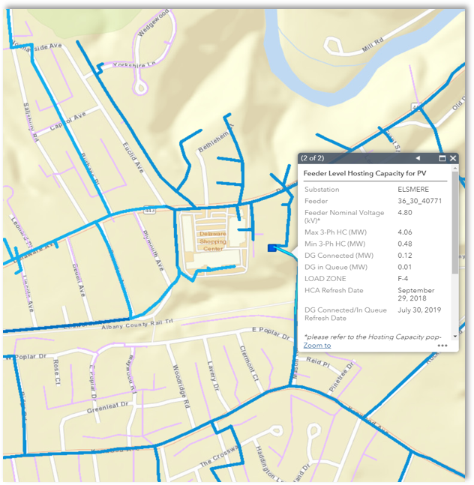
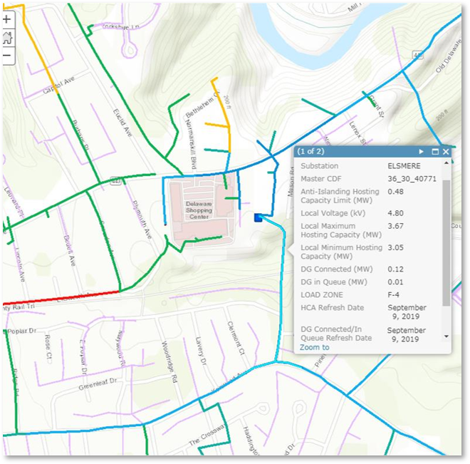
Hosting Capacity Maps and Analysis Presented by: Joe White

Slide 14
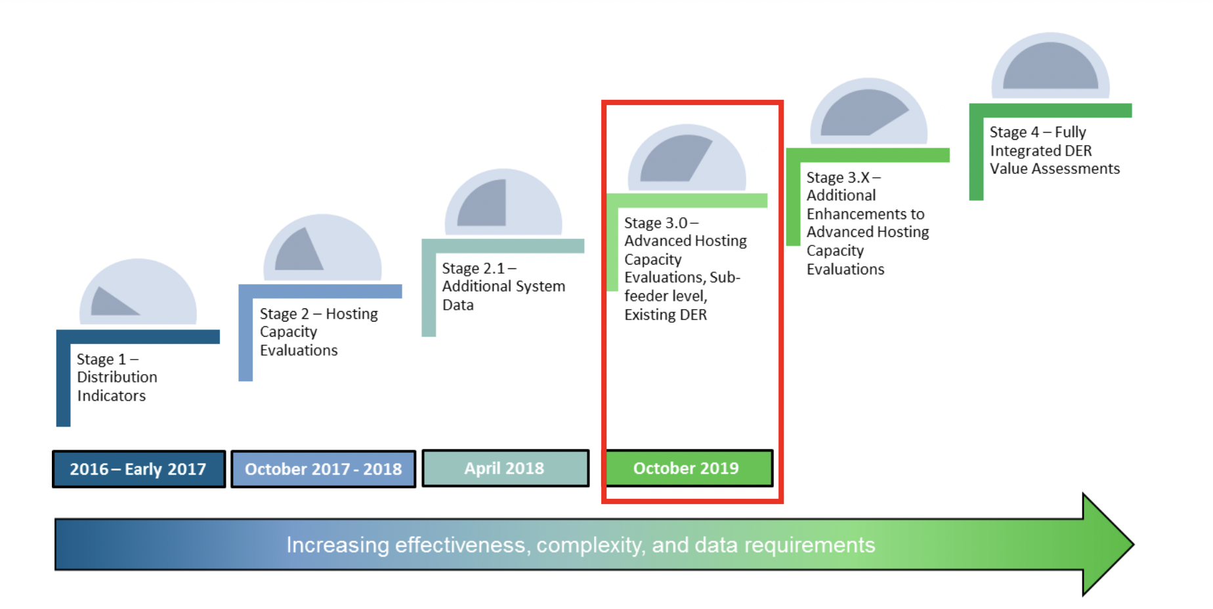
Evolution of the Roadmap
The Joint Utilities, with guidance from stakeholders developed a four staged Hosting Capacity implementation roadmap. This was incorporated into New York Utility filings.
Stage 4 –Advanced Scenarios and Increased Granularity
Stage 4.1 – advanced functionality
Stage 3.5 – EV and Energy Storage Maps
2019 - 2020
2021 - 2022
2023

Slide 15
Overview: Stage 3.5
In 2022, the JU published Storage (ESS) HC maps showing… | In August, the JU presented
1 | Feeder-Level Hosting Capacity (min/max)
2 | Additional System Data
3 | Downloadable Feeder-Level Summary Data
4 | Reflect Existing DER in Circuit Load Curves and Allocations
Due to stakeholder feedback, all map views also showed…
post sub-transmission circuits that are available to host distributed generation on their individual portals to help developers best evaluate options for storage connections.

Slide 16
Overview: Stage 4.1
Based upon your feedback, in 2023, the JU published HC updates showing… | In August, the JU presented
1 | Sub Feeder Level for Storage HC Map
2 | DG Connected Since Last HCA Refresh
3 | Nodal Constraints (Criteria Violations on PV and Storage Maps)
4 | Cost Share 2.0 Items on PV and Storage Maps
The JU is also providing the following information…
Six-month update for circuits that increase in DG > 500kW on the PV maps Links and/or instructions to access 8760 data Storage HC data made available via the API
In Stage 4.1, input models were updated through the year-end 2022.

Slide 17
DG Connected Since Last HCA Refresh (MW)
Each company provides DG Connected Since Last HCA Refresh (MW)
This is provided in collaboration with the IEDR process
Monthly updated expected
Data Field | Description
Feeder DG Connected Since Last HCA Refresh (MW) | The aggregated DG that has been connected on the selected feeder since the listed Hosting Capacity Analysis (HCA) refresh date
Substation / Bank DG Connected Since Last HCA Refresh (MW) | The aggregated DG that has been connected at the selected substation / bank level since the listed HCA refresh date

Slide 18
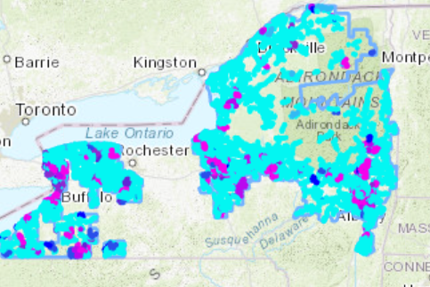
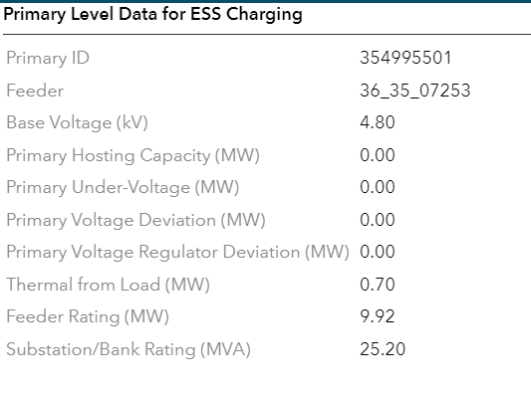
Pop-Up Items – Nodal Constraints
Constraints are displayed by color range for daytime minimum and for peak load periods.
Consistent with the PV map, color is shown as the minimum value. The nodal pop-up will provide a more detailed breakdown of criteria violations.
Several sections of the feeder circuit are shown as a common color if those minimum values fall within a common range.
National Grid Example

Slide 19
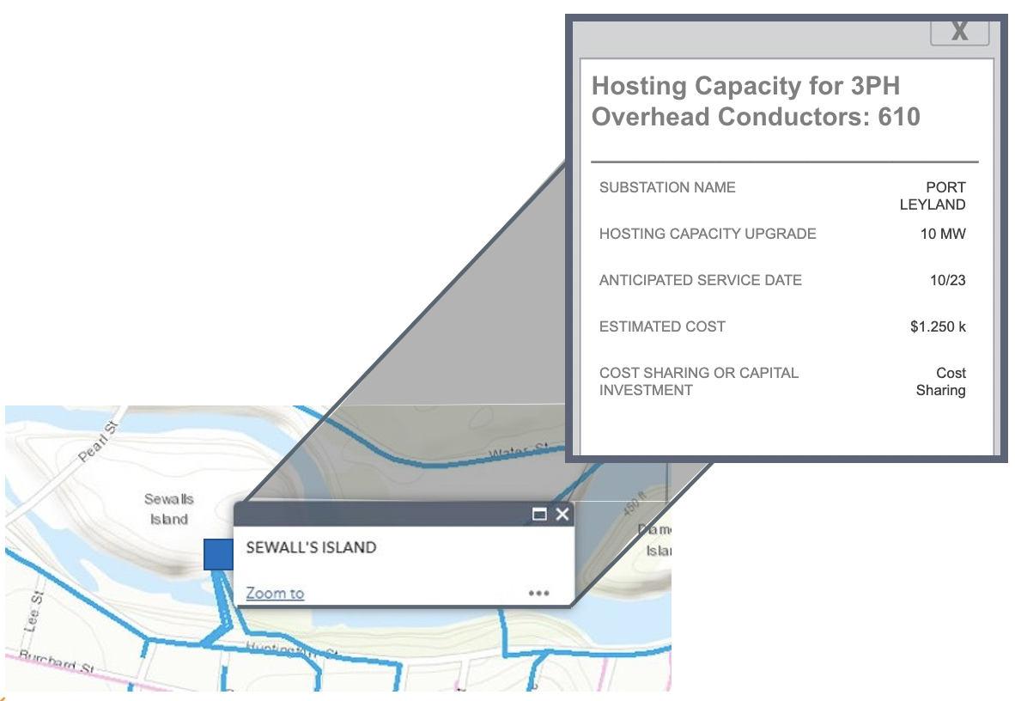
Cost-Sharing 2.0 Mechanism: Additional Draw-down Items
Substation A planned upgrade's location​
Hosting Capacity Upgrade Anticipated impact of project in terms of capacity availability​
Anticipated Service Date The in-service date of the upgrade ​
Estimated Cost Known or ​estimated costs of that capacity

Slide 20
Storage Roadmap
Complete | Pending | Next Steps
2023 | Late 2023-2024 | TBD
Sub Feeder Level HC Incremental Feeder Level Installed Since HCA Refresh Six-month Update for Circuits that Increase in DG > 500kW Continue to implement Cost Sharing 2.0 | Additional scenarios based on Interconnection WG Collaboration with Stakeholders | Continued functionality
At the interim, the JU proposes a seasonal, granular look at load profiles; offering data points outside of the most restrictive interconnection point throughout the year.
To provide different scenarios in a year, beyond peak and minimum load, the JU continues to seek industry feedback on additional scenarios to run.
Notes:
Interconnection, Thursday afternoon

Slide 21
ITWG Collaboration
To maximize the value of the HC portal, the data shared on the portal should have some linkage to the CESIR & SIR.
Investment in the HC maps should provide that the maps are sharing information developers can use.
The Integrated Planning WG updates HC maps but does not have purview over interconnection. Going forward…
The Interconnection Technical Working Group (ITWG) discuss use-cases with developers
The HC maps to be updated upon ITWG alignment

Slide 22
Lookahead: 2023
Continued work with ITWG
Once the ITWG aligns on use cases, the Integrated Planning WG will take this information to discuss next steps for advancing ESS HC maps
PV HC Map Refresh
October 2023
Fall Stakeholder Meeting
TBD

Slide 23
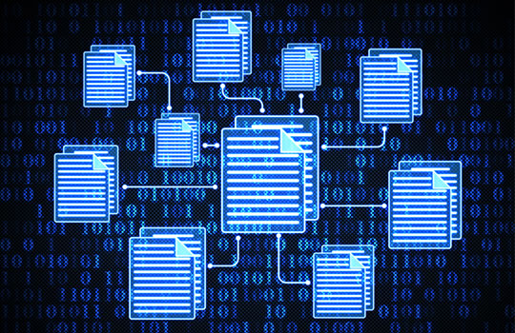
Information Sharing Presented by: Leon Bukhman

Slide 24
Information Sharing
Integrated Energy Data Resource (IEDR) Program
Integrated Energy Data Resource Platform launched
On March 31, 2023, NYSERDA formally launched the Initial Public Version (IPV) version of the IEDR platform. Moving forward, the utilities will continue to support the data delivery pipelines required for IPV use cases while focusing on supporting the implementation of MVP use cases. Utilities securely transferred publicly available data to support three use cases - Large Installed DERs, Large Planned DERs, and Consolidated Hosting Capacity Maps.
Coordination is ongoing
Utilities participate in the Utility Coordination Group (UCG) established by the New York State Energy Research and Development Authority (NYSERDA) and Public Service Commission Staff to “provide a venue for collaboration, coordination, and oversight of the utility activities related to the design and implementation of the IEDR and alignment with the schedules and activities of the Data Access Framework proceeding (DAF)."
IEDR Projects & Investments
The utilities are making investments in people, technology, and processes to support IEDR requirements.

Slide 25
Minimum Viable Product (MVP) Use cases
Information Sharing
DER Siting
Electronic Infrastructure Assessment Tool
Efficient Access to Customer Billing Data
Find and Filter Rate Options
Access to Basic Rate Data and Tariff Book for Individual Rate

Slide 26
Electric Vehicle Programs Presented by: Joshua Kaplan

Slide 27
JU EV Programs and Proceedings
INFRASTRUCTURE
GRID MANAGEMENT
Active Programs
Fleet Assessment Service
Residential Managed Charging
LDV Make-Ready Incentives
MHDV Pilot
Proceedings / Pending Programs
Commercial Managed Charging
Demand Charge Rebate
LDV Make-Ready 2.0
MHDV Make-Ready Program
Load Management Incentive
Phase-in Rate

Slide 28
2023 Programs and Proceedings Milestones
Joint Utilities filed Annual Reports on 4/15*
Midpoint Review technical conferences and comment period*
Commission issued Order Instituting a Proceeding on Medium- and Heavy-Duty EV Charging Infrastructure**
Staff filed Midpoint Review Recommendations Whitepaper* based on stakeholders' initial comments
Anticipated Midpoint Review Order
Q1 2023
Q2 2023
Q3 2023
Q4 2023
JU filed EV/EVSE testing accuracy proposal
JU filed immediate solutions plan in response to EV Rate Design Order
Commission commenced Proceeding on MHDV Electrification**
JU released RFI on testing accuracy
Residential Managed Charging Program launch
Upstate utilities filed commercial managed charging and phase-in rate plans
Continued focus on program implementation and improvement
*JU comments, Staff Midpoint Recommendations Whitepaper, and Company Annual Reports can be found via NYSDPS Case 18-E-0138
**MHDV Proceeding can be found via NYSDPS Case 23-E-0070

Slide 29
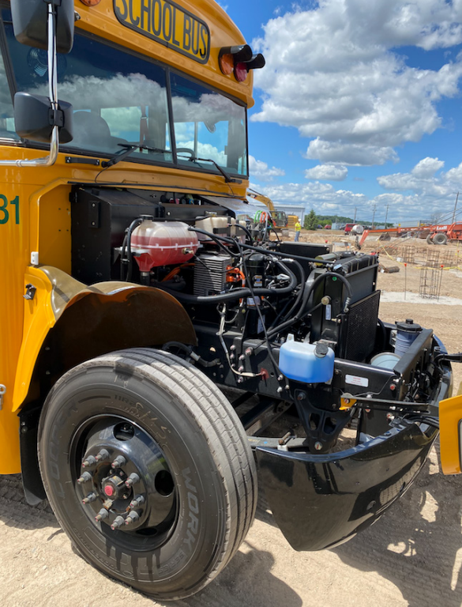
National Grid Bus Dealership EV Charging
New York State school bus mandate:
All new purchases need to be zero-emission by 2027
All buses need to be zero-emission by 2035 (over 50,000 buses)
National Grid’s Make-Ready Program supported EV Charger installation at New York Bus Sales LLC’s new 20,000 sq ft dealership in Batavia.
The new dealership includes office, training, and storage space to help the school districts and bus operators across the Western New York and the Finger Lakes regions with their electrification journey.
Resources like this facility and the Fleet Assessment Services are huge help towards reducing school bus emissions in New York.
EV School Bus Case Study

Slide 30
Q&A Session Moderated by: Matt Robison, ICF

Slide 31
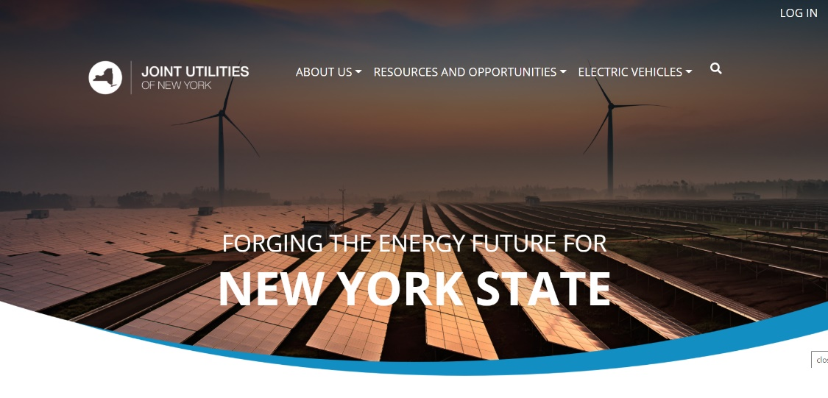
Q&A Session
Please submit questions via the ‘question function’ on the webinar interface
Additional questions may be emailed to info@jointutilitiesofny.org following the webinar
Visit www.jointutilitiesofny.org for more information
Quarterly Newsletter
Check out our quarterly newsletter with meaningful, substantive updates related to the DSIPs

Slide 32
Thank you!
Website: www.jointutilitiesofny.org
E-mail: info@jointutilitiesofny.org

