Slide 1
Distributed System Platform (DSP) Stakeholder Webinar
May 20, 2021

Slide 2
Welcome and Logistics
Welcome and thank you for joining!
Questions can be submitted via the ‘question function’ on the webinar interface
Webinars are open to the public and recordings will be posted following the webinar on the Joint Utilities website: www.jointutiitiesofny.org
Please contact info@jointutilitiesofny.org if you have any additional questions following the webinar
Agenda | Joint Utilities Presenters
Welcome and Logistics | Matt Robison (ICF)
Electric Vehicle Make-Ready Program | Toby Hyde (National Grid)
Hosting Capacity Maps & Analysis | David Lovelady (National Grid)
Information Sharing Orders | John Borchert (Central Hudson)
New JU Website Refresh | Katie Van Horn (ICF)
Q&A Session on JU DSP Efforts | All presenters are happy to answer questions

Slide 3
Electric Vehicle Make-Ready Program (“MRP”) Presented by: Toby Hyde, National Grid

Slide 4
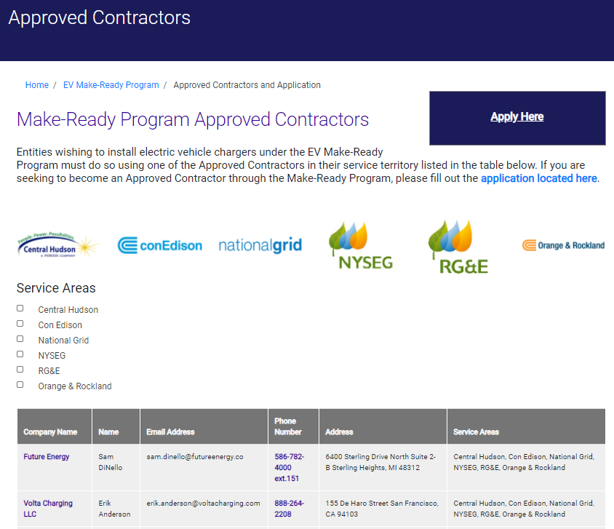
MRP Implementation is Rolling Along
Electric Vehicle Make-Ready Program
Begin accepting applications for MRP
Publish Customer Application Poral (10/16/20))
Participated in Customer Experience Working Group (2/4)
Filed Annual Reports (3/1)*
File revised Managed Charging Proposals (6/4)
Continued implementation of EV MRP with your application!
Q4 2020
Q1 2021
Q2 2021
Q3-4 2021
Filed Managed Charging proposals (12/4)
Published Load Serving Capacity Maps (12/31)
Presented Plans in Managed Charging Technical Conference (3/17)
Launched expanded EV MRP resources on JU website (5/10)
*Company Annual Reports can be found via NYSDPS Case 18-E-0138

Slide 5
Make-Ready Program Activity to Date
Electric Vehicle Make-Ready Program
 | Plugs Applied |  | Plugs Approved / Eligible |  | Plugs in Service
 | DCFC | L2 | DCFC | L2 | DCFC | L2
Central Hudson | 0 | 55 | 0 | 32 | 0 | 22
Con Edison | >750 | 2,441 | >675 | 2,042 | 0 | 10
National Grid | 79 | 456 | 24 | 320 | 0 | 50
NYSEG | 22 | 146 | 16 | 112 | 0 | 6
RG&E | 8 | 74 | 8 | 60 | 0 | 2
O&R | 24 | 49 | 18 | 45 | 0 | 0
JU Total | >883 | 3,221 | >768 | 2,584 | 0 | 90
Plugs Applied: Plugs that have submitted an application to the utility program
Plugs Approved / Eligible: Plug applications that have been reviewed and determined to be eligible by the utility
Plugs in Service: Plugs that are installed, operational, and a MRP incentive has been paid by the utility

Slide 6
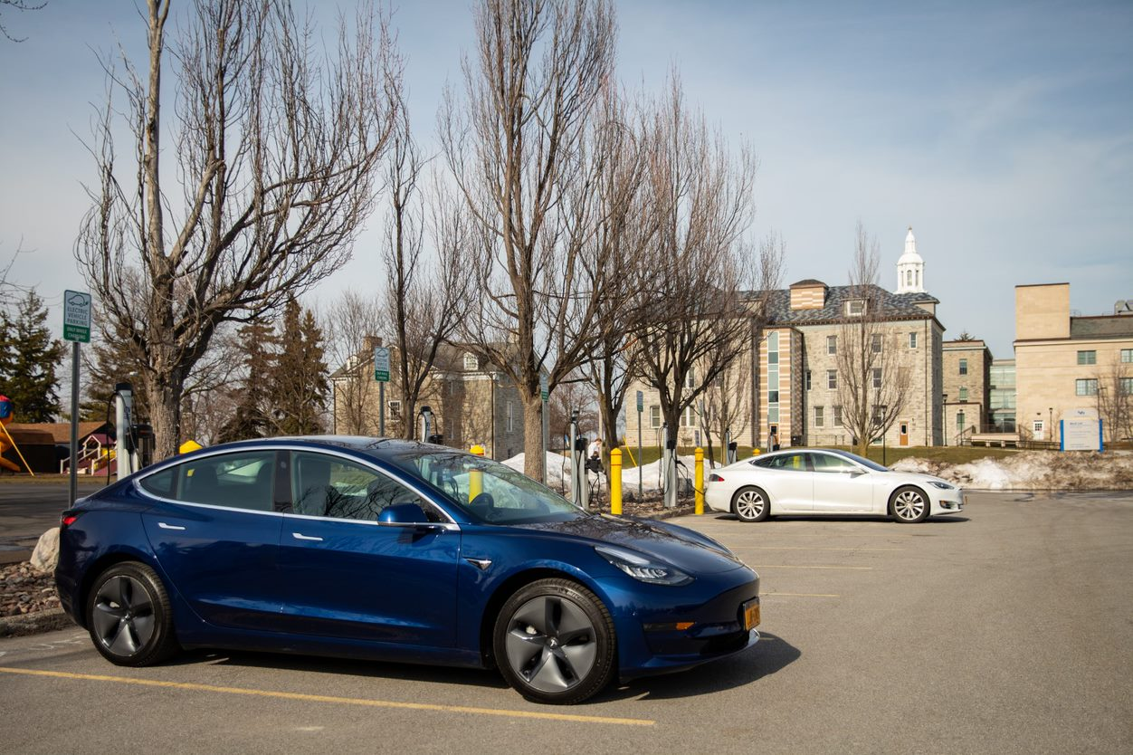
EV Customers across NY State: Campus Commuter Example
Electric Vehicle Make-Ready Program
University of Buffalo installed three plugs as a pilot in 2013, and added 30 plugs split between North and South Campus in 2020
UB Chief Sustainability Officer Ryan McPherson: “…clear and overwhelming need for electric vehicle charging infrastructure as demand outpaced supply. …this represents the next step, and we hope to expand even further upon what we’ve just installed.”
Part of UB’s Greening Our Commute in its updated climate action plan
“The additional charging stations are game changers because they make it more convenient to use my EV to commute to campus.”
- R. Lorraine Collins, EV Driver and Associate Dean in UB’s School of Public Health and Health Professions

Slide 7
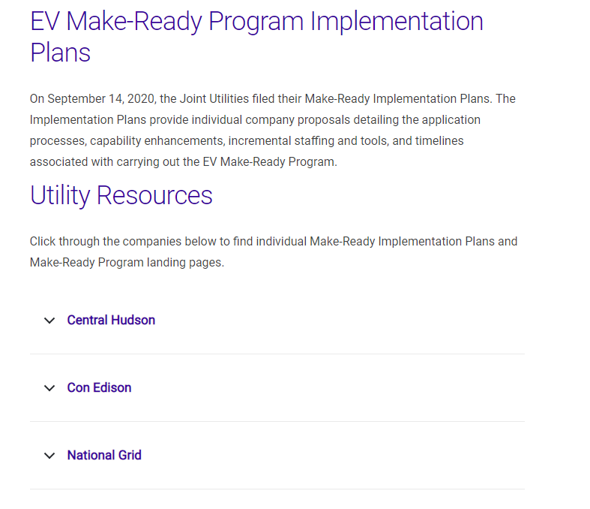
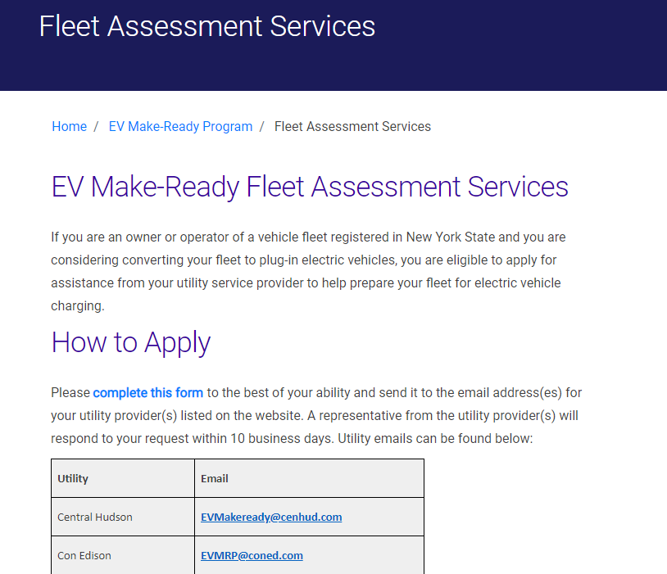
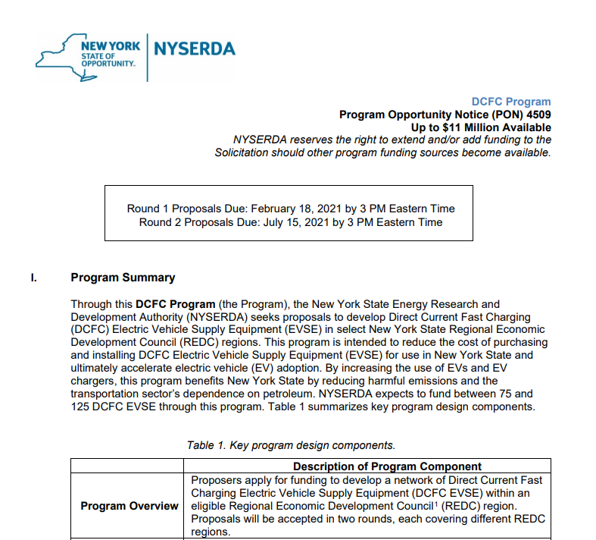
Engagement Opportunities on EVs
Electric Vehicle Make-Ready Program
Participate in the MRP or DCFC Per-Plug Incentive
Apply to be an approved EVSE contractor
Request a fleet advisory consultation
Apply for NYSERDA DCFC Incentives
Participate in NYSERDA Prizes

Slide 8
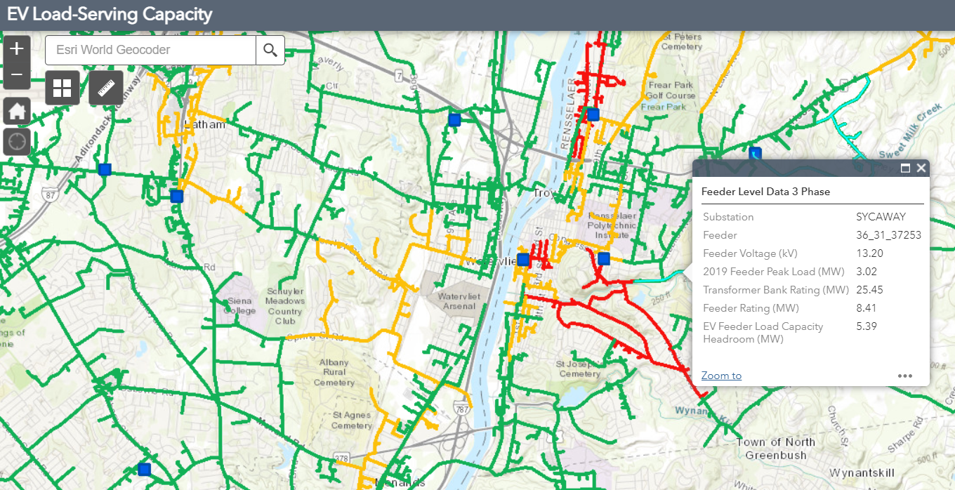
Hosting Capacity Maps & Analysis Presented by: David Lovelady, National Grid

Slide 9
Hosting Capacity Maps Overview
Hosting Capacity Map Refresh
The maps show the gross hosting capacity by feeder calculated using large centralized solar PV scenarios.

Slide 10
Recent Enhancements
Hosting Capacity Map Refresh
Increased Analysis Refresh Rate – The hosting capacity maps were refreshed April 1, 2021, for circuits with a total increase of connected DG above 500 kW over the prior 6 months.
Additional Map Functionality – Third-party REST URL access provides users with the ability to overlay hosting capacity data with other non-utility data, e.g. land availability.
EV Load Capacity Maps – A separate display/layer focused on a load-based hosting capacity analysis was released in December 2020.

Slide 11
EV-load Hosting Capacity Maps
The EV load capacity maps were prioritized for development in response to the July 2020 EV Order.
The maps are an estimate of the remaining circuit load capacity.
The use case is to help indicate areas with potentially lower interconnection costs and/or faster project timeline.

Slide 12
Developing Hosting Capacity Maps for Storage
Increasing effectiveness, complexity, and data requirements
The EV load capacity maps helped provide a starting point for further refinement and development per the hosting capacity roadmap.
EV Load Capacity Maps December 2021
Initial Energy Storage Hosting Capacity Release ~ April 2022
Future Releases
2023 +
Focused on thermal violation criteria
Tailored to EVSE development use case
Feeder-level analysis (Min / Max)
Focused on large, centralized systems (> 300 kW)
All applicable system data already provided
Rest URL access
Sub-feeder-level analysis
Increased temporal granularity
Long-term priorities to be defined

Slide 13
Information Sharing Orders Presented by: John Borchert, Central Hudson

Slide 14
Strategic Use of Energy Related Data
The JU continues to collaborate with DPS Staff, NYSERDA, and stakeholders to enable improved access to useful customer and system data in support of New York’s clean energy goals.
Integrated Energy Data Resource (IEDR) Platform Order
On February 11, 2021, the PSC issued an Order approving the design and implementation of a statewide IEDR.
Phase 1 will enable the development of up to five (5) priority data use cases over 24-30 months.
Phase 2 will enable 40+ additional data use cases over 30-36 months.
The Joint Utilities continue to actively collaborate with NYSERDA and DPS Staff.
Data Access Framework (DAF) Order
On April 15, 2021, the PSC issued an Order adopting a DAF to standardize privacy, cybersecurity, and quality standards for users to access energy data.
DPS Staff was directed to file, within 30 days, a Matrix to show how each existing cybersecurity and privacy requirement are mapped to each data access consideration (purpose, access mechanisms, and data type).
The Matrix will be instrumental to defining the Data Access Agreement that ESEs will need to comply with once the Data Ready Certification process is operational in 2022.
The Joint Utilities are developing the compliance filings required in the Order.
For any inquiries or feedback please e-mail: info@jointutilitiesofny.org
For more information regarding the data proceeding, visit: Case 20-M-0082 Proceeding on Motion of the Public Service Commission Regarding Strategic Use of Energy Related Data.

Slide 15
Examples of energy data available today
The Joint Utilities continue to make useful energy information available and accessible to customers and market participants.
Data Type | Data | Access Mechanism [general / utility example]
System Data | Load historical and forecasted data | System Data Portal
 | Hosting Capacity Analysis | Hosting Capacity Maps
 | Non-wires Alternatives Opportunities | NWA Opportunities
 | Capital Investment Plans | System Data Portal
 | Distribution System Implementation Plans | System Data Portal
 | Reliability Statistics | System Data Portal
 | EV Loading Capacity Maps | ConEdison: Hosting Capacity Maps
 | Installed/Queued DG | NY DPS SIR Inventory
Customer Data | Aggregated customer data - Building data | Whole Building Benchmarking
Customer data | Aggregated customer data - Community/county/zip code) | NYSERDA Utility Energy Registry UER Portal
 | Customer-specific data w/consent to utility | Green Button Connect (GBC) / Green Button Download (GBD)
 | Customer-specific data w/consent to utility | Con Edison only: Third Party Access to My Account (web portal)
 | Customer-specific data | Electronic Data Interchange (EDI)
 | Customer-specific data | Community Choice Aggregation (CCA)
 | Anonymized customer-specific usage data Customer-specific data (w/consent) | O&R/NYSERDA only: DER Pilot Program*

Slide 16
Green Button Connect (GBC) Update
Each utility continues to advance GBC implementation as AMI deployment rolls out in their service territory. NYSEG/RG&E and National Grid anticipate using Con Edison’s model as a basis for design and implementation, allowing for modifications specific to each utility’s system requirements.
2019
GBC Working Group Meetings with JU updates
JU GBC Status Report
Utility | Registered Third-Parties | GBC Phase I | Additional Phases
Con Edison | 13 initiated process and received welcome package 11 completed 3 actively onboarding 31 paused onboarding | Meter number(s), corresponding energy or net energy usage (kWh, net kWh, ccf), and reactive power (kVAR) | Phase 2 (2019): Total electric bill cost, total gas bill cost, service class per tariff, ICAP tag, billing history Phase 3 (2020): Account number, service address (GBC Retail Customer Module)
O&R
NYSEG/R&GE | 6 (Energy Manager Pilot) | AMI approved (Nov 2020); GBC go live end of 2021
National Grid | 1 completed 7 onboarding | Launched GBC on March 31, 2021 - utilizing existing upstate NY AMR data
Central Hudson | Only Green Button Download (GBD) available. No immediate plans to implement AMI at scale.
2020
New strategic use of energy-related data proceeding stablished
2021
DAF Order requires development of GBC User Agreement and Onboarding Process

Slide 17
Joint Utilities Website Refresh Presented by: Katie Van Horn, ICF

Slide 18
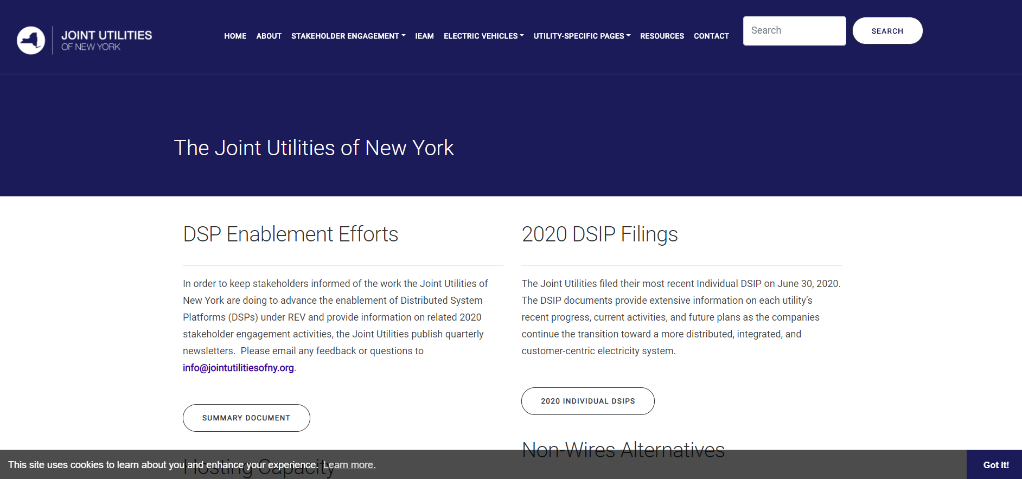
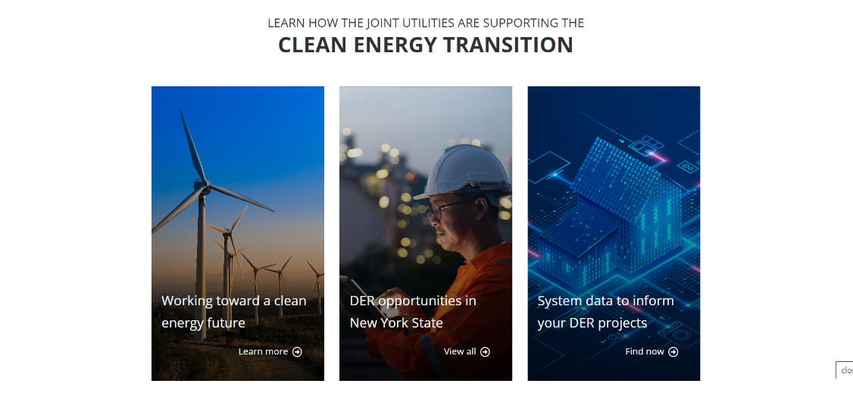
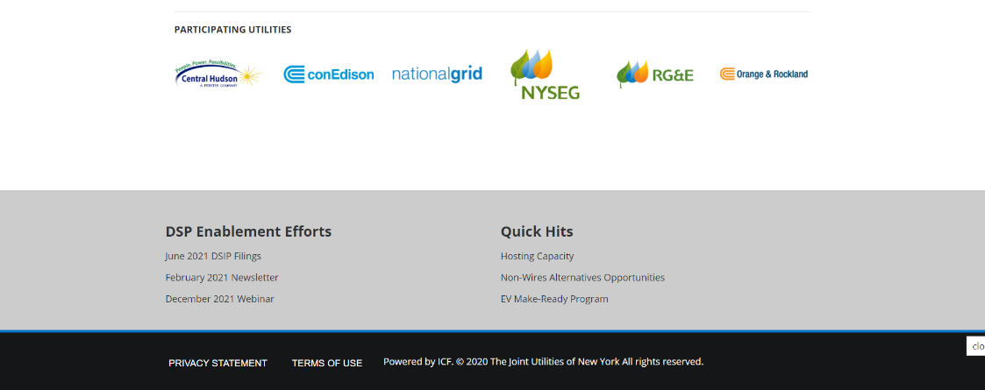
Website Refresh Overview
Joint Utilities Website Refresh
Goals
Improved user experience – centralized launch point for information on statewide programs, rules, and data
More resources on how to engage with the Joint Utilities and their programs​
Eliminated unnecessary pages and filings crowding the site ​
Complete visual refresh of website​

Slide 19
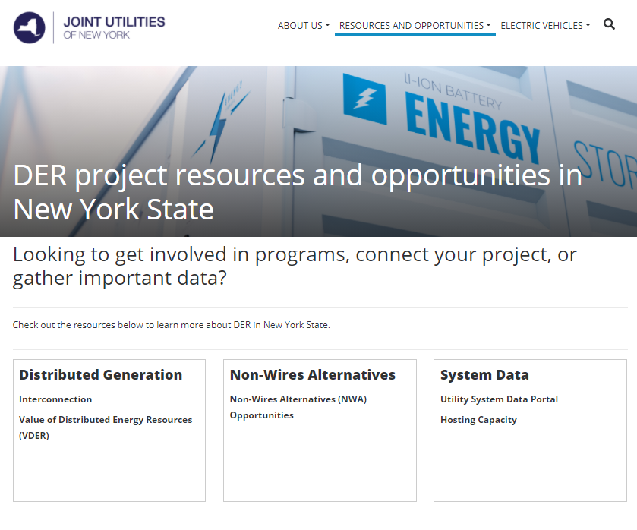
Launch Pad to DER Project Resources
Joint Utilities Website Refresh
New “Resources and Opportunities” page is one-stop-shop to find DER project information.
Simple navigation gets customers and developers to the information they need in seconds.

Slide 20
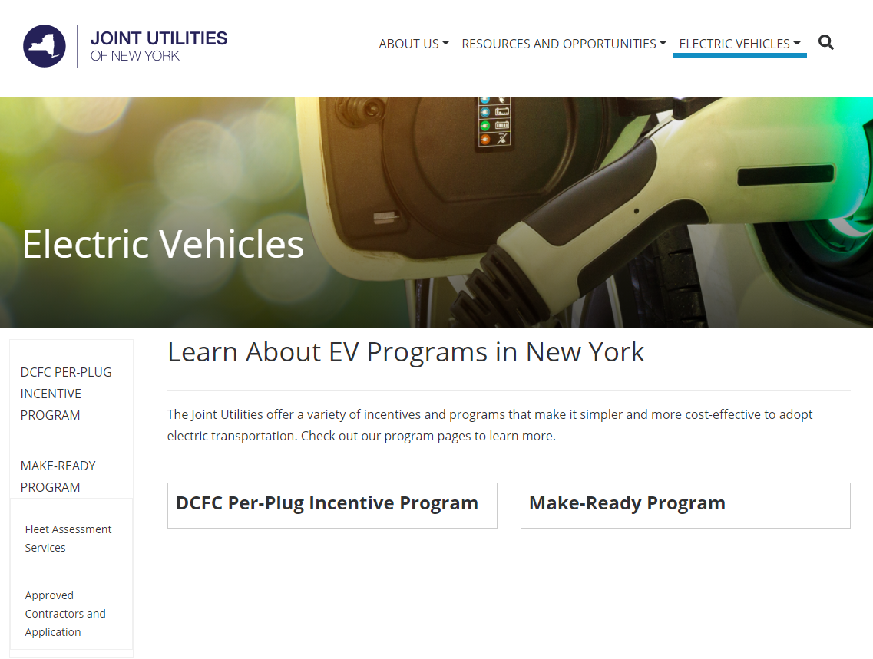
Hub for New York EV Programs
Joint Utilities Website Refresh
Program information on DCFC Per-Plug Incentive Program and Make-Ready Program services.
Details on how to participate in EV programs – whether you’re a developer or a customer.
Links to utility program pages and resources.
Apply to be an EV MRP Approved Contractor, or edit your application to answer new optional questions at our website.

Slide 21
Demonstration of New Joint Utilities Website

Slide 22
Q&A Session Moderated by: Matt Robison, ICF

Slide 23
Q&A Session
Please submit questions via the ‘question function’ on the webinar interface
Additional questions may be emailed to info@jointutilitiesofny.org following the webinar
Visit www.jointutilitiesofny.org for more information
Quarterly Newsletter
Check out our quarterly newsletter with meaningful, substantive updates related to the DSIPs
Succinct snapshot of how the utilities are making progress on the DSP

Slide 24
Thank you!
Website: www.jointutilitiesofny.org
E-mail: info@jointutilitiesofny.org

